Slide 1
Presentation skills: 101
Prepared by: tara sall

Slide 2
Skill #1: graphics and other aids
Slide layout examples
Laser pointers/clickers
Notecards

Slide 3
This is an example of a really difficult slide to read. You see the entire thing is full of text. Text! How in the world is someone supposed to read this much information and pay attention to you? Answer, they won’t do both. They will either read the slide and tune you out, you will read the entire slide to them (because it’s a temptation to do so) and they will tune you out, or they will not be able to keep up with reading, feel overwhelmed and then tune you out. In summary – too many words on the screen will cause your audience to tune you out. Once you lose the audience, you can no longer persuade them to buy in to what you’re selling. Without keeping the audience’s attention, there’s really no point in giving the presentation in the first place.
Stop. Evaluate what you’re doing right now. Have you stopped reading? have you stopped listening to me? Both?
This screen is so big that I’m trying to find sentences to fill in the entire space to show you how difficult it is to read. All in all don’t have this many words on the screen. Please!

Slide 4
This is an example of a really difficult slide to read. You see the entire thing is full of text. Text! How in the world is someone supposed to read this much information and pay attention to you? Answer, they won’t do both. They will either read the slide and tune you out, you will read the entire slide to them (because it’s a temptation to do so) and they will tune you out, or they will not be able to keep up with reading, feel overwhelmed and then tune you out. In summary – too many words on the screen will cause your audience to tune you out. Once you lose the audience, you can no longer persuade them to buy in to what you’re selling. Without keeping the audience’s attention, there’s really no point in giving the presentation in the first place.
Stop. Evaluate what you’re doing right now. Have you stopped reading? have you stopped listening to me? Both?
This screen is so big that I’m trying to find sentences to fill in the entire space to show you how difficult it is to read. All in all don’t have this many words on the screen. Please!

Slide 5
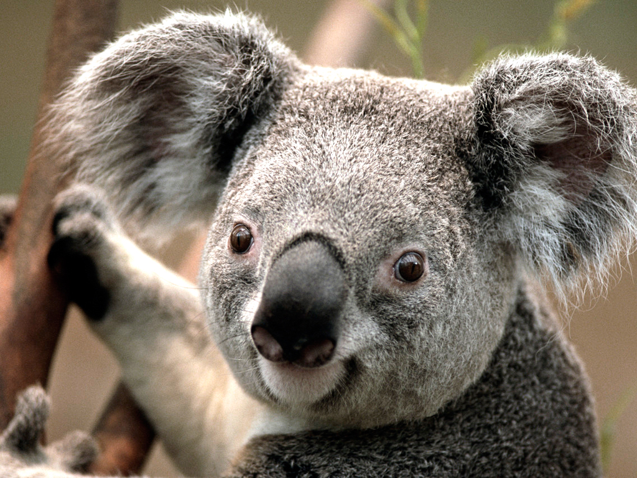
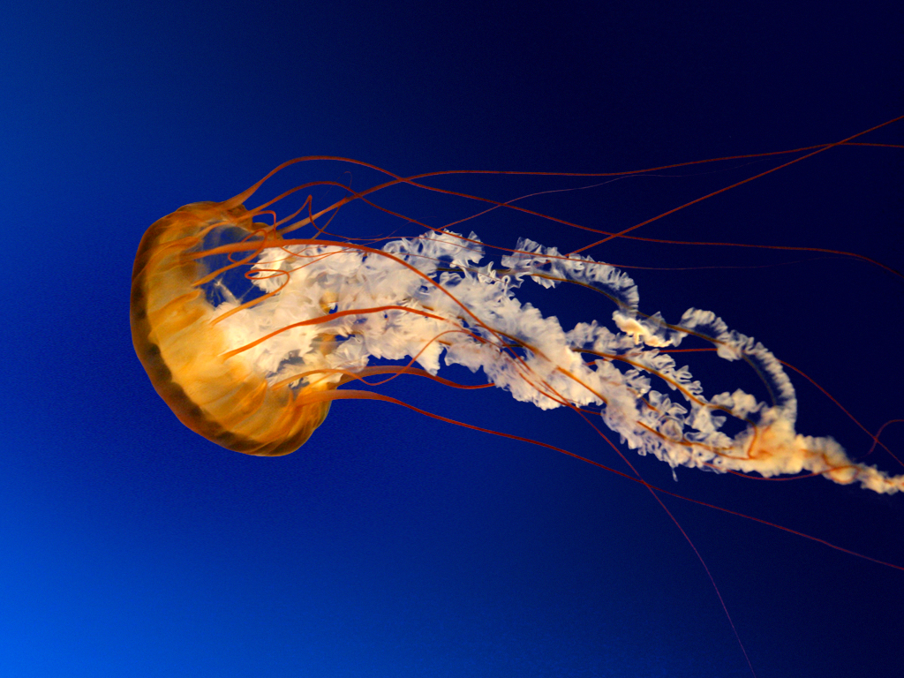
All pictures

Slide 6
A balanced approach:
Short amount of text on the screen helps the following:
Remind you what to say
Focus the attention of the audience
Add depth to your presentation – facts and images and spoken word
Keeps you organized
There are going to be times when you have all images on the slide and that’s ok! All text can also work if done correctly

Slide 7
Tools and Tips
Laser pointer/clicker
Test it out!
Have spare batteries
USB/flash drives
Have multiple contingencies
Technology fails, be prepared
Notecards
Don’t put too much on them that you end up reading straight off them
Don’t put too little that glancing at it confuses you
Practice! Practice! Practice!
NOTHING MAKES UP FOR PREPARATION AND PRACTICE!
KNOW YOUR TEAM MEMBERS’ PARTS TOO IN CASE OF AN EMERGENCY

Slide 8
Skill #2: BODY LANGUAGE AND POSITION

Slide 9
STUDENT PARTICIPATION
WHAT IS YOUR NAME
WHAT GRADE ARE YOU IN
WHAT PROJECT ARE YOU DOING FOR ACE
WHAT’S YOUR FAVORITE FOOD

Slide 10
Skill #3: NOT GIVING IN TO FEAR

Slide 11
Skill #3: NOT GIVING IN TO FEAR
What was I fearful of in public speaking?
Passing out!
Running out of Breath
What are some of your fears?

Slide 12
Some advice on your presentation
Not in the book, but in the rfp: remember to explain why your project is the best use TO Improve the community – Add this slide or incorporate the topic some how
Remember – in your short presentation do not go room by room on your floor plan
Animations will help convey concepts, but they take time so watch the clock

Slide 13
Professionalism
What it means and why it matters

Slide 14
Professionalism
How do you define it?

Slide 15
Professionalism
Webster’s Definition: the conduct, aims, or qualities that characterize or mark a professional person
Conduct
Aims
Qualities

Slide 16
Professionalism
Why does it matter?
60-Second Message
Who your future boss may be
Social media

