Slide 1
Session One:
Affiliate Management Strategies
Database and Fundraising
Wednesday, May 15
1:15 - 2:45

Slide 2
(15 mins) Utilizing Database to Manage Affiliate
Andrew Frankel, ACE National Director of Program Operations
DJ Esquivel, Dieselhaus (Database Developer)
(10 mins) Events, BOD Ask & Required Giving
Lori Guidry, ACE Mentor Program of LA & ACE National Board
(10 mins) Moody Foundation and Affiliate Grants Committee
Gerardo Gandy, ACE Mentor Program of Austin
(15 mins) Engaging National Sponsors
Stephanie Davi, ACE National Director of Development
(10 mins) Ralph C. Wilson Foundation
Ken Bertolini, ACE Mentor Program of Michigan
(20 mins) Q&A/Discussion

Slide 3
Utilizing Database to Manage Affiliate
Andrew Frankel, ACE National Director of Program Operations
DJ Esquivel, Dieselhaus (Database Developer)
Team Management
Role Assignment
Alumni
Scholarships
Sponsor Tracking

Slide 4
Teams Management
Setting Up
Assigning Teams (models)
Team Leader Access
Attendance – how many affiliates used?

Slide 5
Teams Management
386 Teams in 2017/18
444 Teams in 2018/19
585 Actual Teams in 2017/18
(The last time we asked about teams in Program Report)

Slide 6
Teams Management
Database sub-admin creates and assigns teams
Team leader manages team
Manage parent consent forms
Take attendance and mark program status
Export team lists for contact info

Slide 8
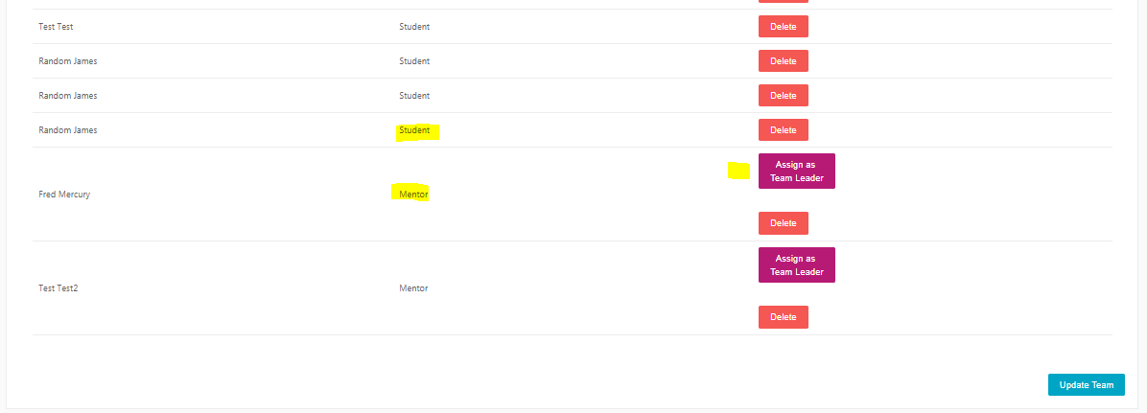
ASSIGN TEAM

Slide 9
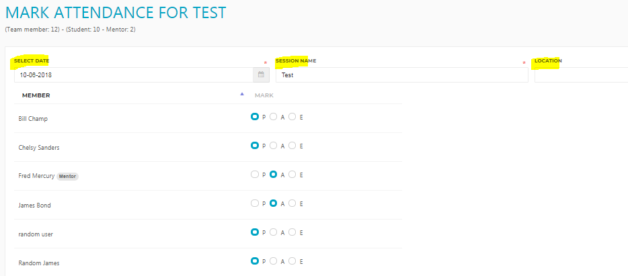

Slide 10
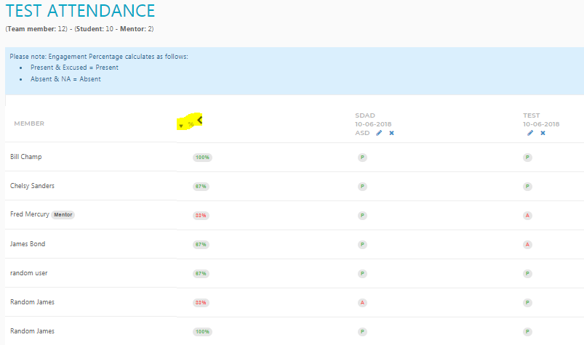

Slide 11
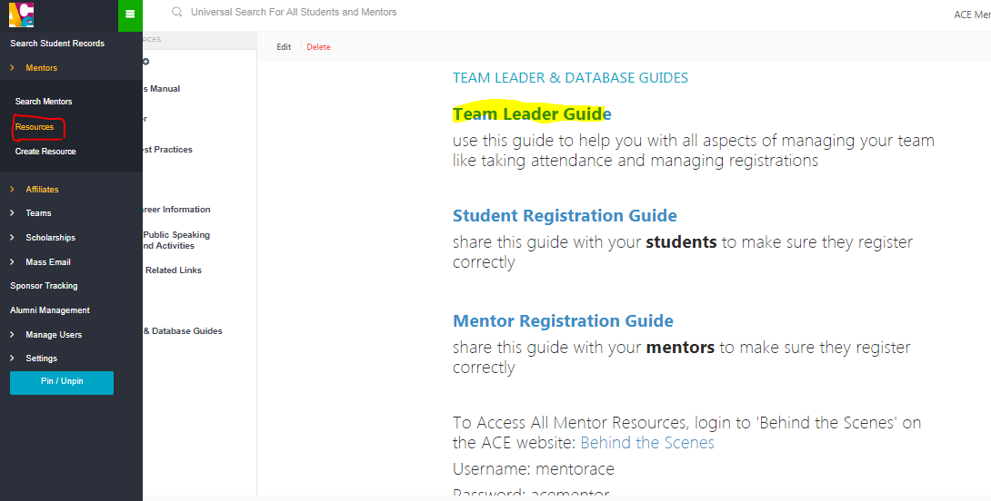

Slide 12
Affiliate Sub-Admin Role Management
Available Roles
Role Assignment
Requesting New Roles

Slide 13
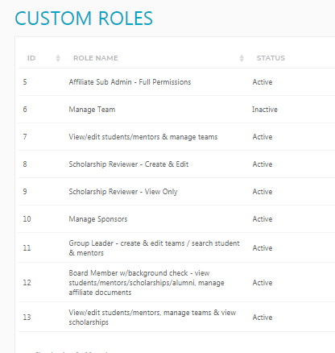

Slide 14
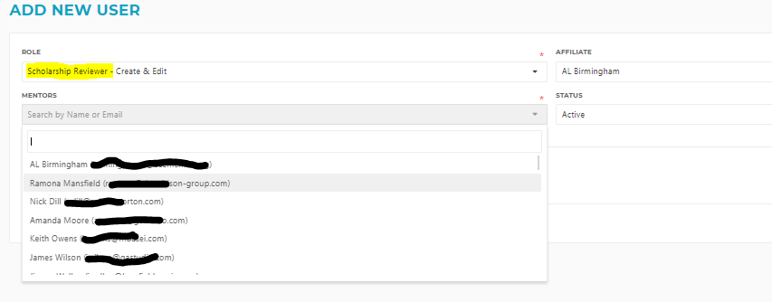

Slide 15
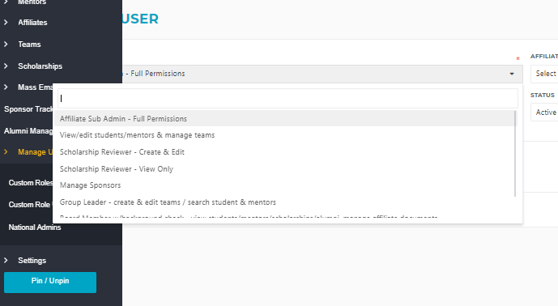
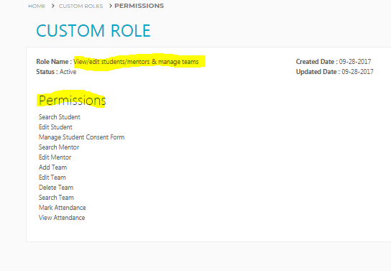

Slide 16
Alumni Management
Database doesn’t recruit Alumni
Alumni application
17+ years old
1+ program year active/complete
Alumni Management

Slide 17
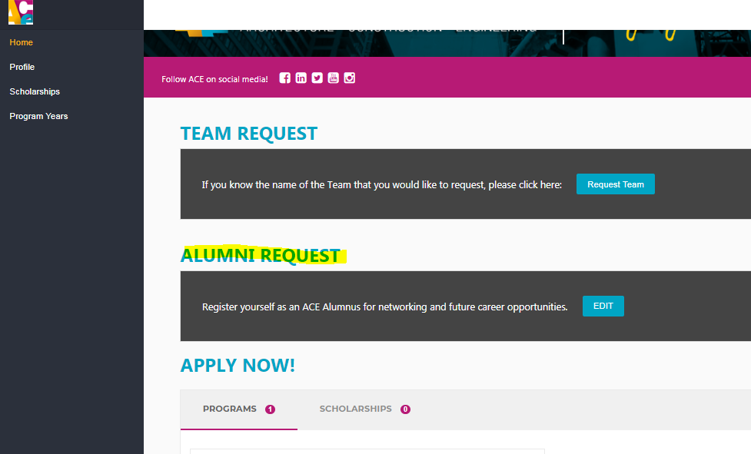

Slide 19
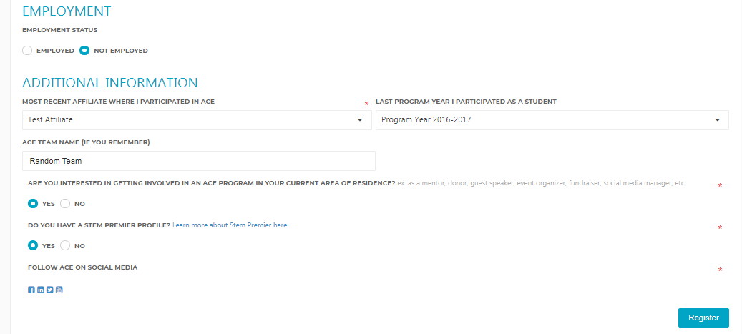

Slide 20
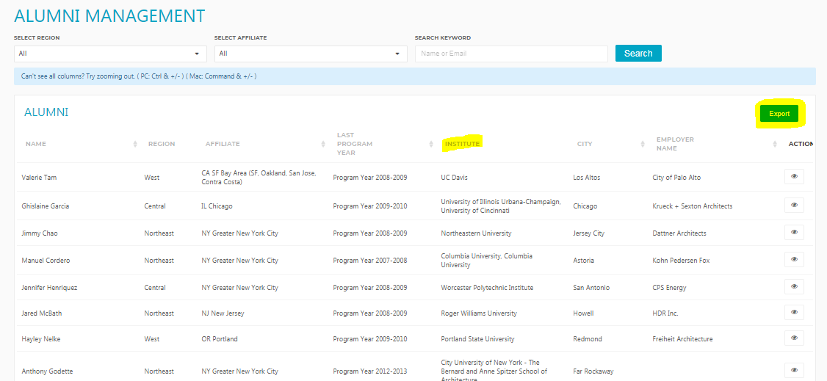

Slide 21
Mentor Search
Student Search

Slide 22
Scholarship Mgmt
Creating custom Scholarships
New features
Student view
Export options
Evaluating Scholarships

Slide 23
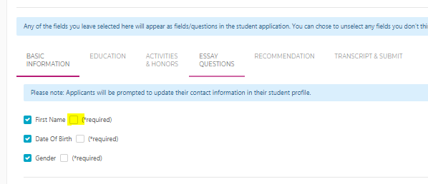
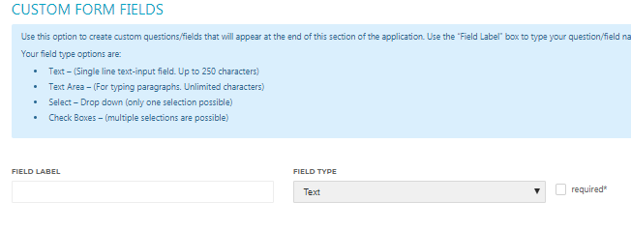

Slide 24
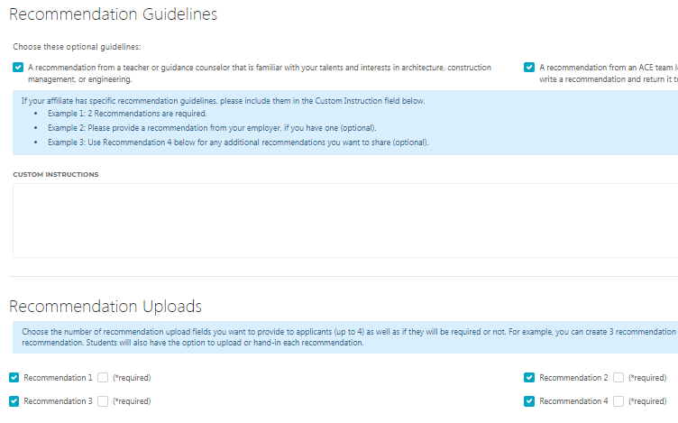

Slide 25
EDIT MODE
SCHOLARSHIP LIST
To make visible in student profile
Duplicate!

Slide 26
Sponsorships
Sponsor form – designed for smaller affiliates

Slide 27
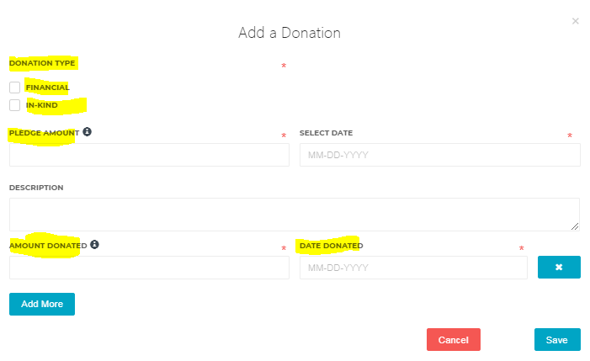

Slide 29
Events, BOD Ask & Required Giving
Lori Guidry
ACE Mentor Program of LA & ACE National Board

Slide 30
Moody Foundation and Affiliate Grants Committee
Gerardo Gandy
ACE Mentor Program of Austin

Slide 31
Engaging National Sponsors
Stephanie Davi
ACE National Director of Development

Slide 32
Ralph C. Wilson Foundation
Ken Bertolini
ACE Mentor Program of Michigan

Slide 33
Questions;
&Answers;
&Discussion

