Slide 1
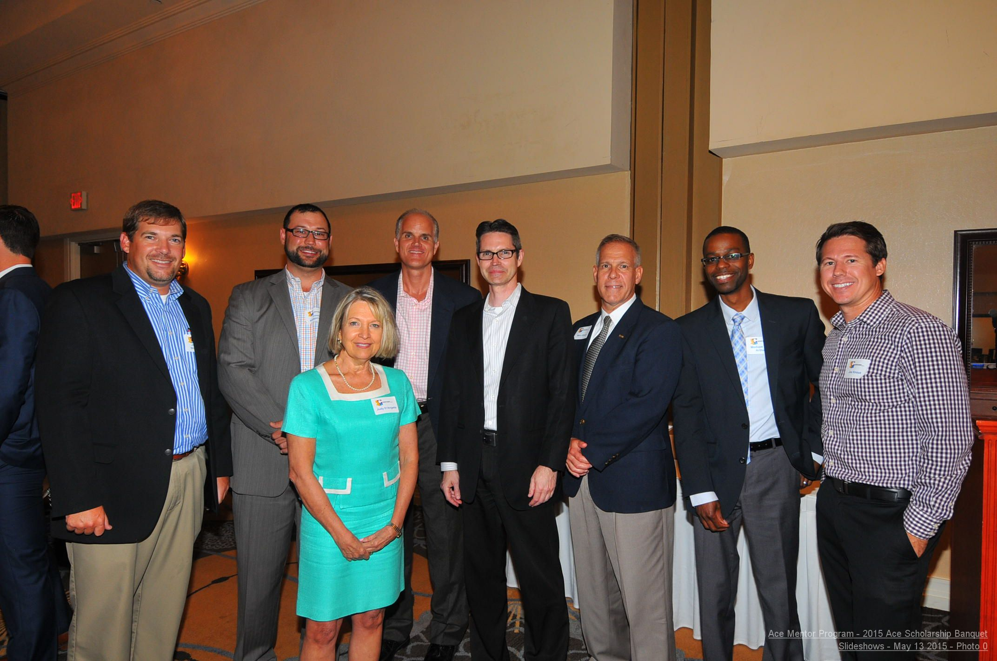
COMMITTEE STRUCTURE
ACE Mentor of Central Florida
Greater Orlando Area
Travis Kolbjornsen
Chairman

Slide 2
COMMITTEE STRUCTURE
BY-LAWS - Mission. The Corporation has a three-fold mission:
a) To enlighten and motivate students toward architecture, construction, engineering, and related careers, including both the skilled trades and professional pursuits.
b) To provide mentoring and scholarship opportunities for future designers and constructors
Executive Board of Directors: Chairman, Vice Chairman, Secretary and Treasurer

Slide 3
COMMITTEE STRUCTURE
Chairman Duties:
Effect or monitor Implementation of decision by the Board, preside over all meetings of the Board and Executive Committee.
Vice Chairman Duties:
As may be assigned by Board. In absence of Chairman shall perform duties of the Chairman.

Slide 4
COMMITTEE STRUCTURE
Secretary Duties:
Promote communication among Board Committees and the Board via contact with Committee Chairpersons prior to each board meeting and other actions appropriate to support the full and active function of Board Committees; keep running list of tasks to be completed
Treasurer Duties:
Shall be chairman of Finance Committee; shall be responsible for custody and investment of all funds; shall keep full and accurate accounts of receipts and disbursements of the Corporation and provide financial statements at each meeting

Slide 5
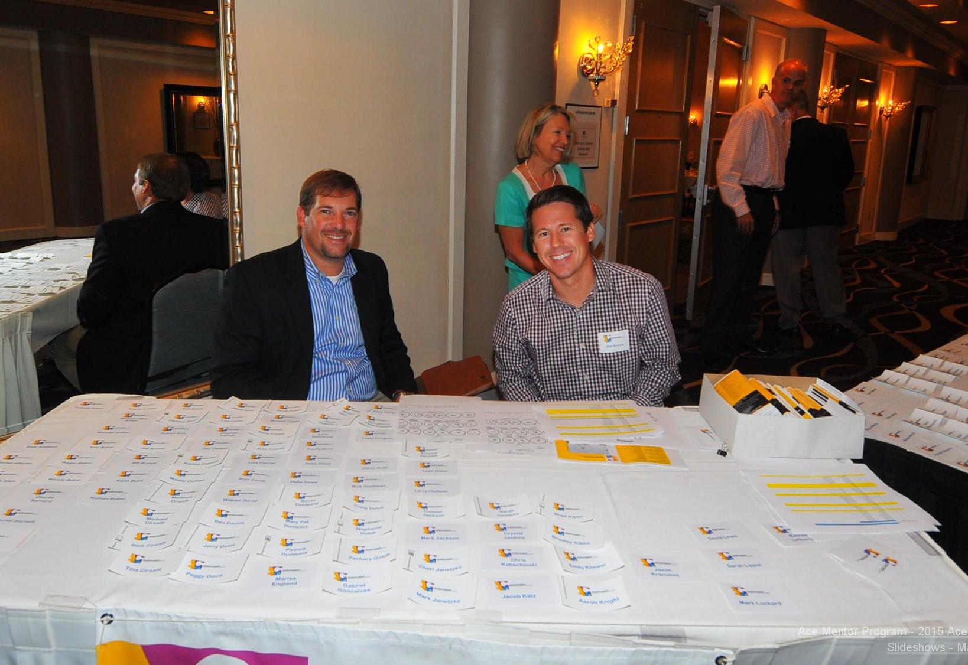
COMMITTEE STRUCTURE
Overall Duties of Board of Directors
 | Develop and monitor annual timeline for duties of all committees
 | Set up annual retreat for Board and Committee Chairs
 | Plan end of program meeting with Leaders to discuss best practices for future
Executive Committee**: Chairman & 6 elected members (from Elected Directors)
Nominating Committee **: Chairman & 2 elected members and 1 appointed by chairman
 | Duties
 |  | Identify and nominate new members to fill vacant seats
Finance and Audit Committee** (Treasurer is the Chairman)
 | Duties
 |  | Propose Annual Budget
 |  | Review Periodic financial reports against budget
 |  | Supervise investments of funds
 |  | HR Advisor
 |  | Responsible for annual audit
 |  | Send annual thank you letters to donors at end of fiscal period
 |  | File annual tax forms

Slide 6
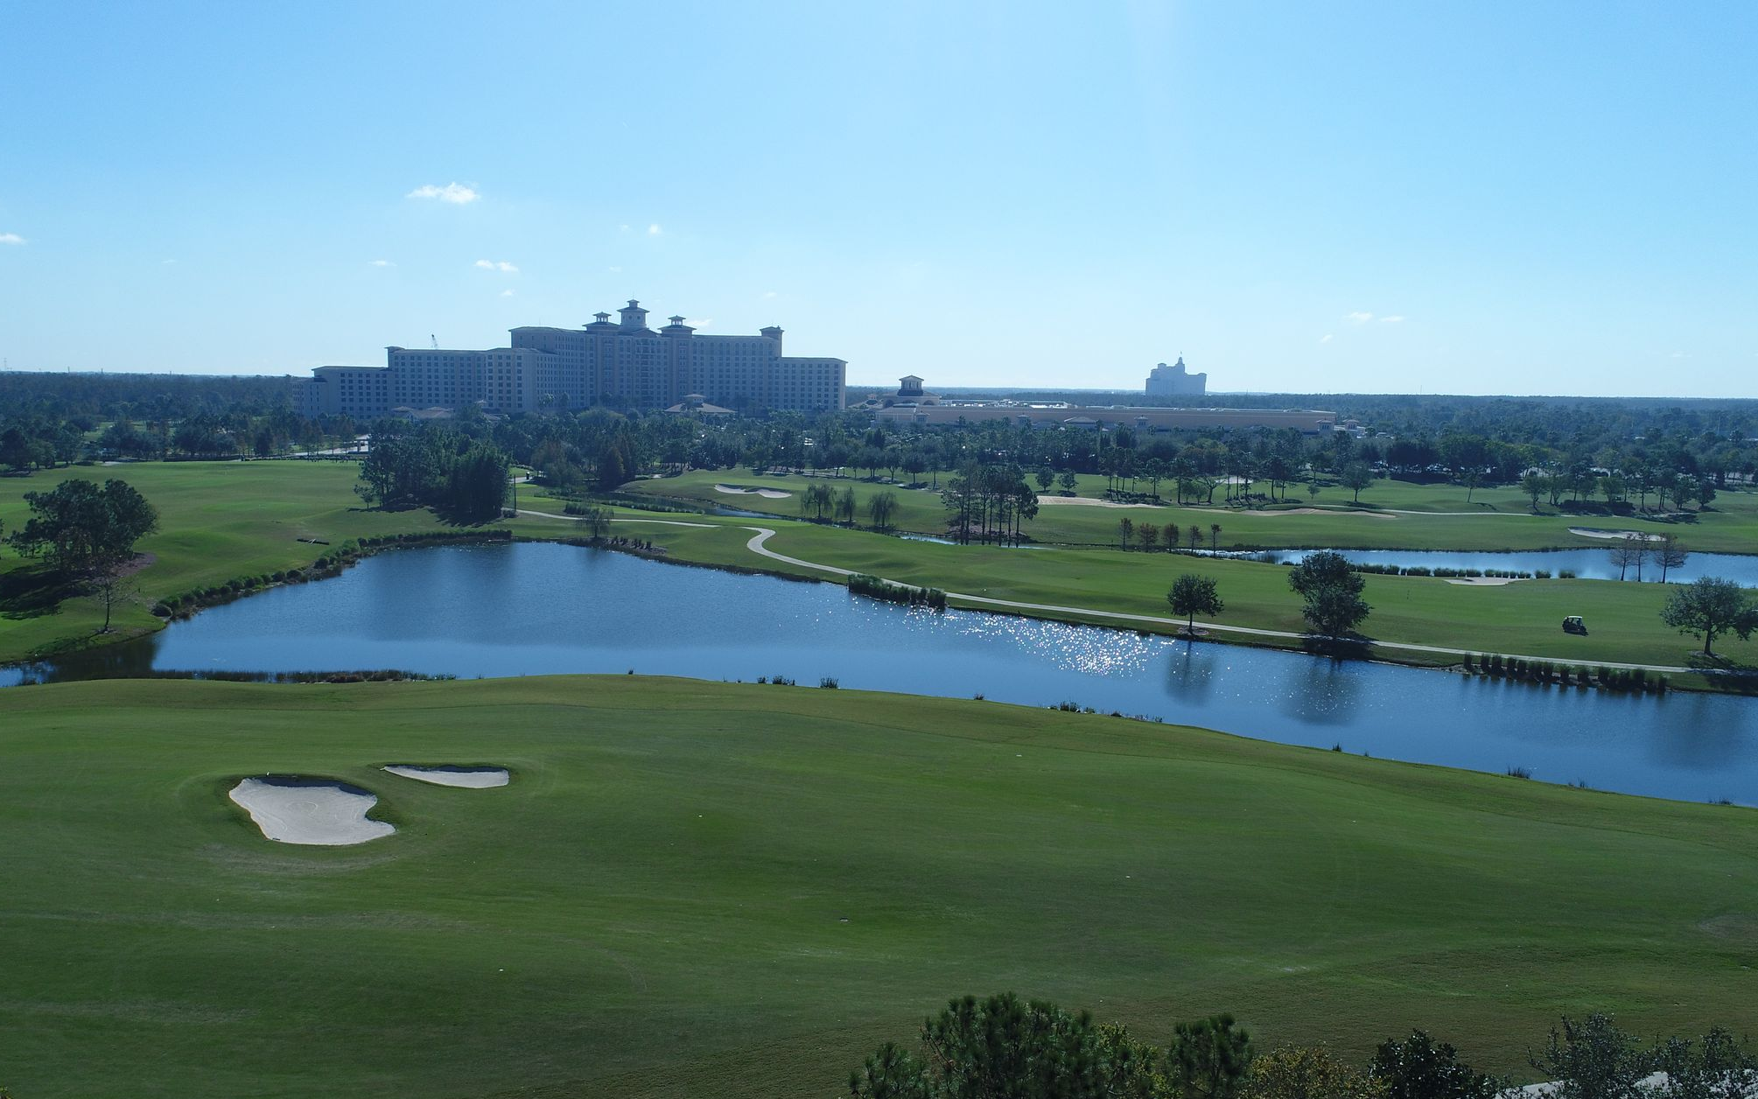
COMMITTEE STRUCTURE
Strategic Planning Committee**
 | Duties
 |  | Responsible for the development, evaluation, and revision of the Corporations' Strategic Plan
 |  | Monitor industry trends, business factors, and external forces to determine their impact and/or relevance to the Strategic Plan
 |  | Establish performance measures and report results to board when necessary
 |  | Need a 5 and 10 year strategic plan.
Fund-Raising Committee
 | Duties
 |  | Develop a fundraising policy
 |  | Develop several fundraising letters for all to use
 |  | Identify key target donors and their staff
 |  | Identify and follow up with local Foundations, i.e. United Way, Magic
 |  | Plan and execute fundraising events
 |  | Set up Sphere to track participants
 |  | Apply for programs through Best Buy and Wal-Mart (N FL)
 |  | Research Grants available and present to Board
 |  | Form liaison with local Workforce
 |  | Work with student committee chair to plan annual student presentation and scholarship award event

Slide 7
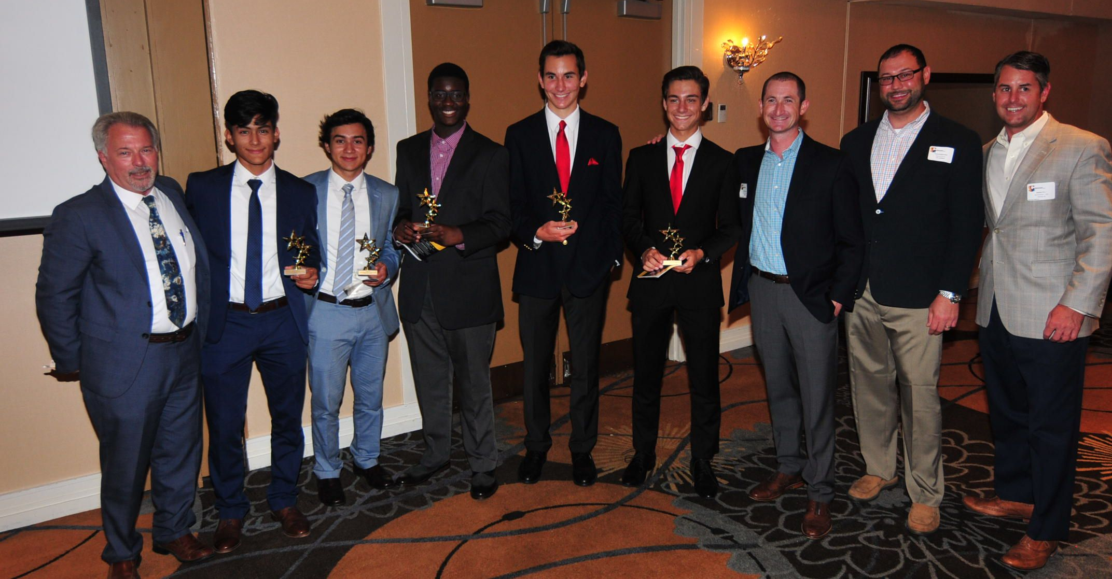
COMMITTEE STRUCTURE
Public Relations Committee
 | Duties
 |  | Responsible for media relations
 |  |  | Create a press kit
 |  |  | Distribute kit at private meetings with general education reporters, community press and business press in hard copy and CD
 |  |  | Develop press releases and distribute to media on periodic basis
 |  |  | Work with Student, Scholarship, and Fundraising Committee to develop story ideas for increased coverage of committee events, advancements and other newsworthy items
 |  |  | Turn press releases into emails to send to database to keep supporters aware of chapter progress and achievements on a periodic basis
 |  | Responsible for outreach to school district public information officers/public relations specialists
 |  |  | Work to develop joint media pitches
 |  |  | Secure details needed for organization releases
 |  |  | Develop awareness of the program through use of school communication outlets
 |  | Responsible for coordination with national public relations
 |  |  | Develop relationship with national PR professionals
 |  |  | Piggy-back on national press releases and create local interest focus
 |  | Develop presentation materials to be used by all Board members
 |  | Update ACE Affiliate website quarterly or more often
 |  | Update contacts in Constant Contact
 |  | Create local video of programs to bring to sponsors

Slide 8
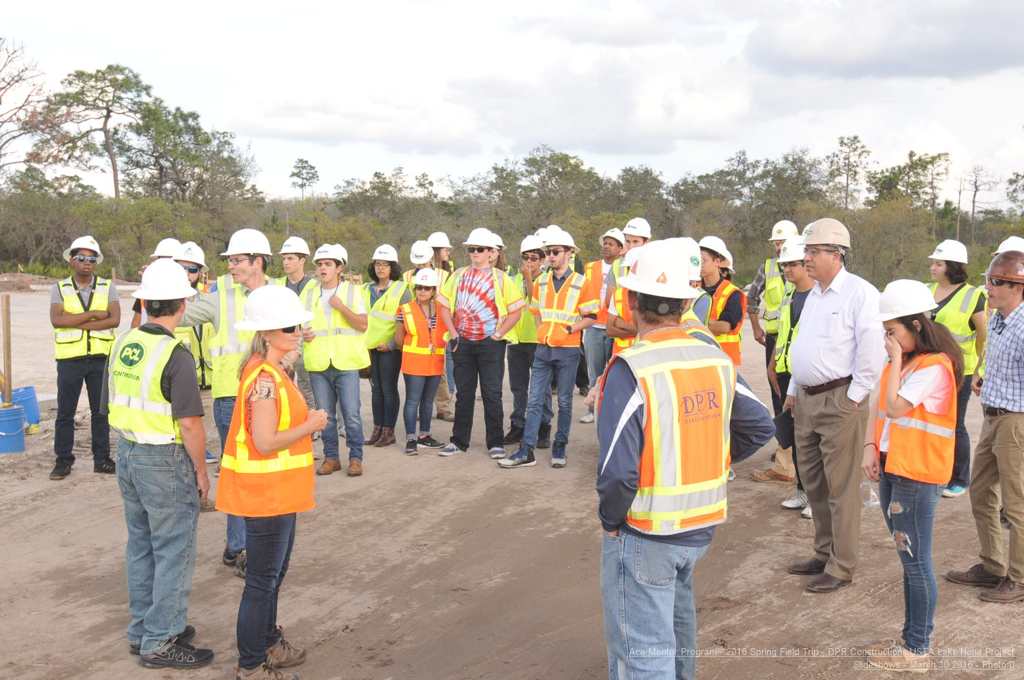
COMMITTEE STRUCTURE
Student Committee
 | Duties
 |  | Create liaison with "Future Cities" program
 |  | Recruit and enroll students in the program
 |  | Plan student/parent informational meetings with Education Committee
 |  | Inform and advise the Board about student admission policy, scholarship award policy, program policy
 |  | Track parent permission forms
 |  | Update student information on National website
 |  | Set up a career night for students (N FL $10 for non-ACE students)
 |  | Create bio of students
 |  | Make sure national website has listed as active those students that do participate so don't pay too much for insurance
 |  | Evaluate scholarship applications and assign scholarship awards
 |  | Plan & execute presentation night event for awards and student presentations
 |  | Provide student certificates of completion
 |  | Record and follow up on alumni students
 |  | Keep active contact list of all students past and present/ demogrphics for future grants
 |  | Monitor Student FaceBook page

Slide 9
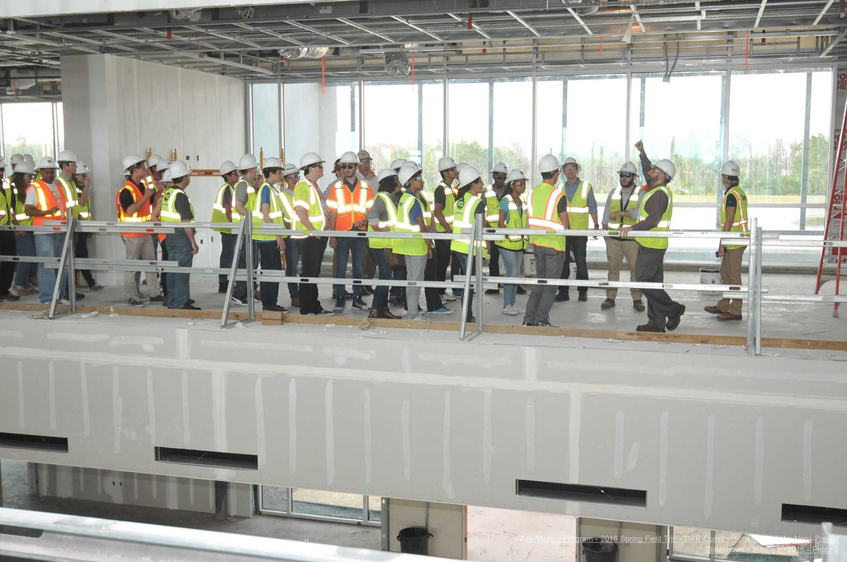
COMMITTEE STRUCTURE
Education Liaison Committee
 | Duties
 |  | Serve as school/county school board liaison to Board
 |  | Locate school/ County School Board "Champions"; CRT-Career Tech Educator
 |  | Suggest "Adopt a school" for lower socio-economic schools
 |  | Create partnership with universities to support the ACE mission
 |  | Help PR Committee in placing notices on school website for August
 |  | Deliver media to schools in August such as posters and flyers
 |  | Plan student/parent informational meetings with Student Committee
 |  | Prepare surveys for students and present results to Board
 |  | Send information to schools in April for next program
Program Committee
 | Duties
 |  | Act as liaison between Board and teams during school year
 |  | Recruit mentors, leaders, and mentoring firms to support the goals of ACE
 |  | Order ACE Best Practice manuals for Leaders
 |  | Plan mentor and leader training
 |  | Aid and track mentors and leaders with required background checks
 |  | Assist leaders in planning student site tours, i.e. forms, supplies, transportation
 |  | Assist leaders in group project
 |  | Encourage Leaders to prepare meeting reports with photos to share with PR Committee
 |  | Prepare survey for mentors/leaders at end of program to present to Board
 |  | Collect bios of mentors and leaders to share with students & PR
 |  | Collect testimonials from mentors and leaders for PR committee
 |  | Assist leaders in setting up an apprenticeship site visit
 |  | Set up mentor Face book to exchange ideas

Slide 10
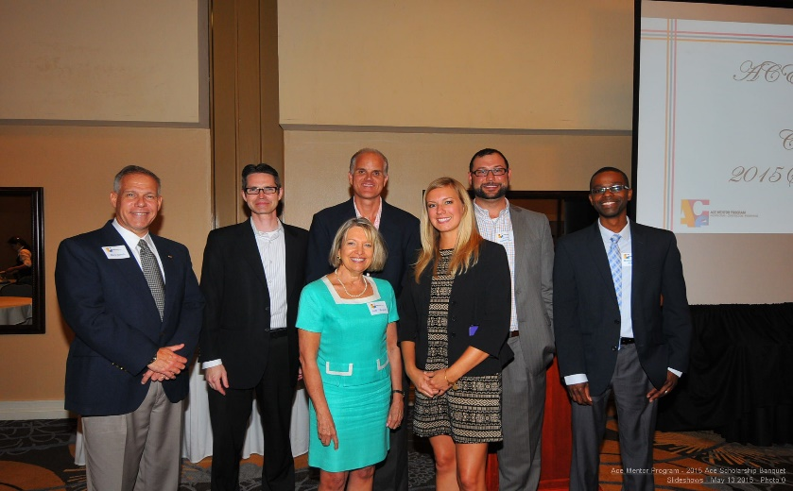
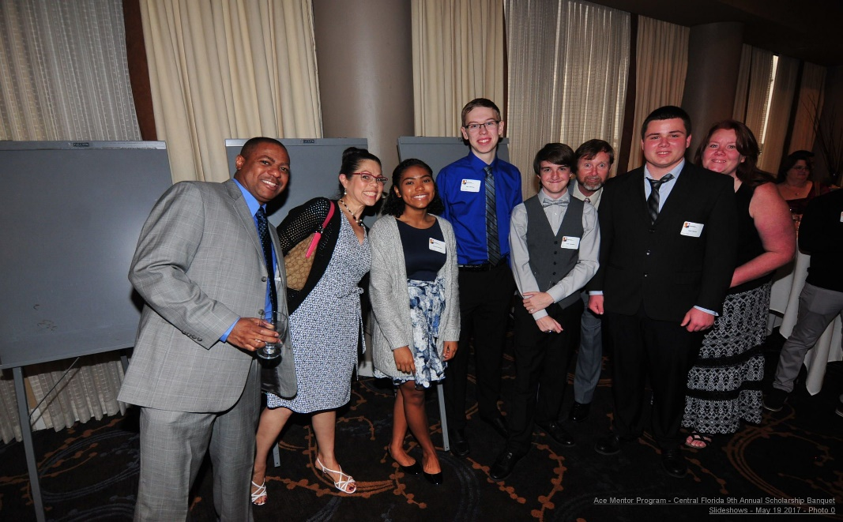
COMMITTEE STRUCTURE
Board of Directors – Supporting our local ACE Mentor Program in Central Florida takes a TEAM of leaders across the ACE industry as well as other industries including banking, law and insurance.

Slide 11
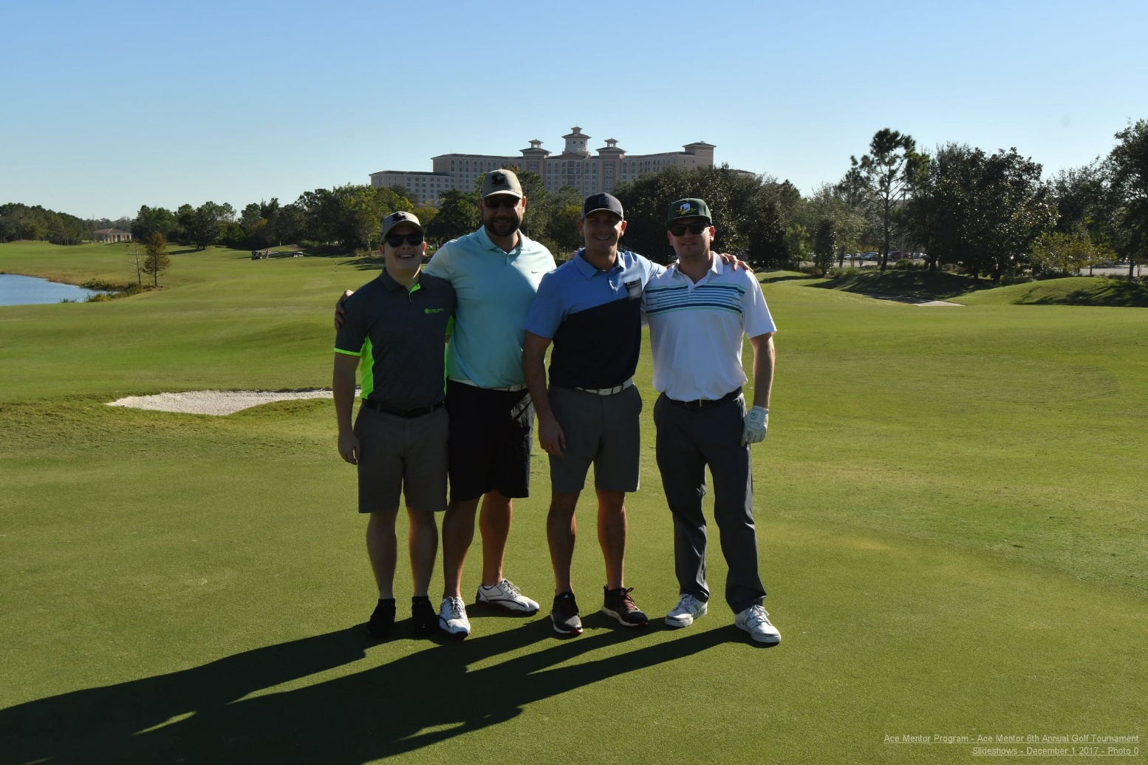
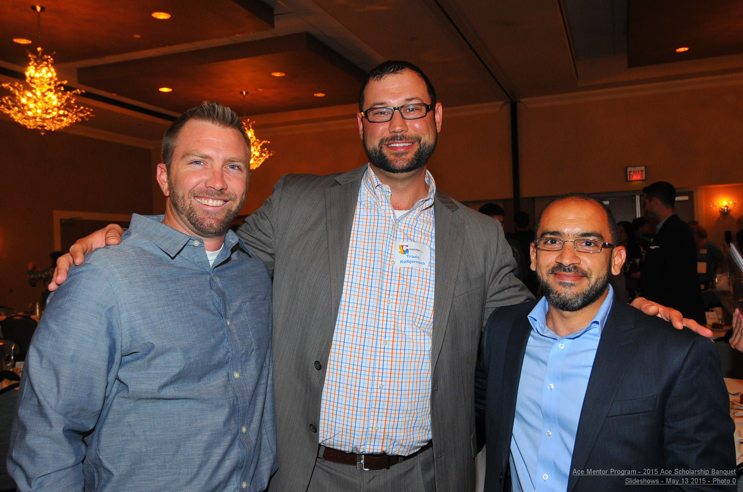
COMMITTEE STRUCTURE
Travis Kolbjornsen, LEED AP – Chairman
Barton Malow Company
General Contractor

Slide 12
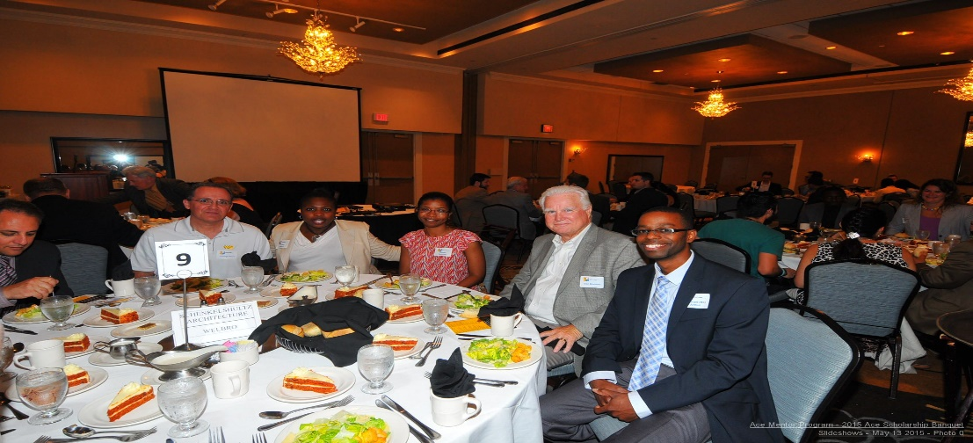
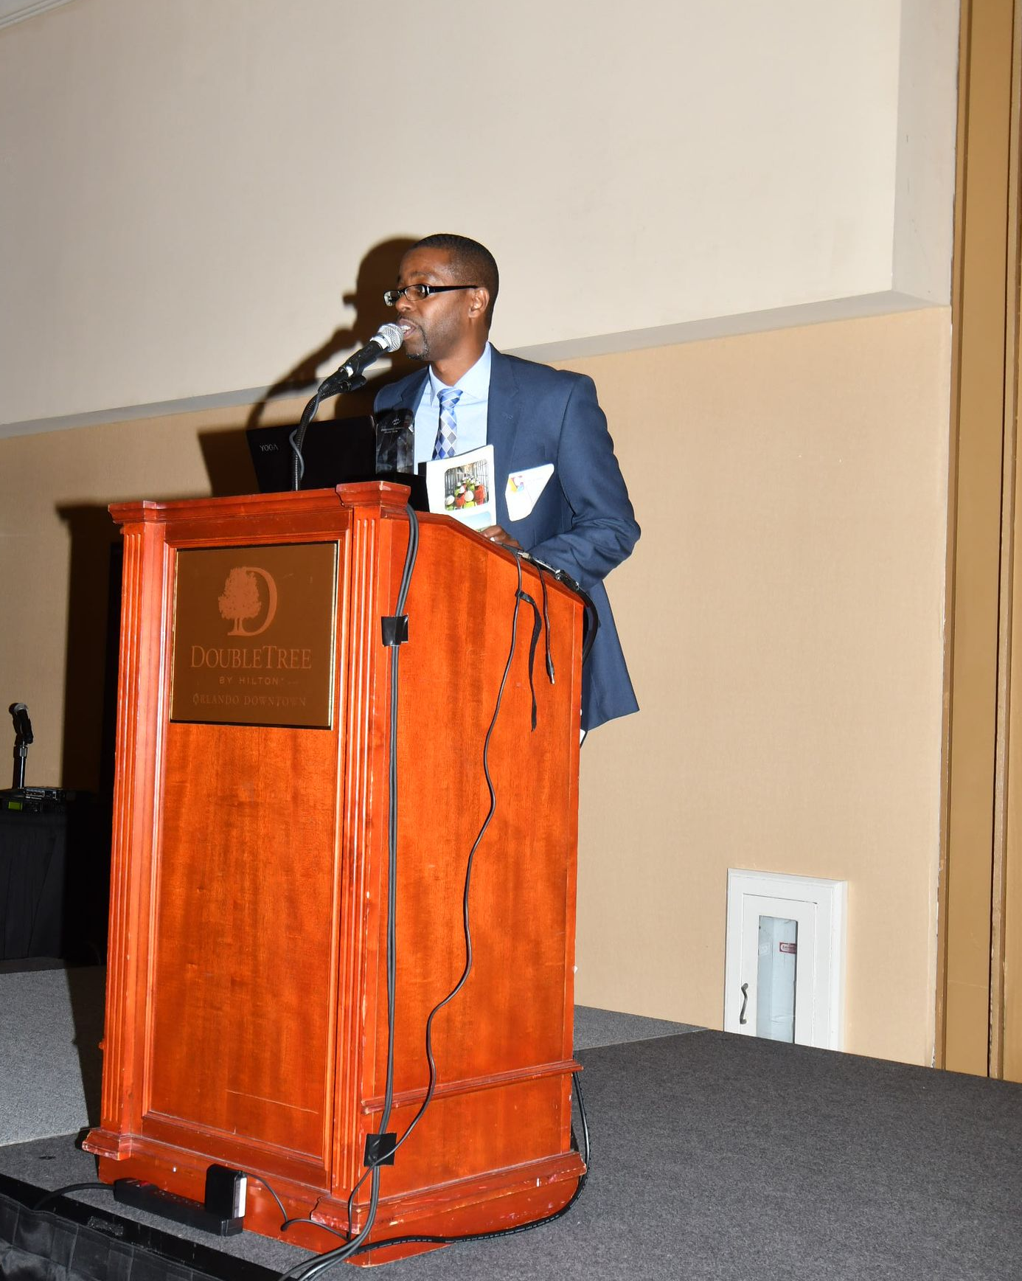
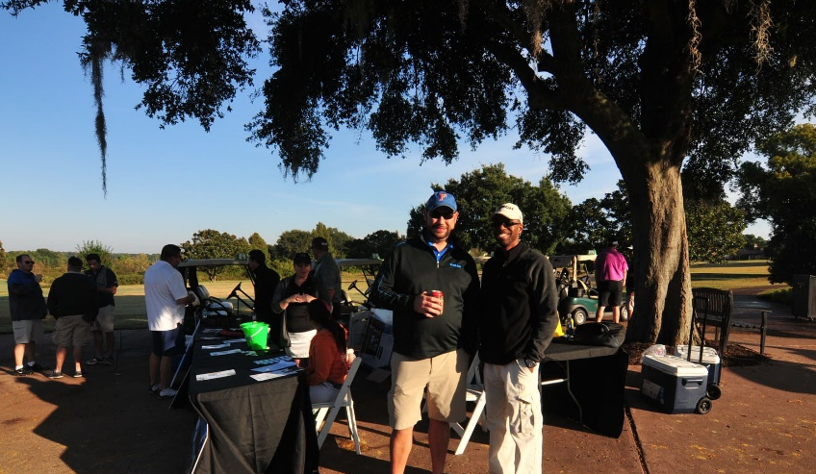
COMMITTEE STRUCTURE
Mo Arthur, AIA – Vice Chairman
Orange County Public Schools (CMI)
Owner’s Rep / Architect

Slide 13
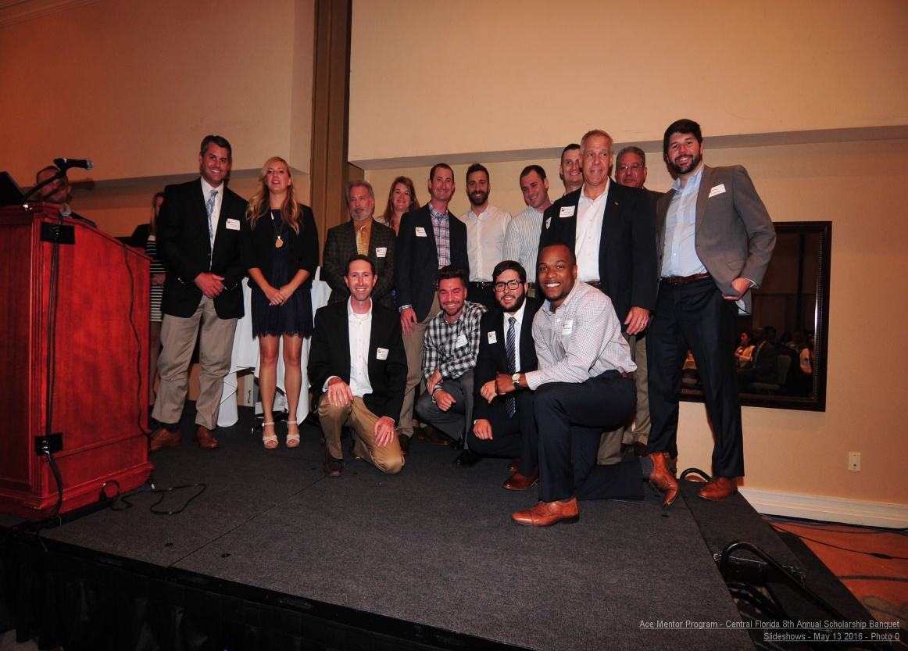
COMMITTEE STRUCTURE
Andrew Laney – Treasurer
Winter Park Bank
Banker

Slide 14
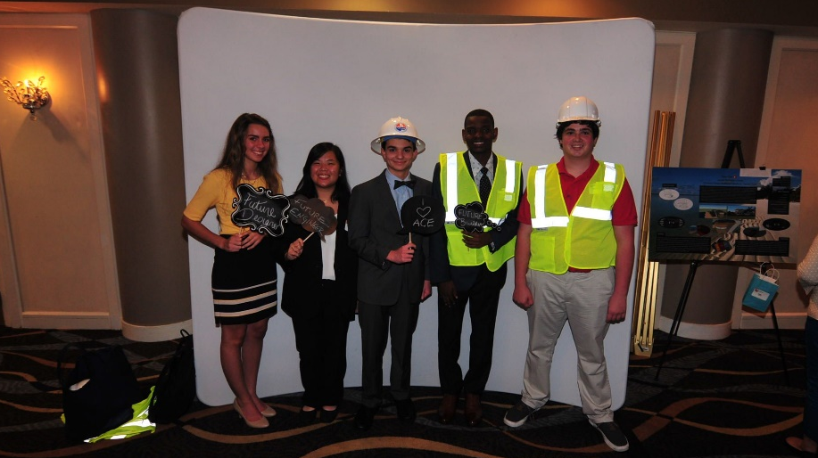
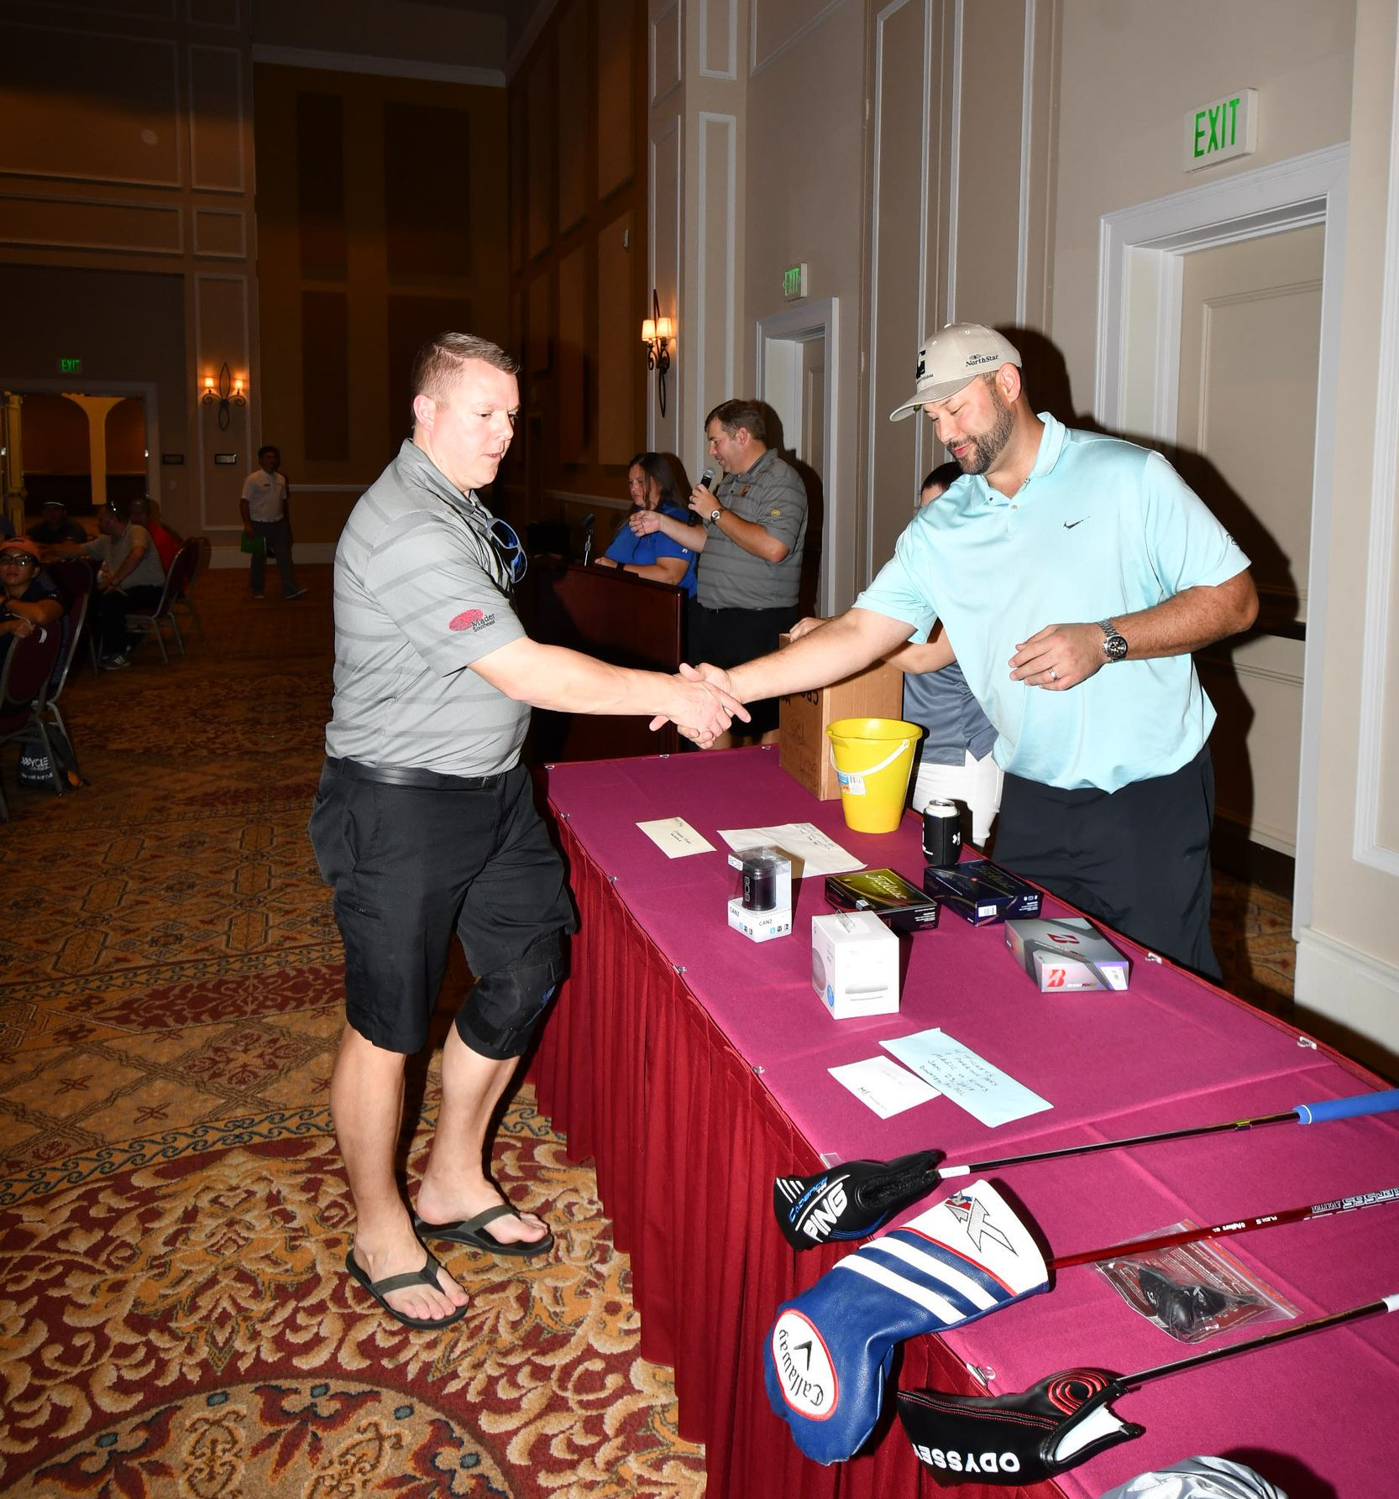
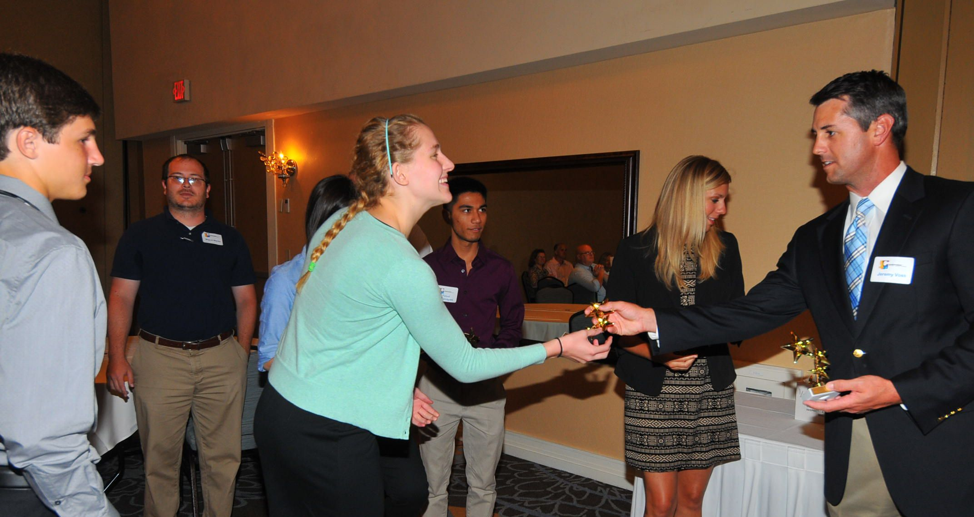
COMMITTEE STRUCTURE
Brad Kroger, P.E. – Secretary
Matern Professional Engineering
Engineer

Slide 15
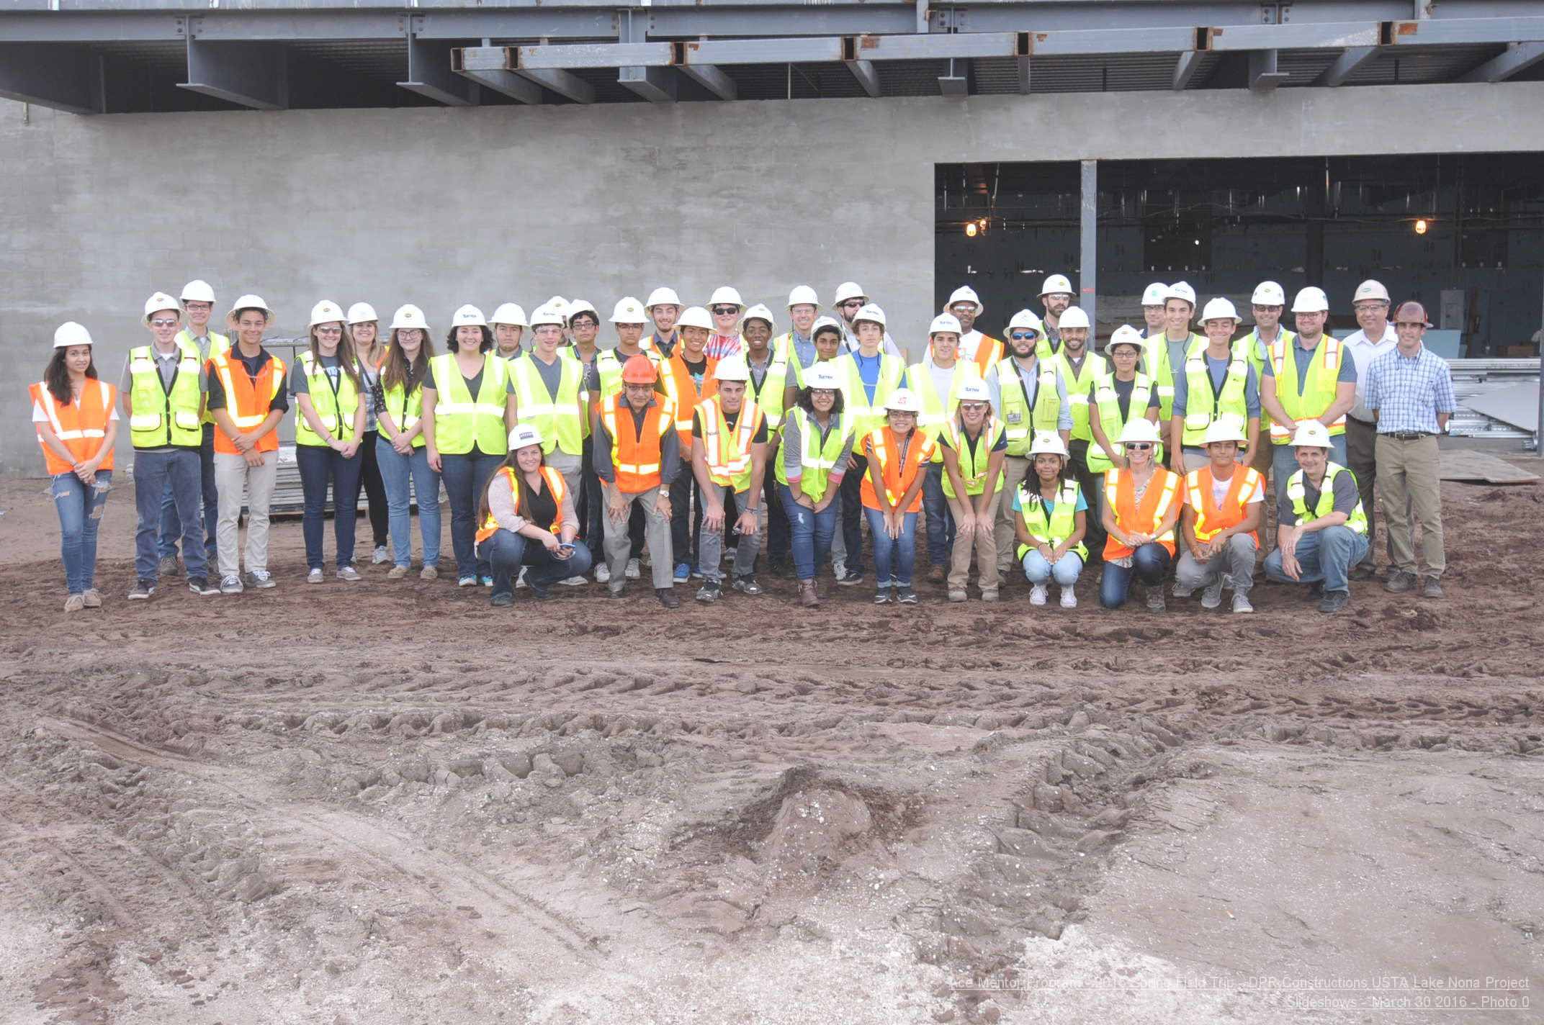
COMMITTEE STRUCTURE
Judy D’Angelo – Student Committee Chair
Matern Professional Engineering
Engineer / Controller

Slide 16
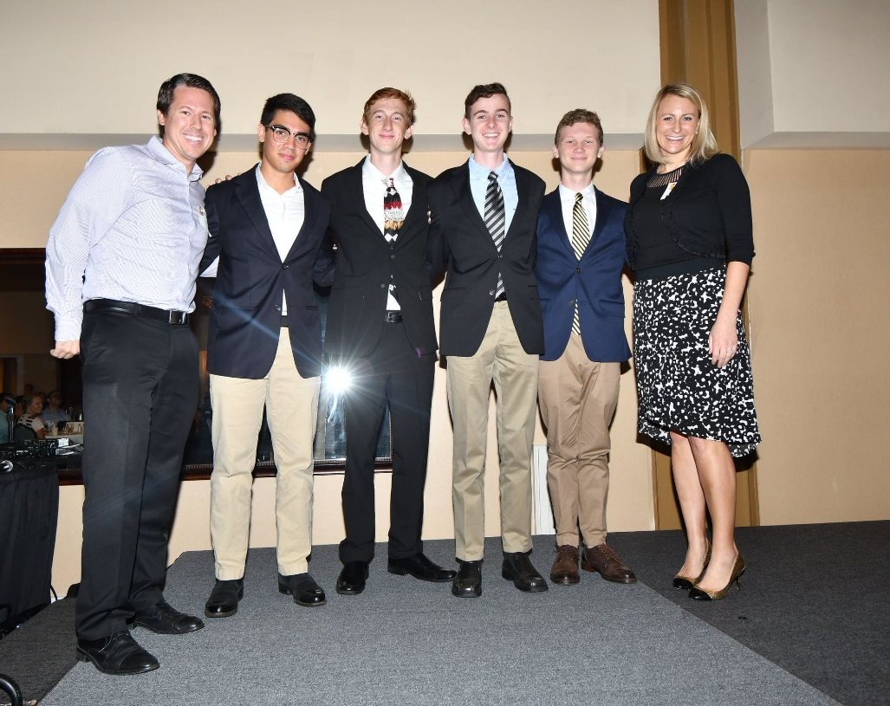
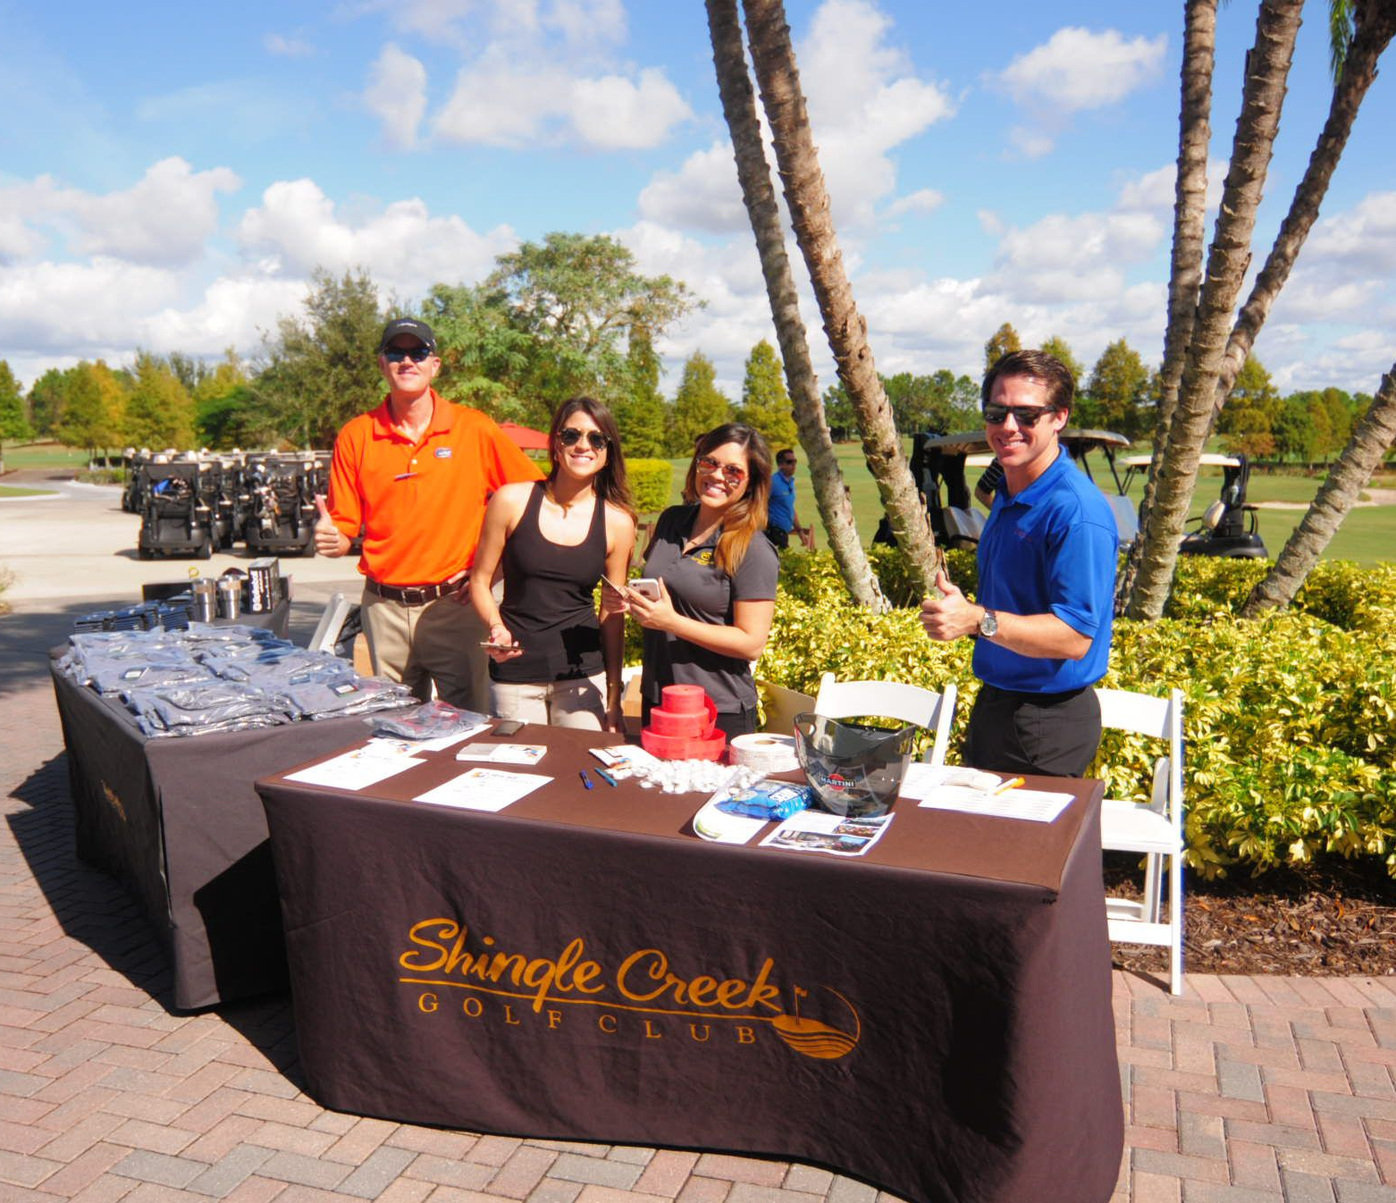
COMMITTEE STRUCTURE
Joe Knous, AIA – Program Chair
Calic Group
Architect

Slide 17
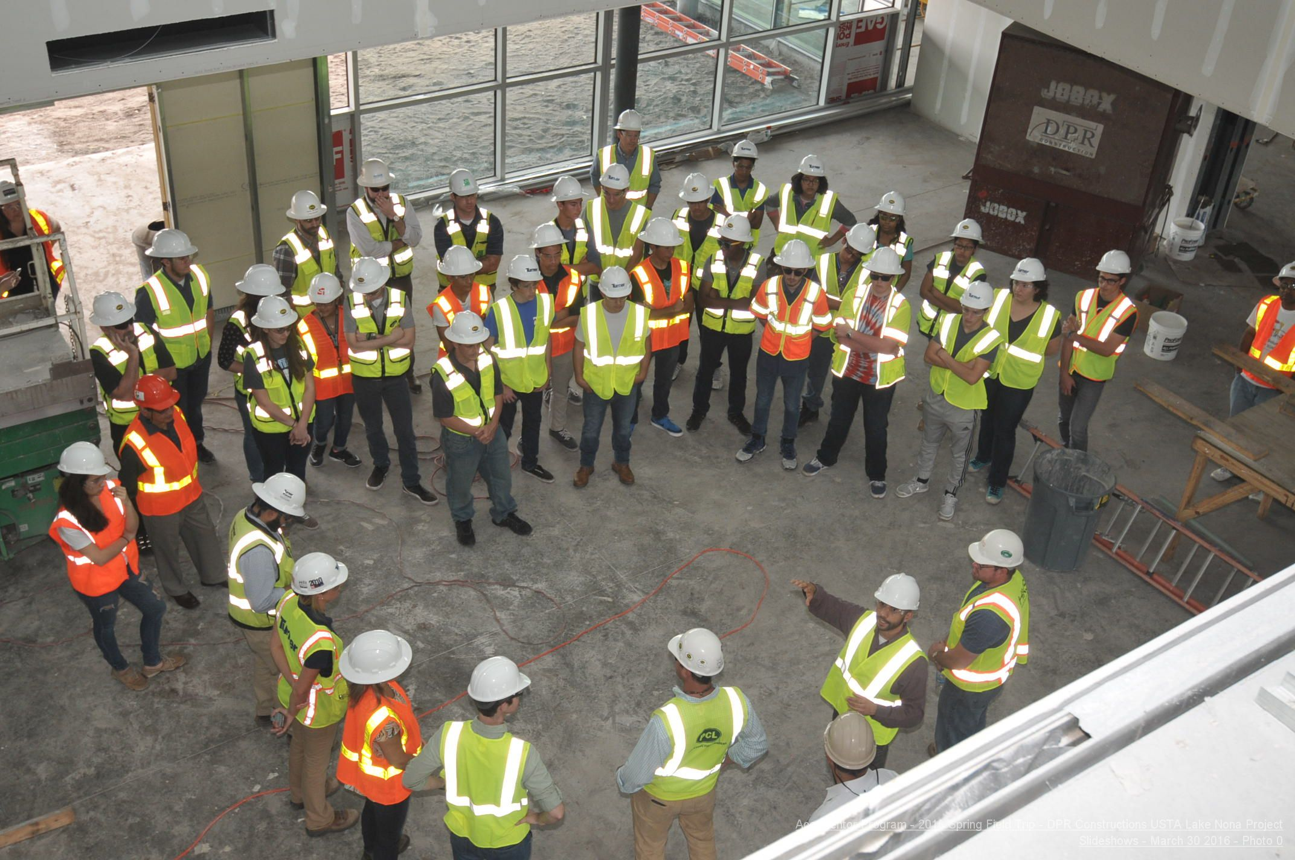
COMMITTEE STRUCTURE
Kristin Gray, LEED AP – Student Committee Chair
Turner Construction
General Contractor

Slide 18
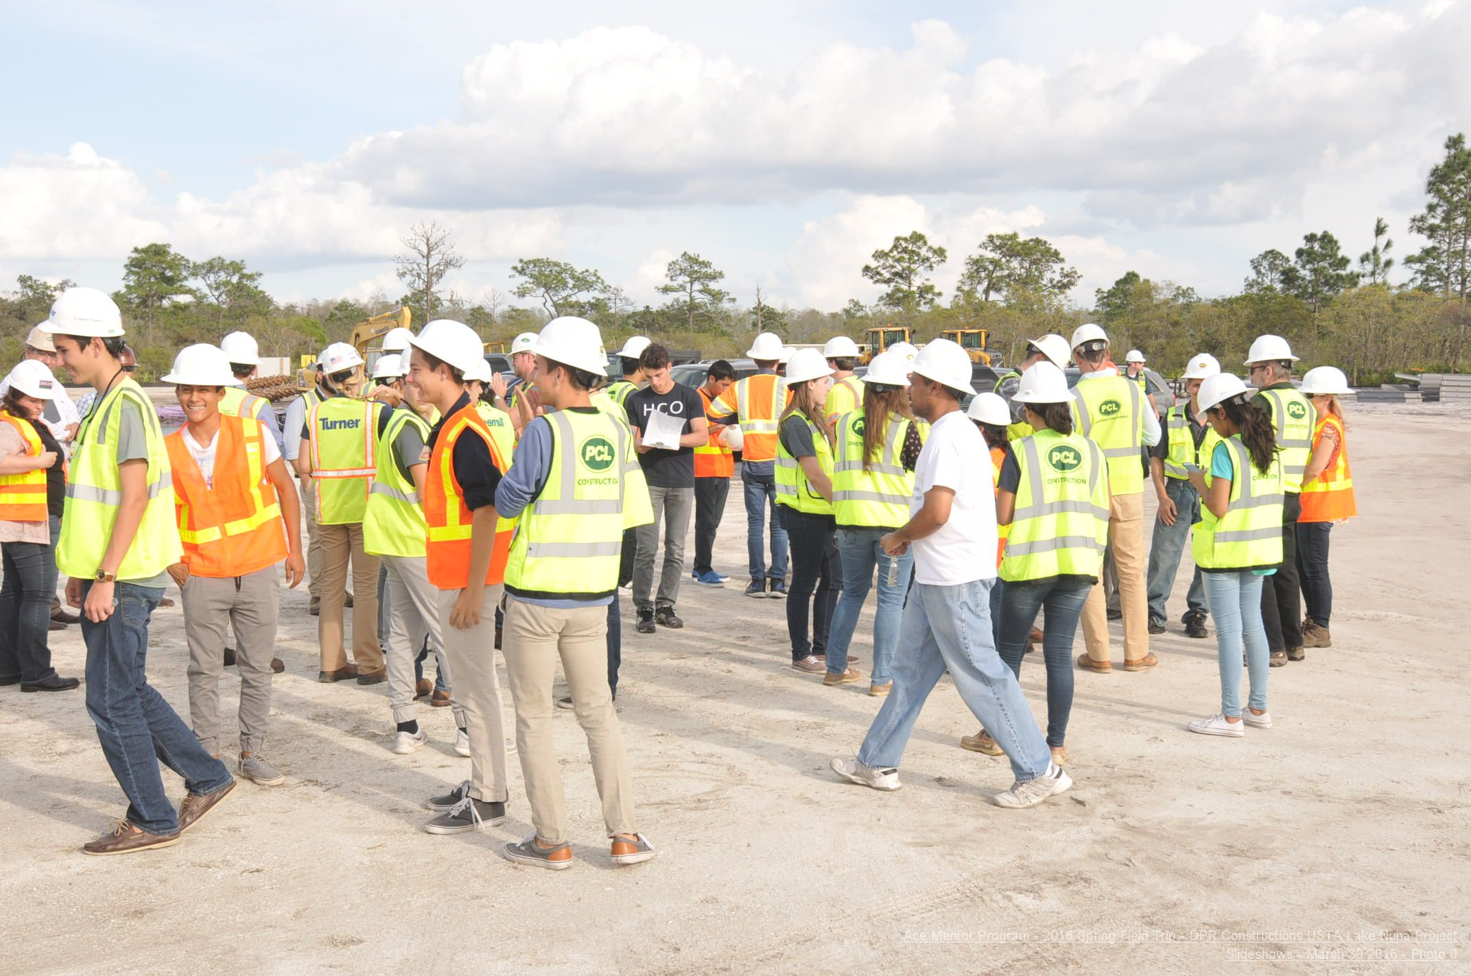
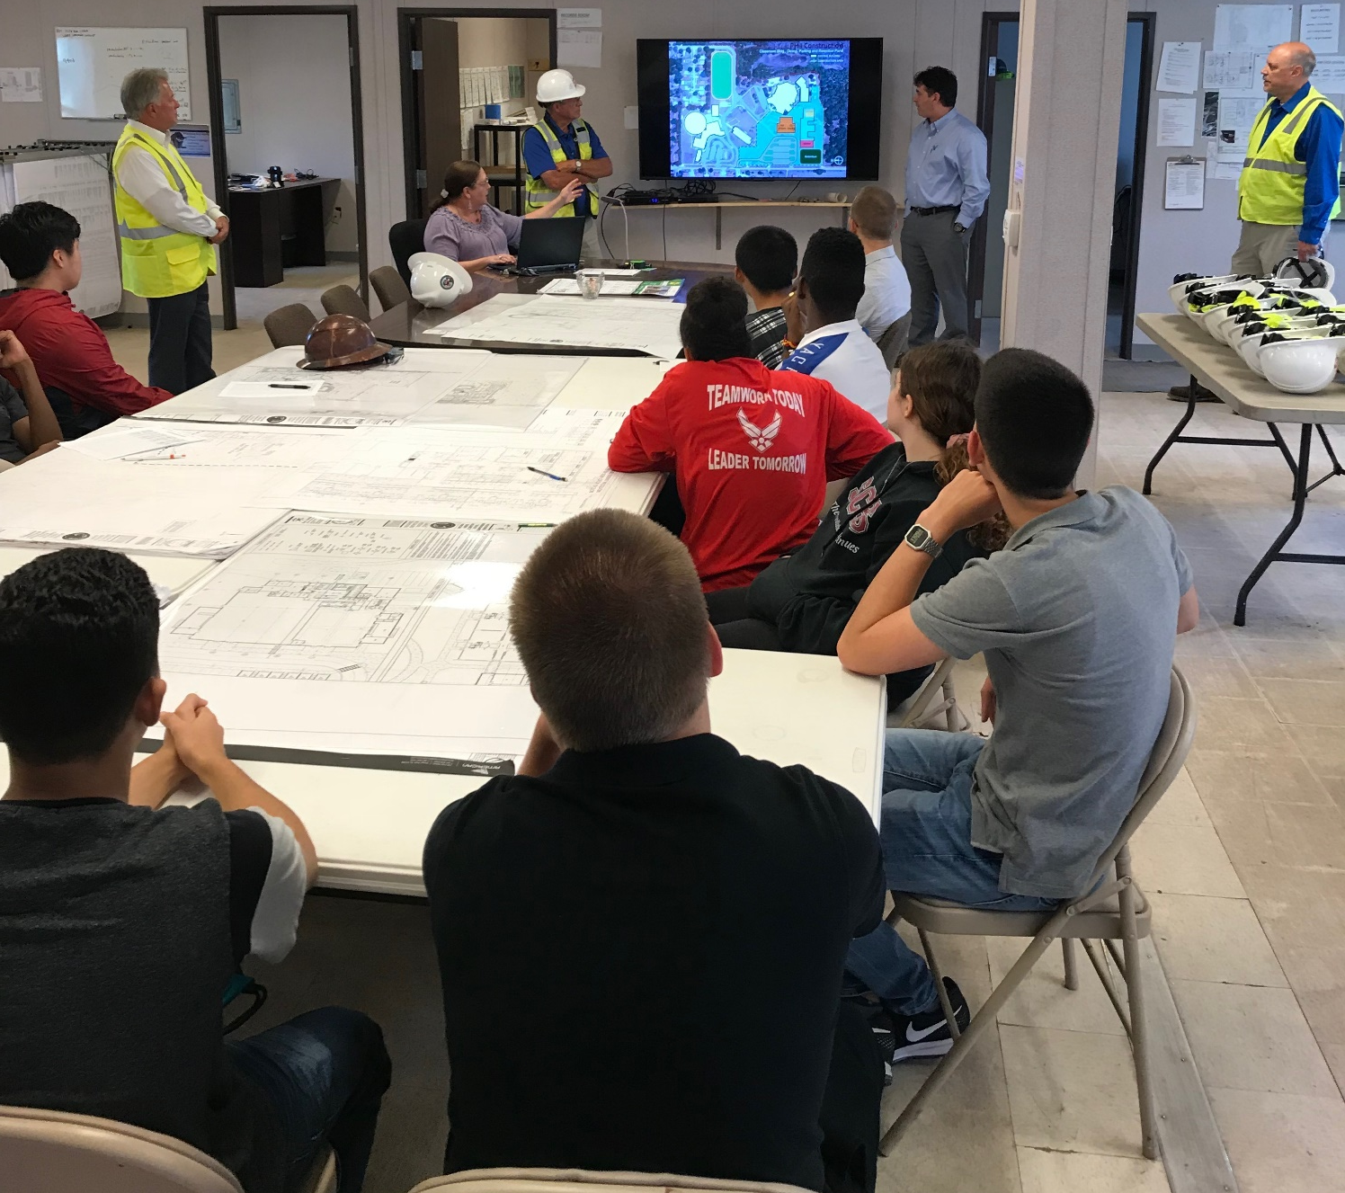
COMMITTEE STRUCTURE
Marc Clinch – Education Chair
School District of Osceola County
Owner’s Rep / Navy Seabees

Slide 19
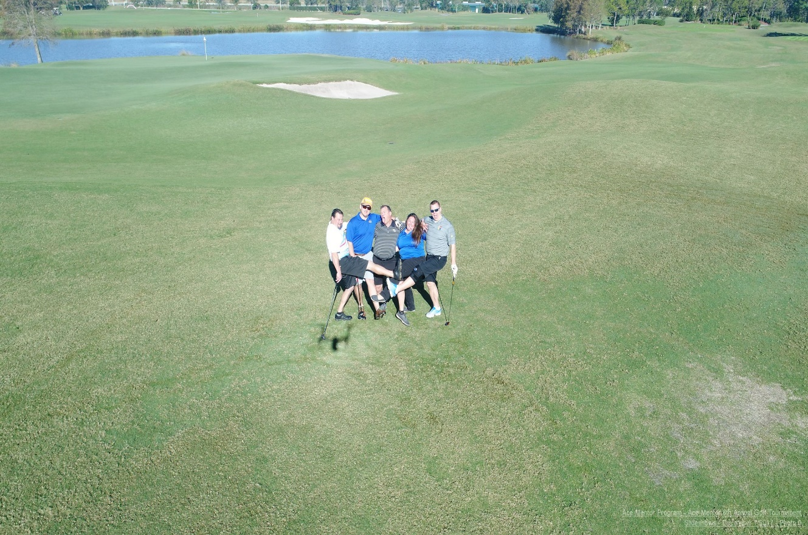
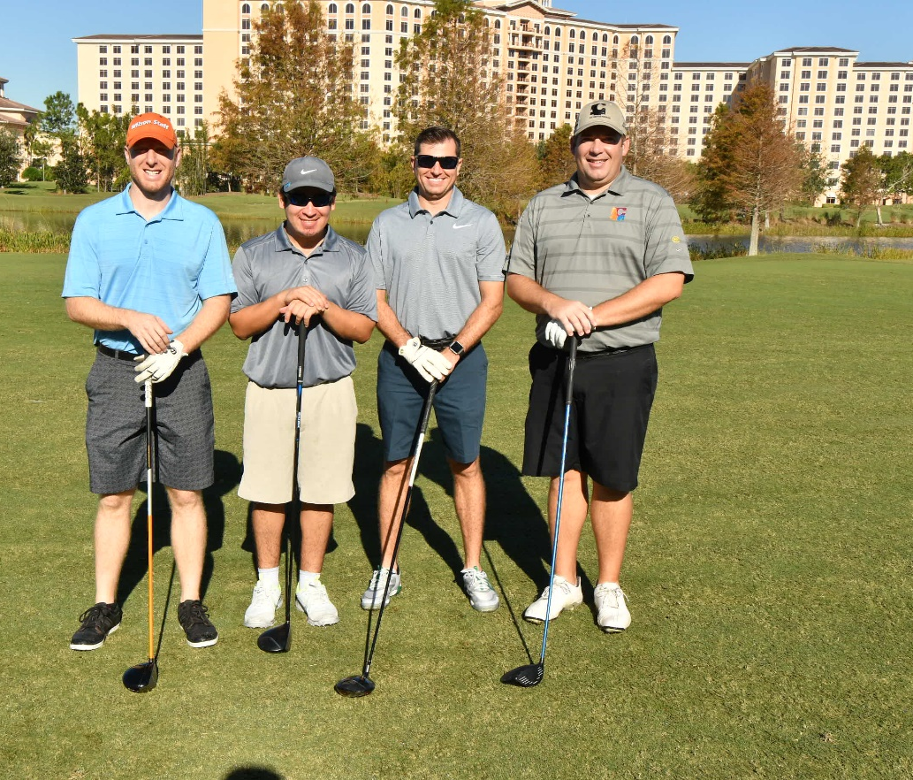
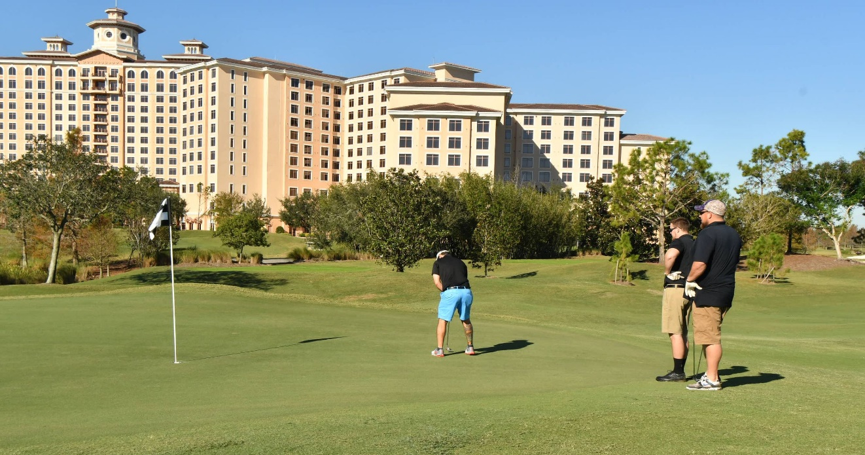
COMMITTEE STRUCTURE
Jonathan Sheppeard – Fundraising Chair
Austin Commercial
General Contractor

Slide 20
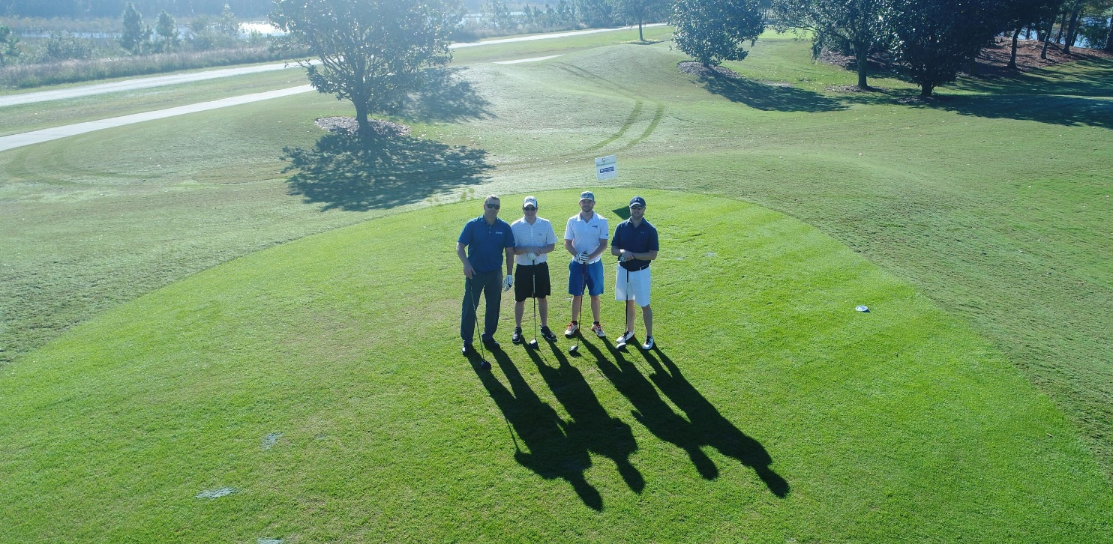
COMMITTEE STRUCTURE
Tim McLaughlin – Fundraising Chair
Hoar Construction
General Contractor

Slide 21
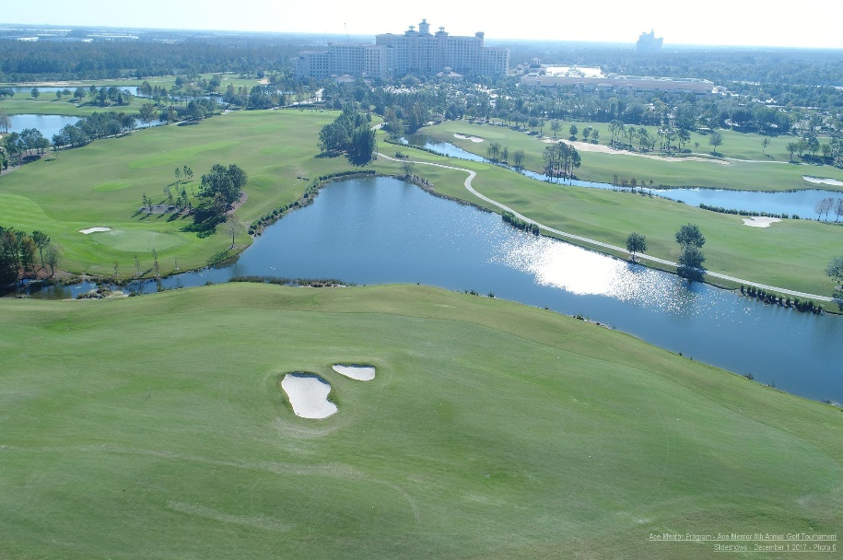
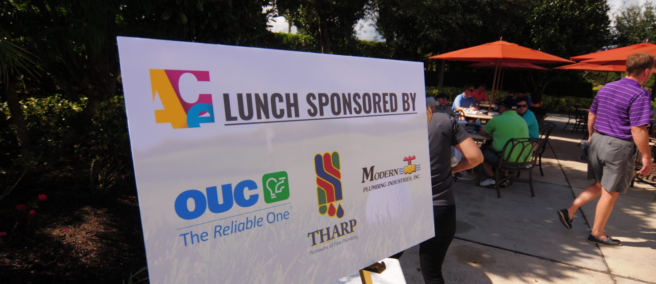
COMMITTEE STRUCTURE
Robbie Gosnell – Fundraising Chair
PCL Construction
General Contractor

Slide 22
COMMITTEE STRUCTURE
Nathan Butler, AIA – Design Chair
HKS Architects
Architect

Slide 23
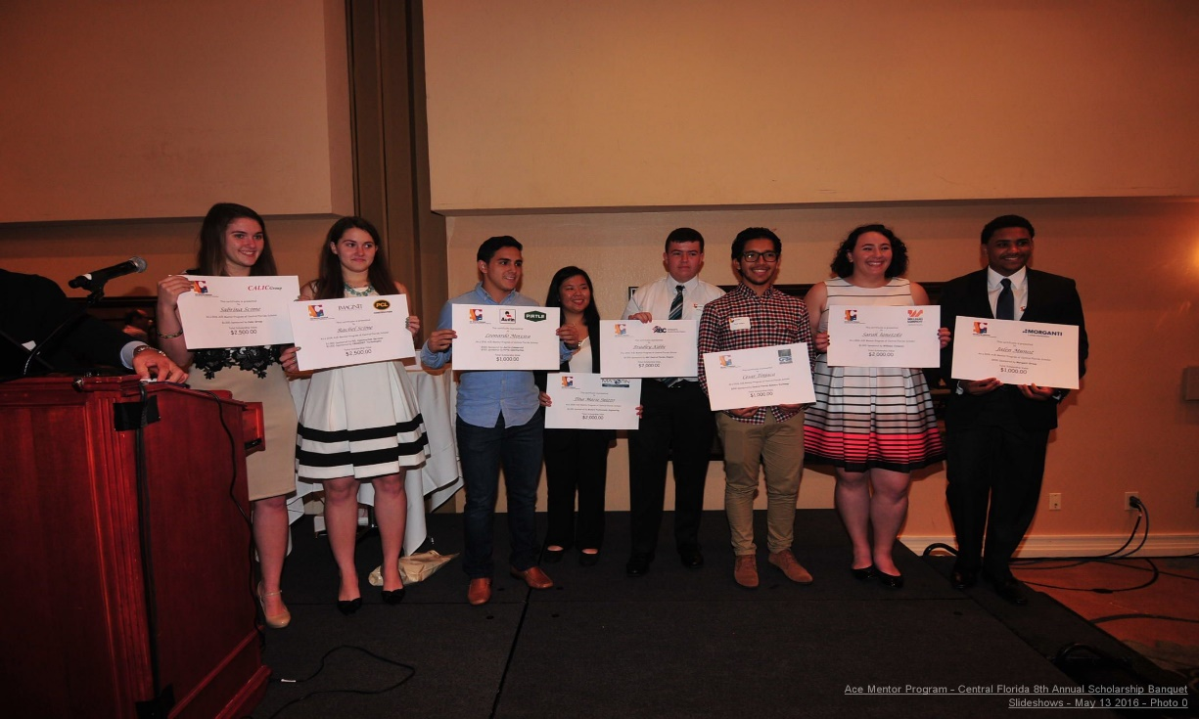
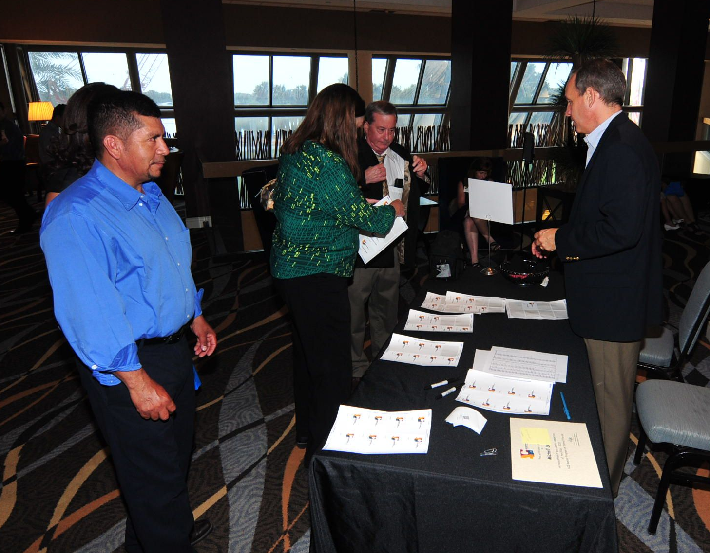
COMMITTEE STRUCTURE
Mark Jackson – Scholarship Chair
Jackson, Collingsworth & Johnson Insurance
Insurance Agency

Slide 24
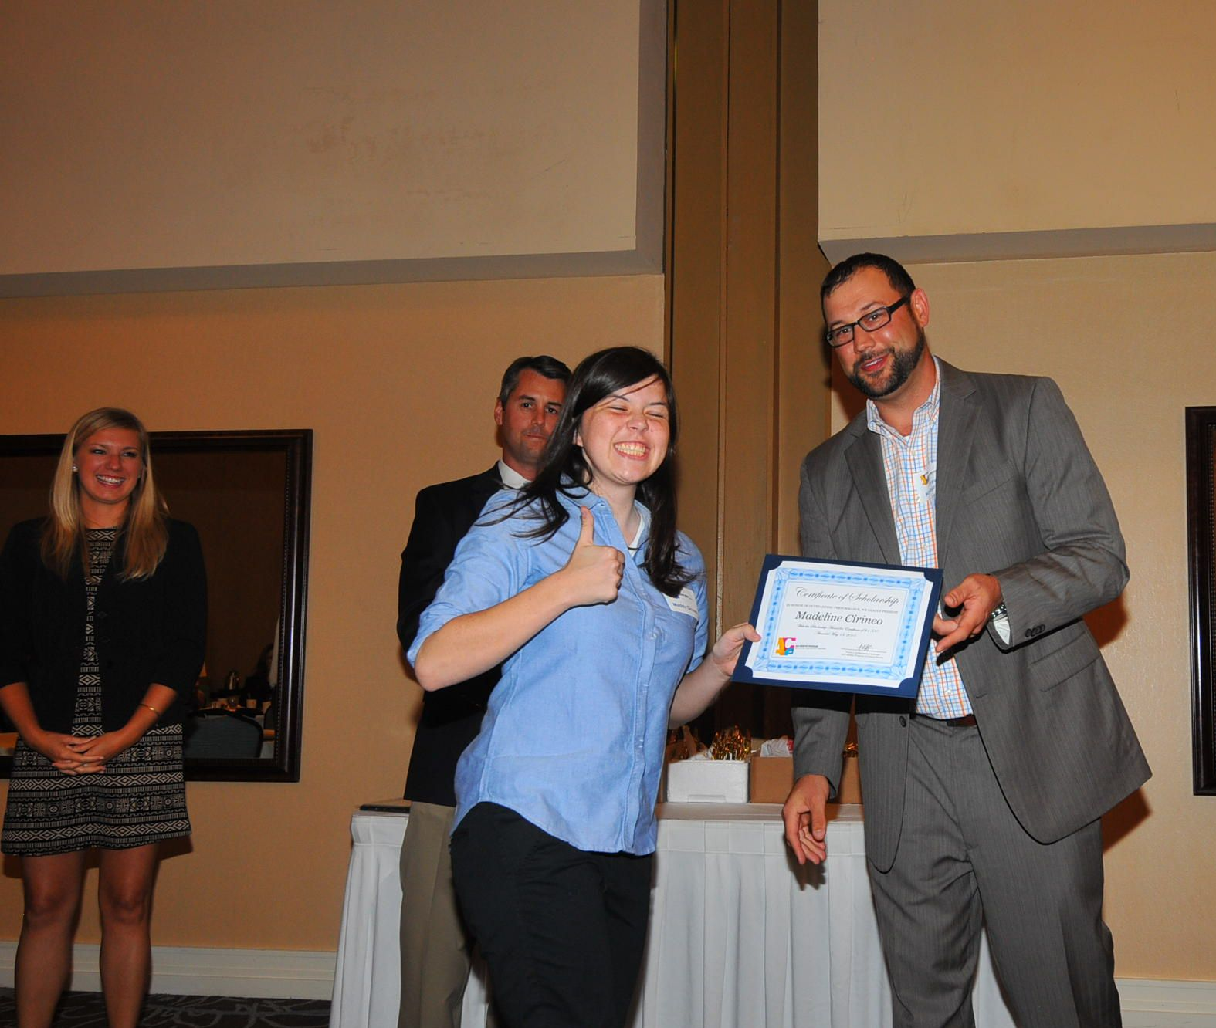
COMMITTEE STRUCTURE
Sean Dillon – Governance Chair
Moye, O’Brien, Pickert, Dillon & Masterson
Attorney at Law – Construction Law

Slide 25
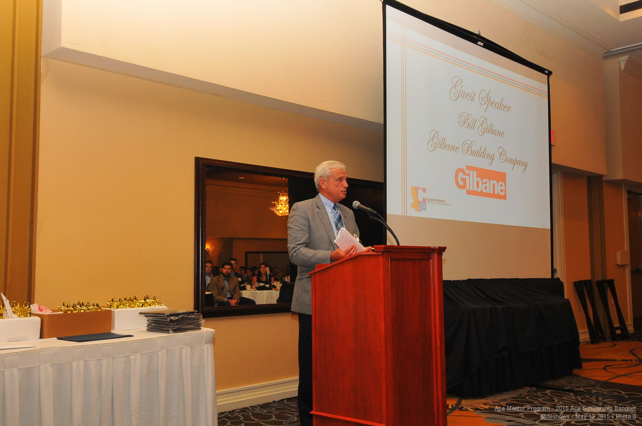
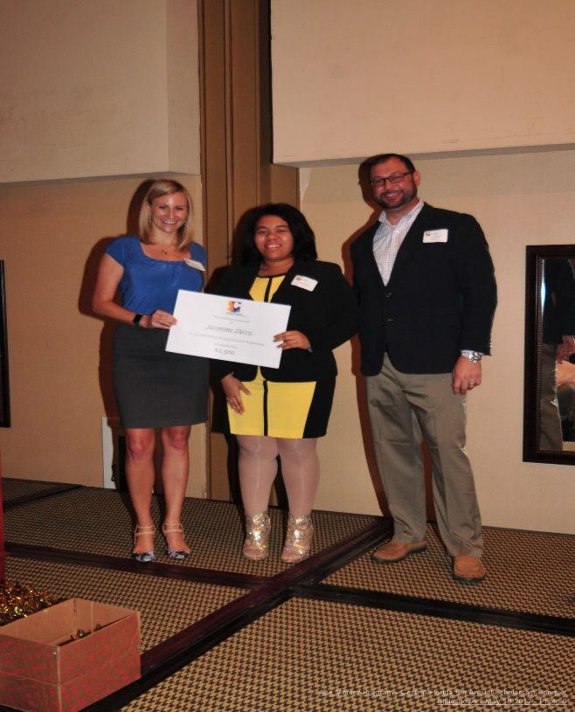
COMMITTEE STRUCTURE
Corey Zimmerman – PR / Marketing Chair
Gilbane Building Company
General Contractor

Slide 26
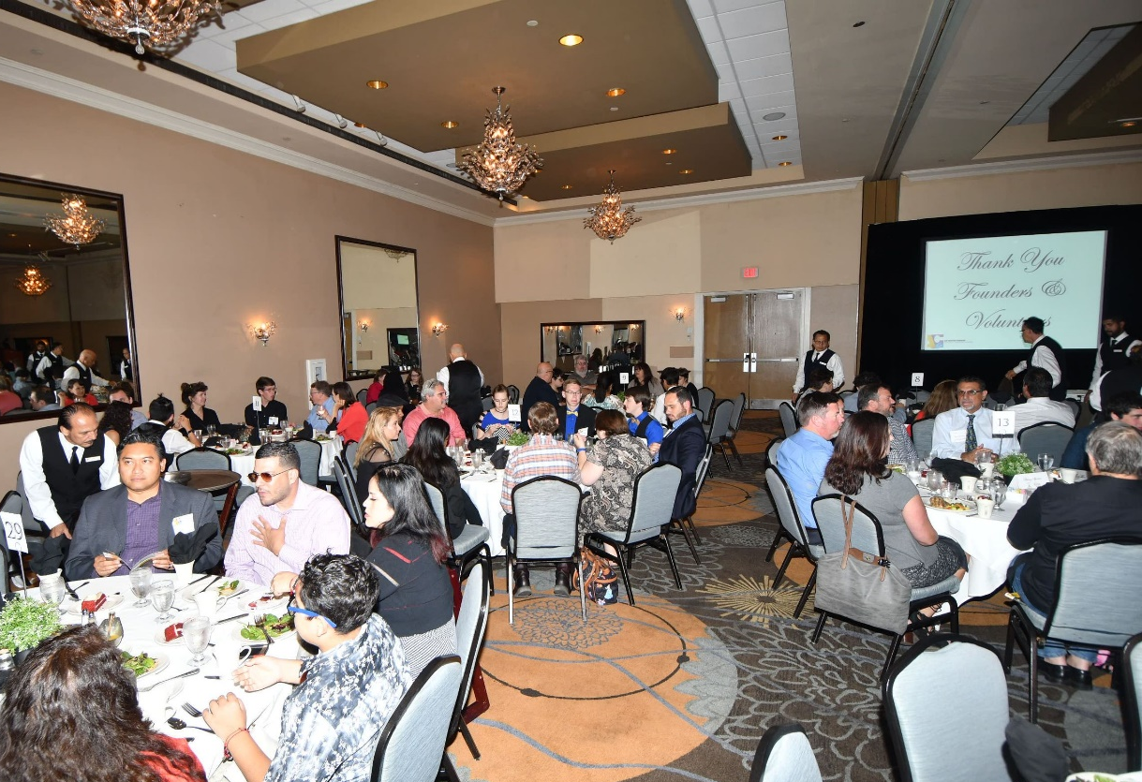
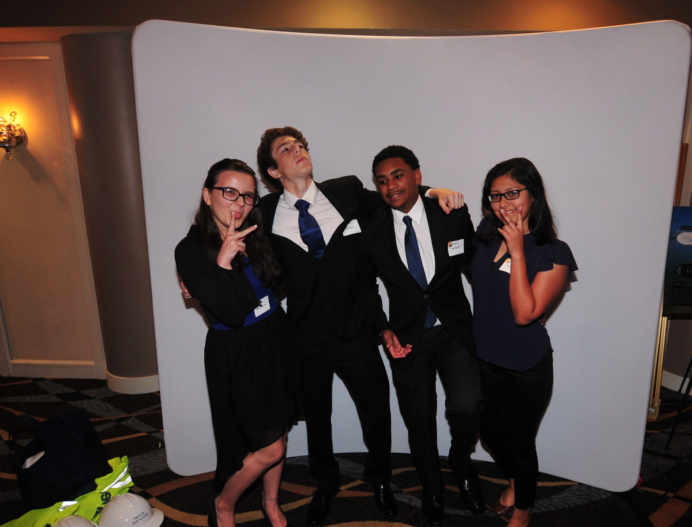
COMMITTEE STRUCTURE
In closing, diversity within our Central Florida ACE Mentor Board is paramount for our ability to serve our student protégés, their parents, our mentors and overall Orlando community.
Q&A

