Slide 1
MENTORS
Mentor Recruitment
Akilah Darden
ACE Mentor Program of Indianapolis

Slide 2
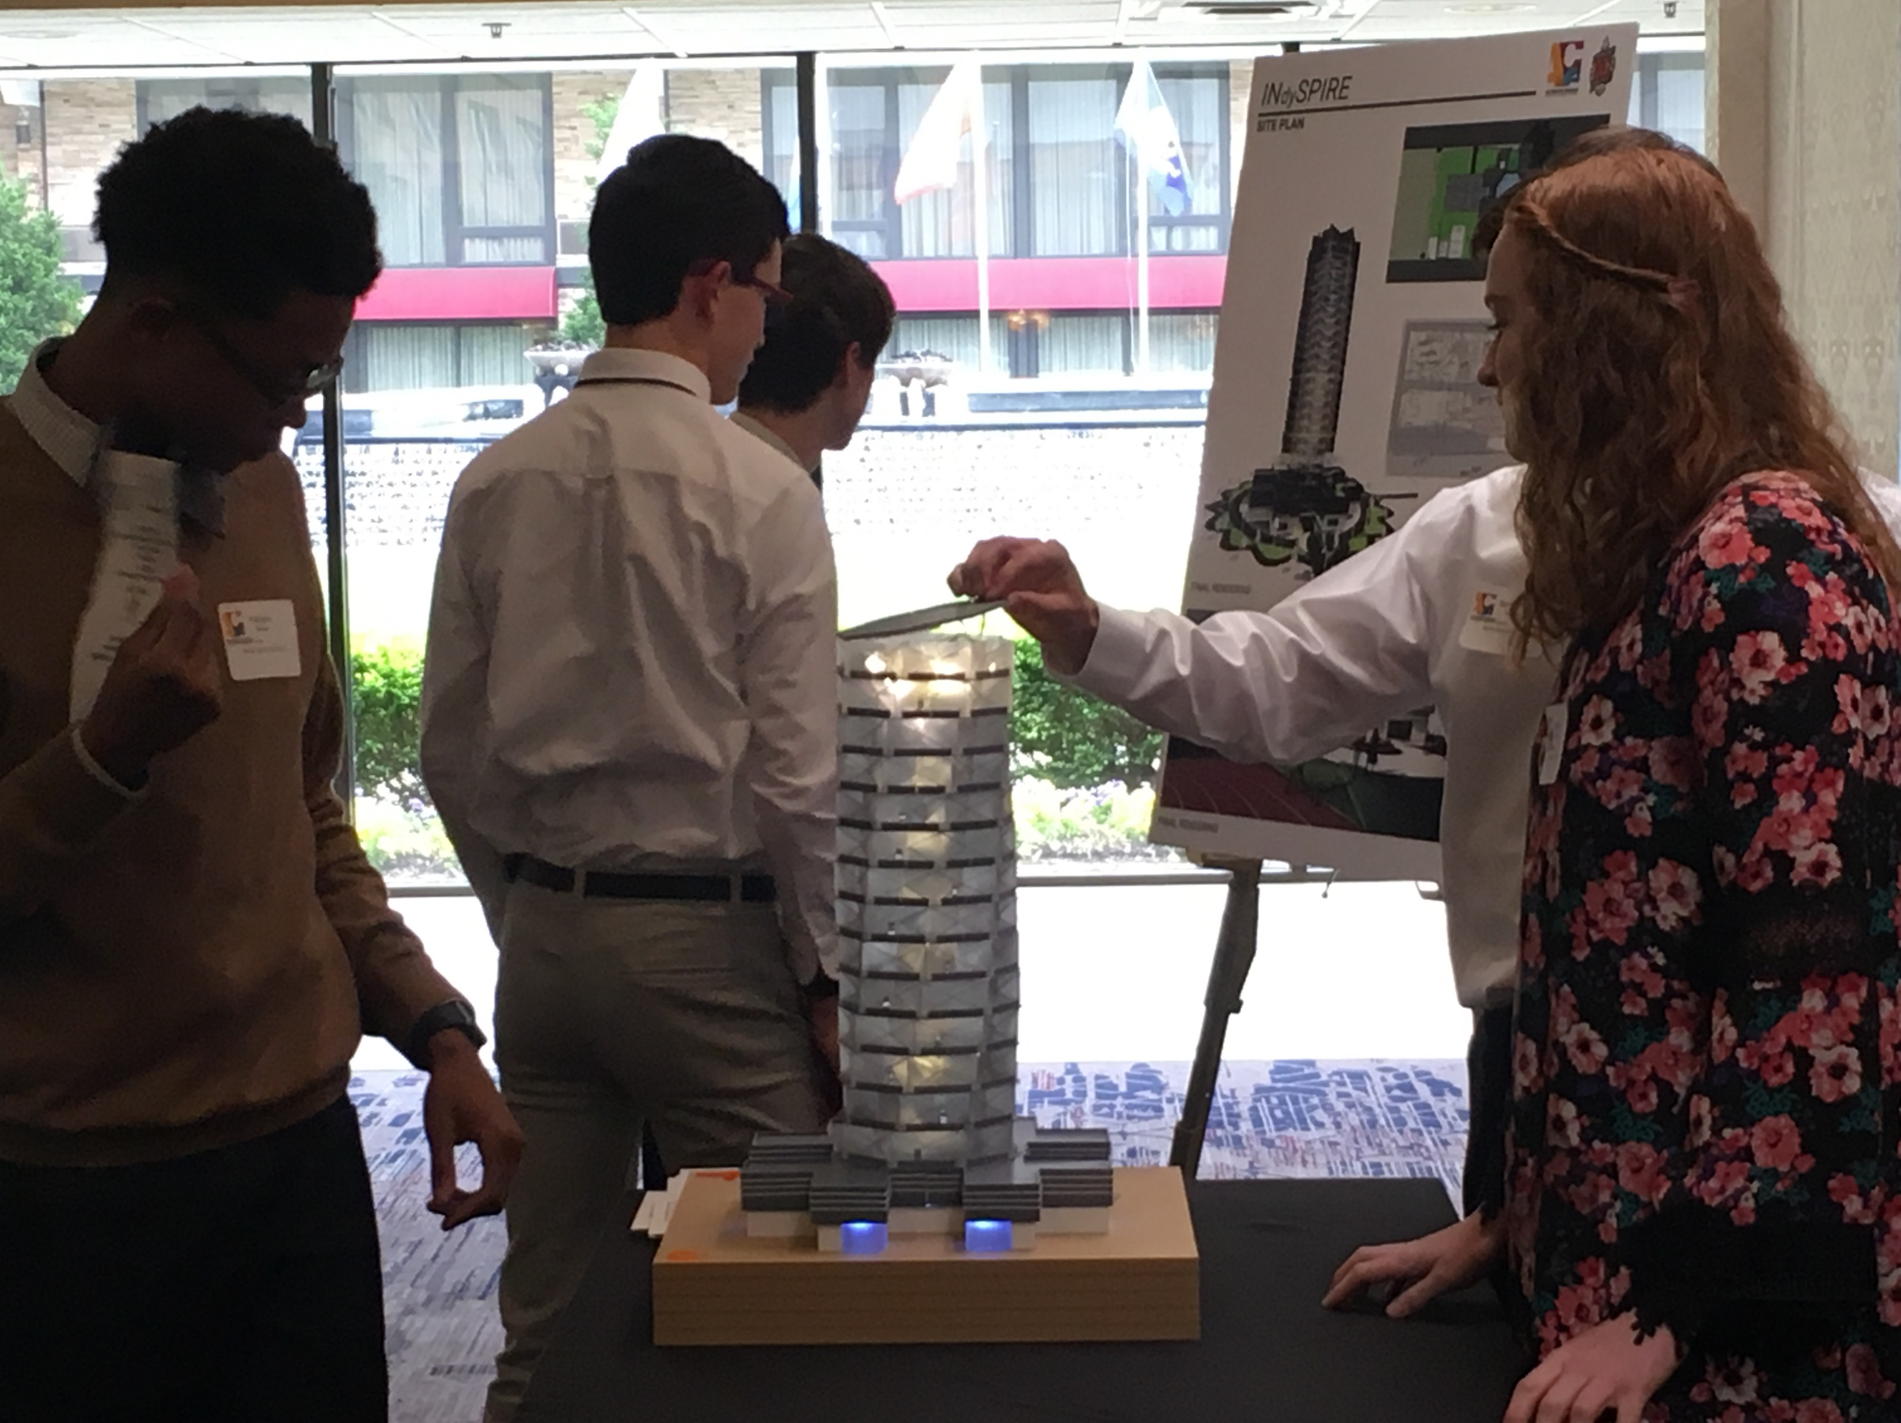
MENTOR RECRUITMENT
Partnerships
Corporate CEOs
Industry Leaders
Principals / Vice Principals

Slide 3
MENTOR RECRUITMENT
Preparation
Team Leader Tool Kit

Slide 4
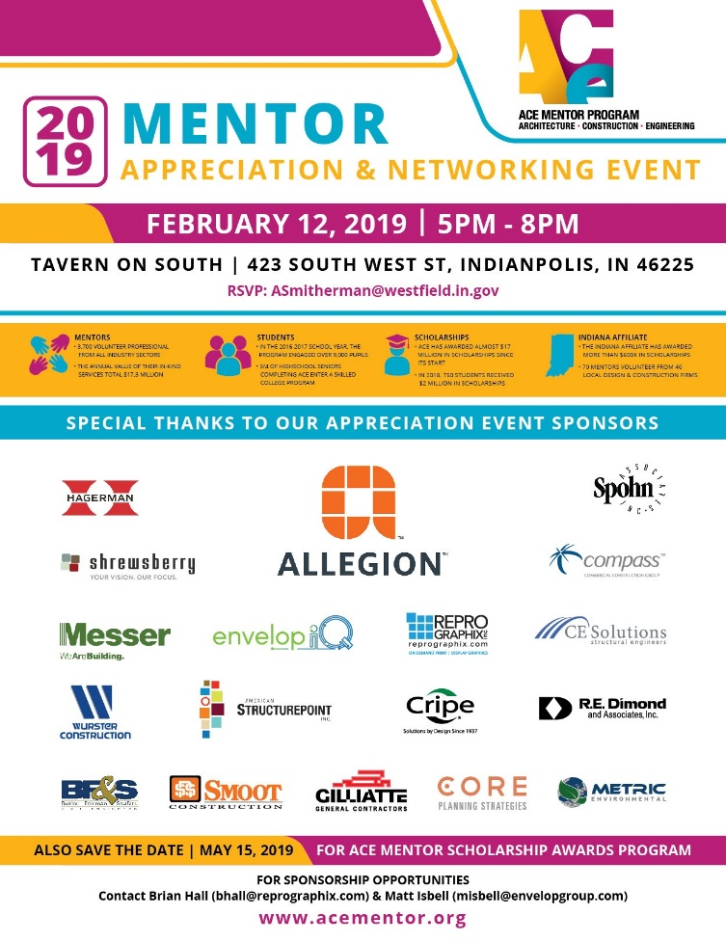
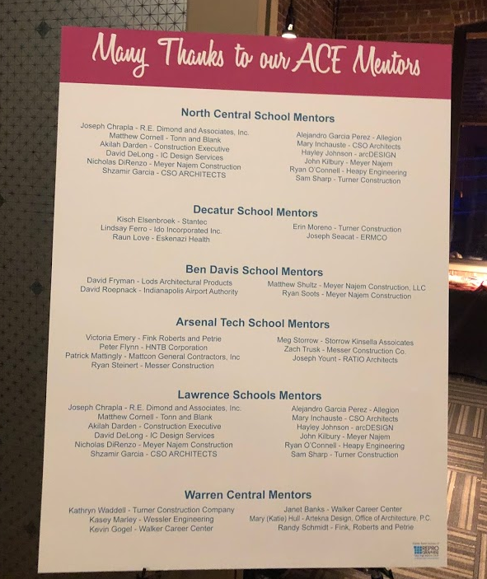
MENTOR RECRUITMENT
Appreciation
Thank You Cards
Christmas Token
Mentor Appreciation Event
Gifts
Raffle

Slide 5
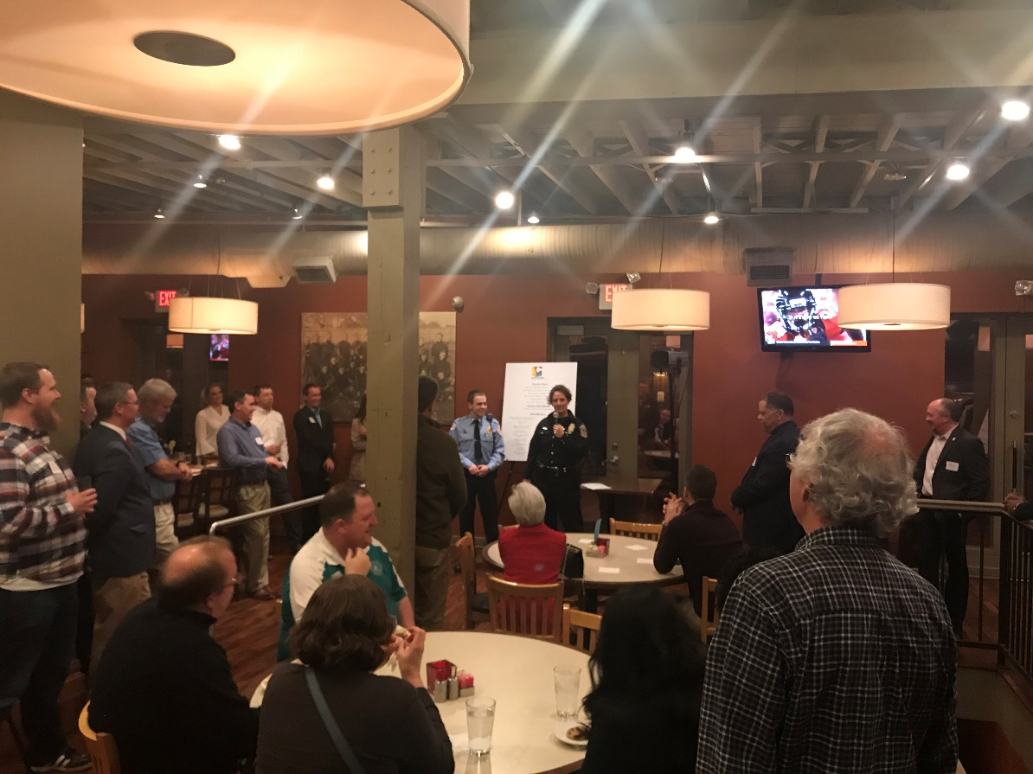
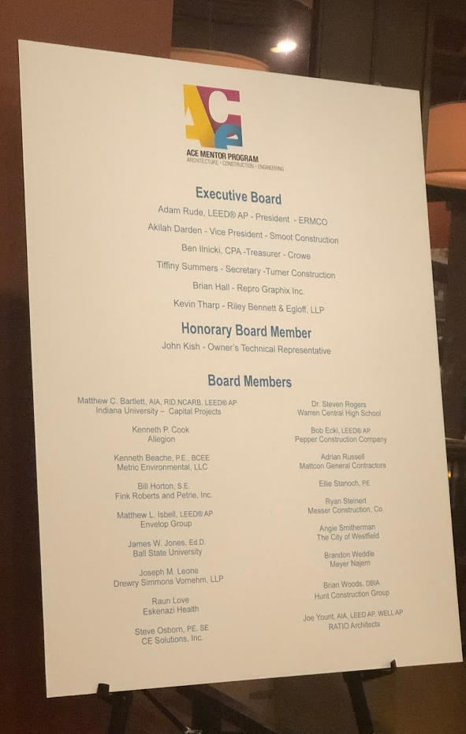
MENTOR RECRUITMENT
Appreciation
Thank You Cards
Christmas Token
Mentor Appreciation Event
Gifts
Raffle

Slide 6
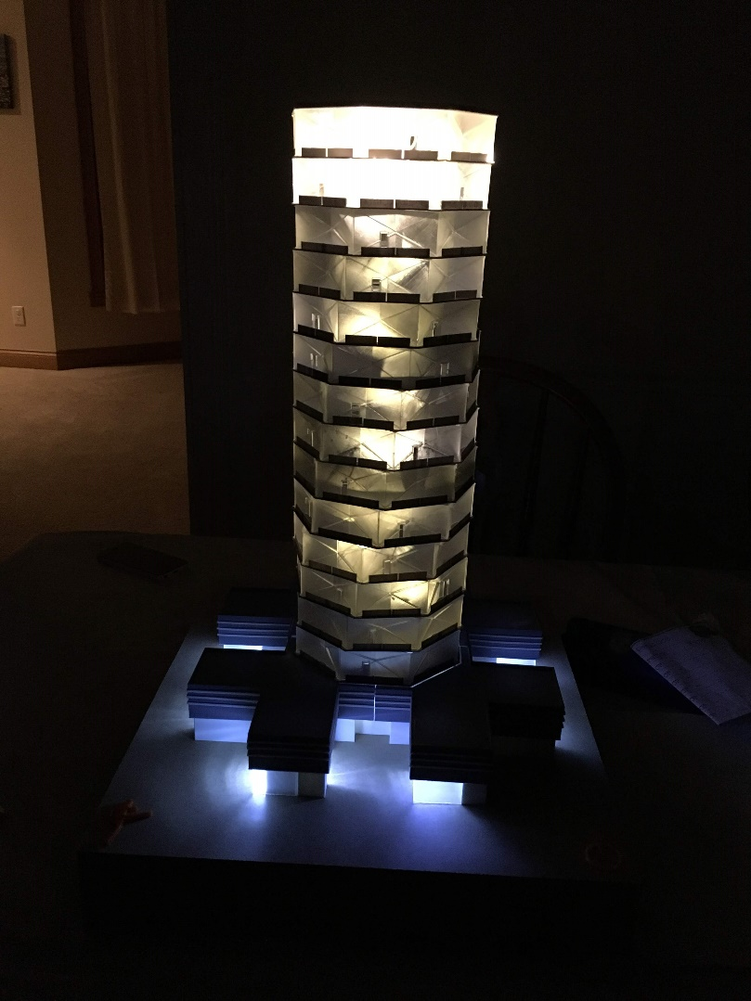
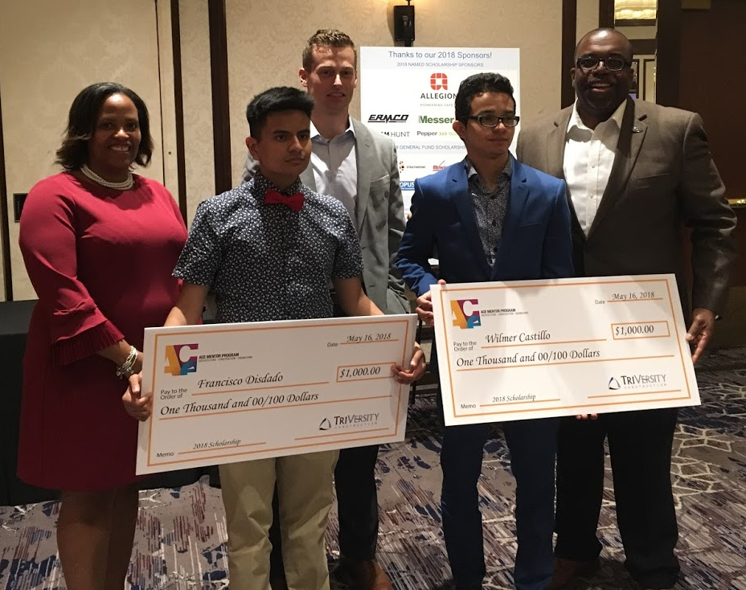
MENTOR RECRUITMENT
Banquet
Annual Banquet

Slide 7
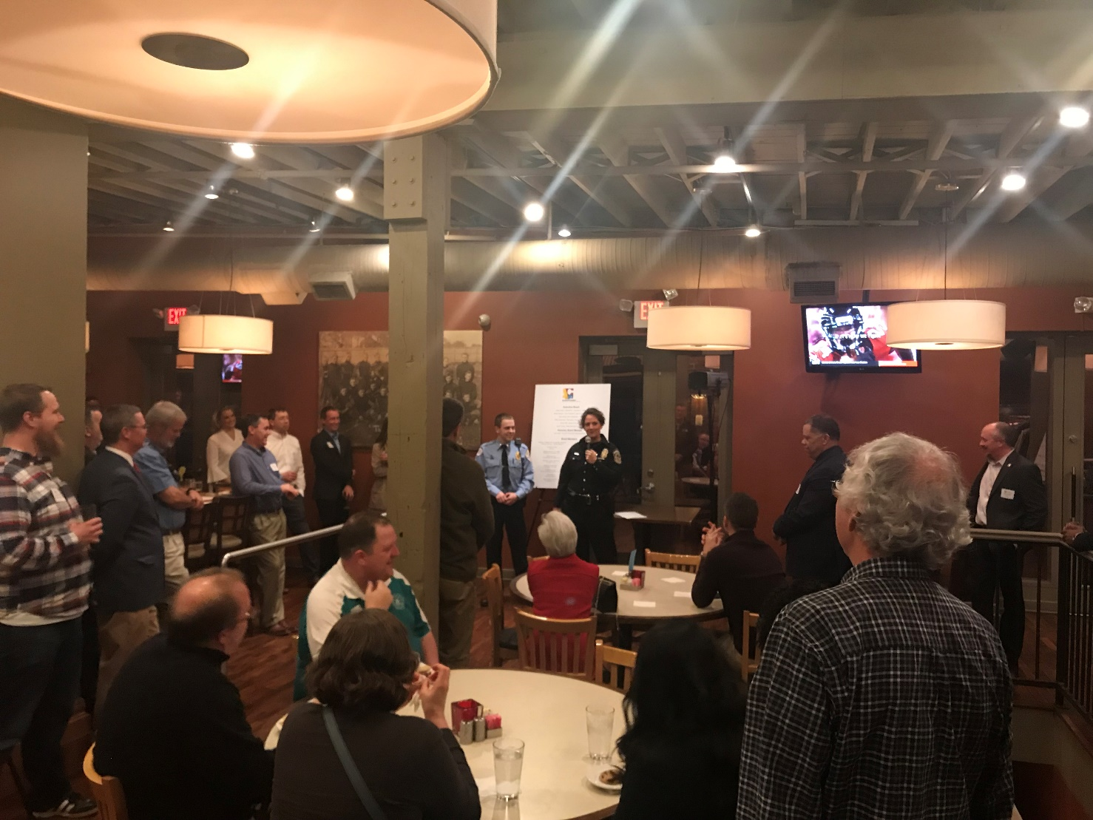
MENTOR RECRUITMENT
End-of Year
Stats
Appreciation

Slide 8
MENTORS
Mentor Recruitment & Retention
Glen Shumate
ACE Mentor Program of Cleveland

Slide 9
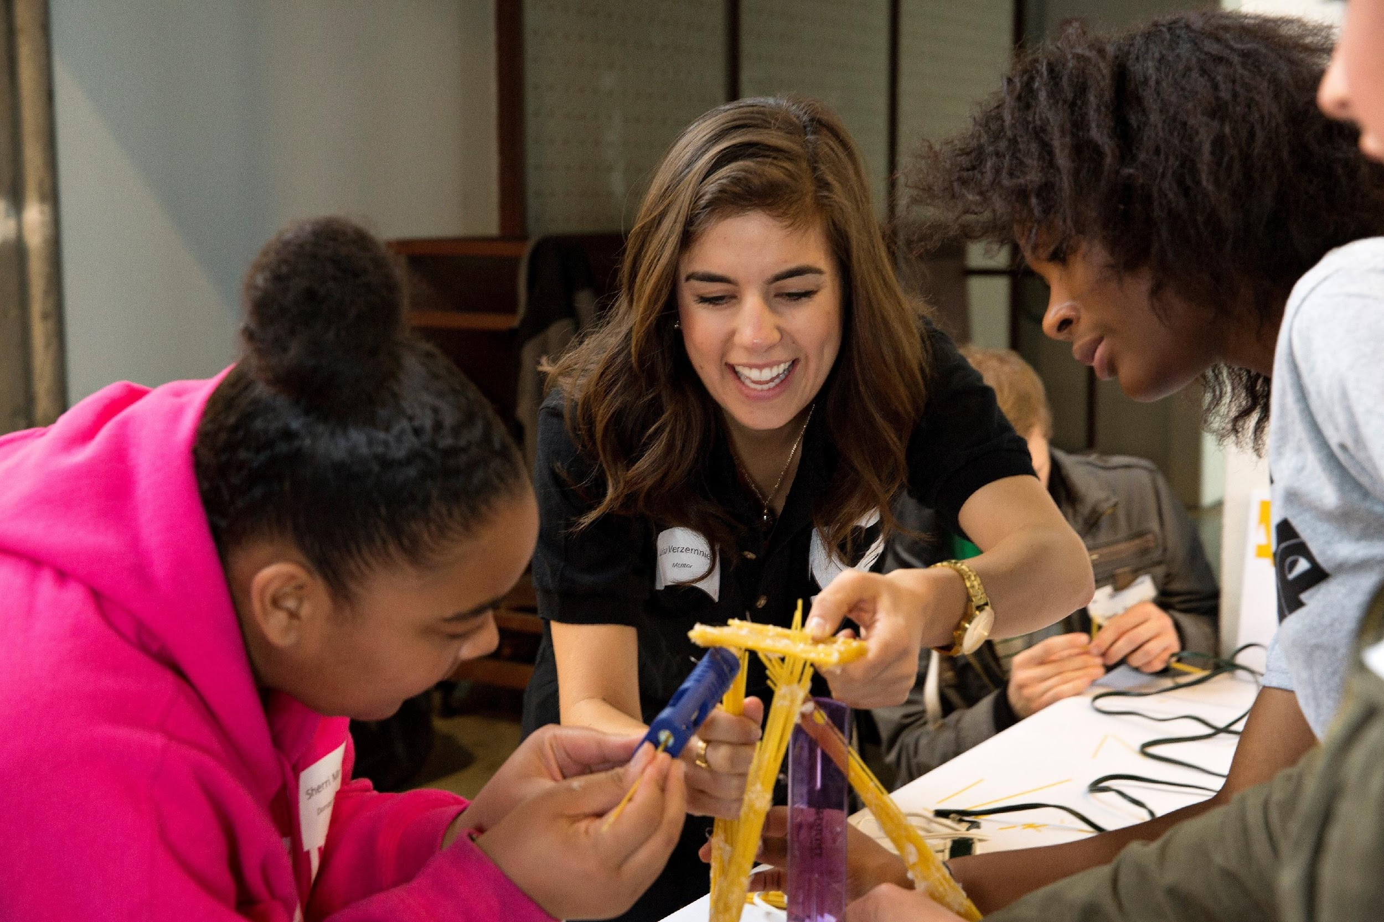
ACE Mentor Retention
CLEVELAND
Annual Mentor Kickoff
Mentor socials
Mentor profiles & articles
ACE newsletter recognition
Presentation & Scholarship Banquet Recognition
Mentor Certificates
Annual Survey

Slide 10
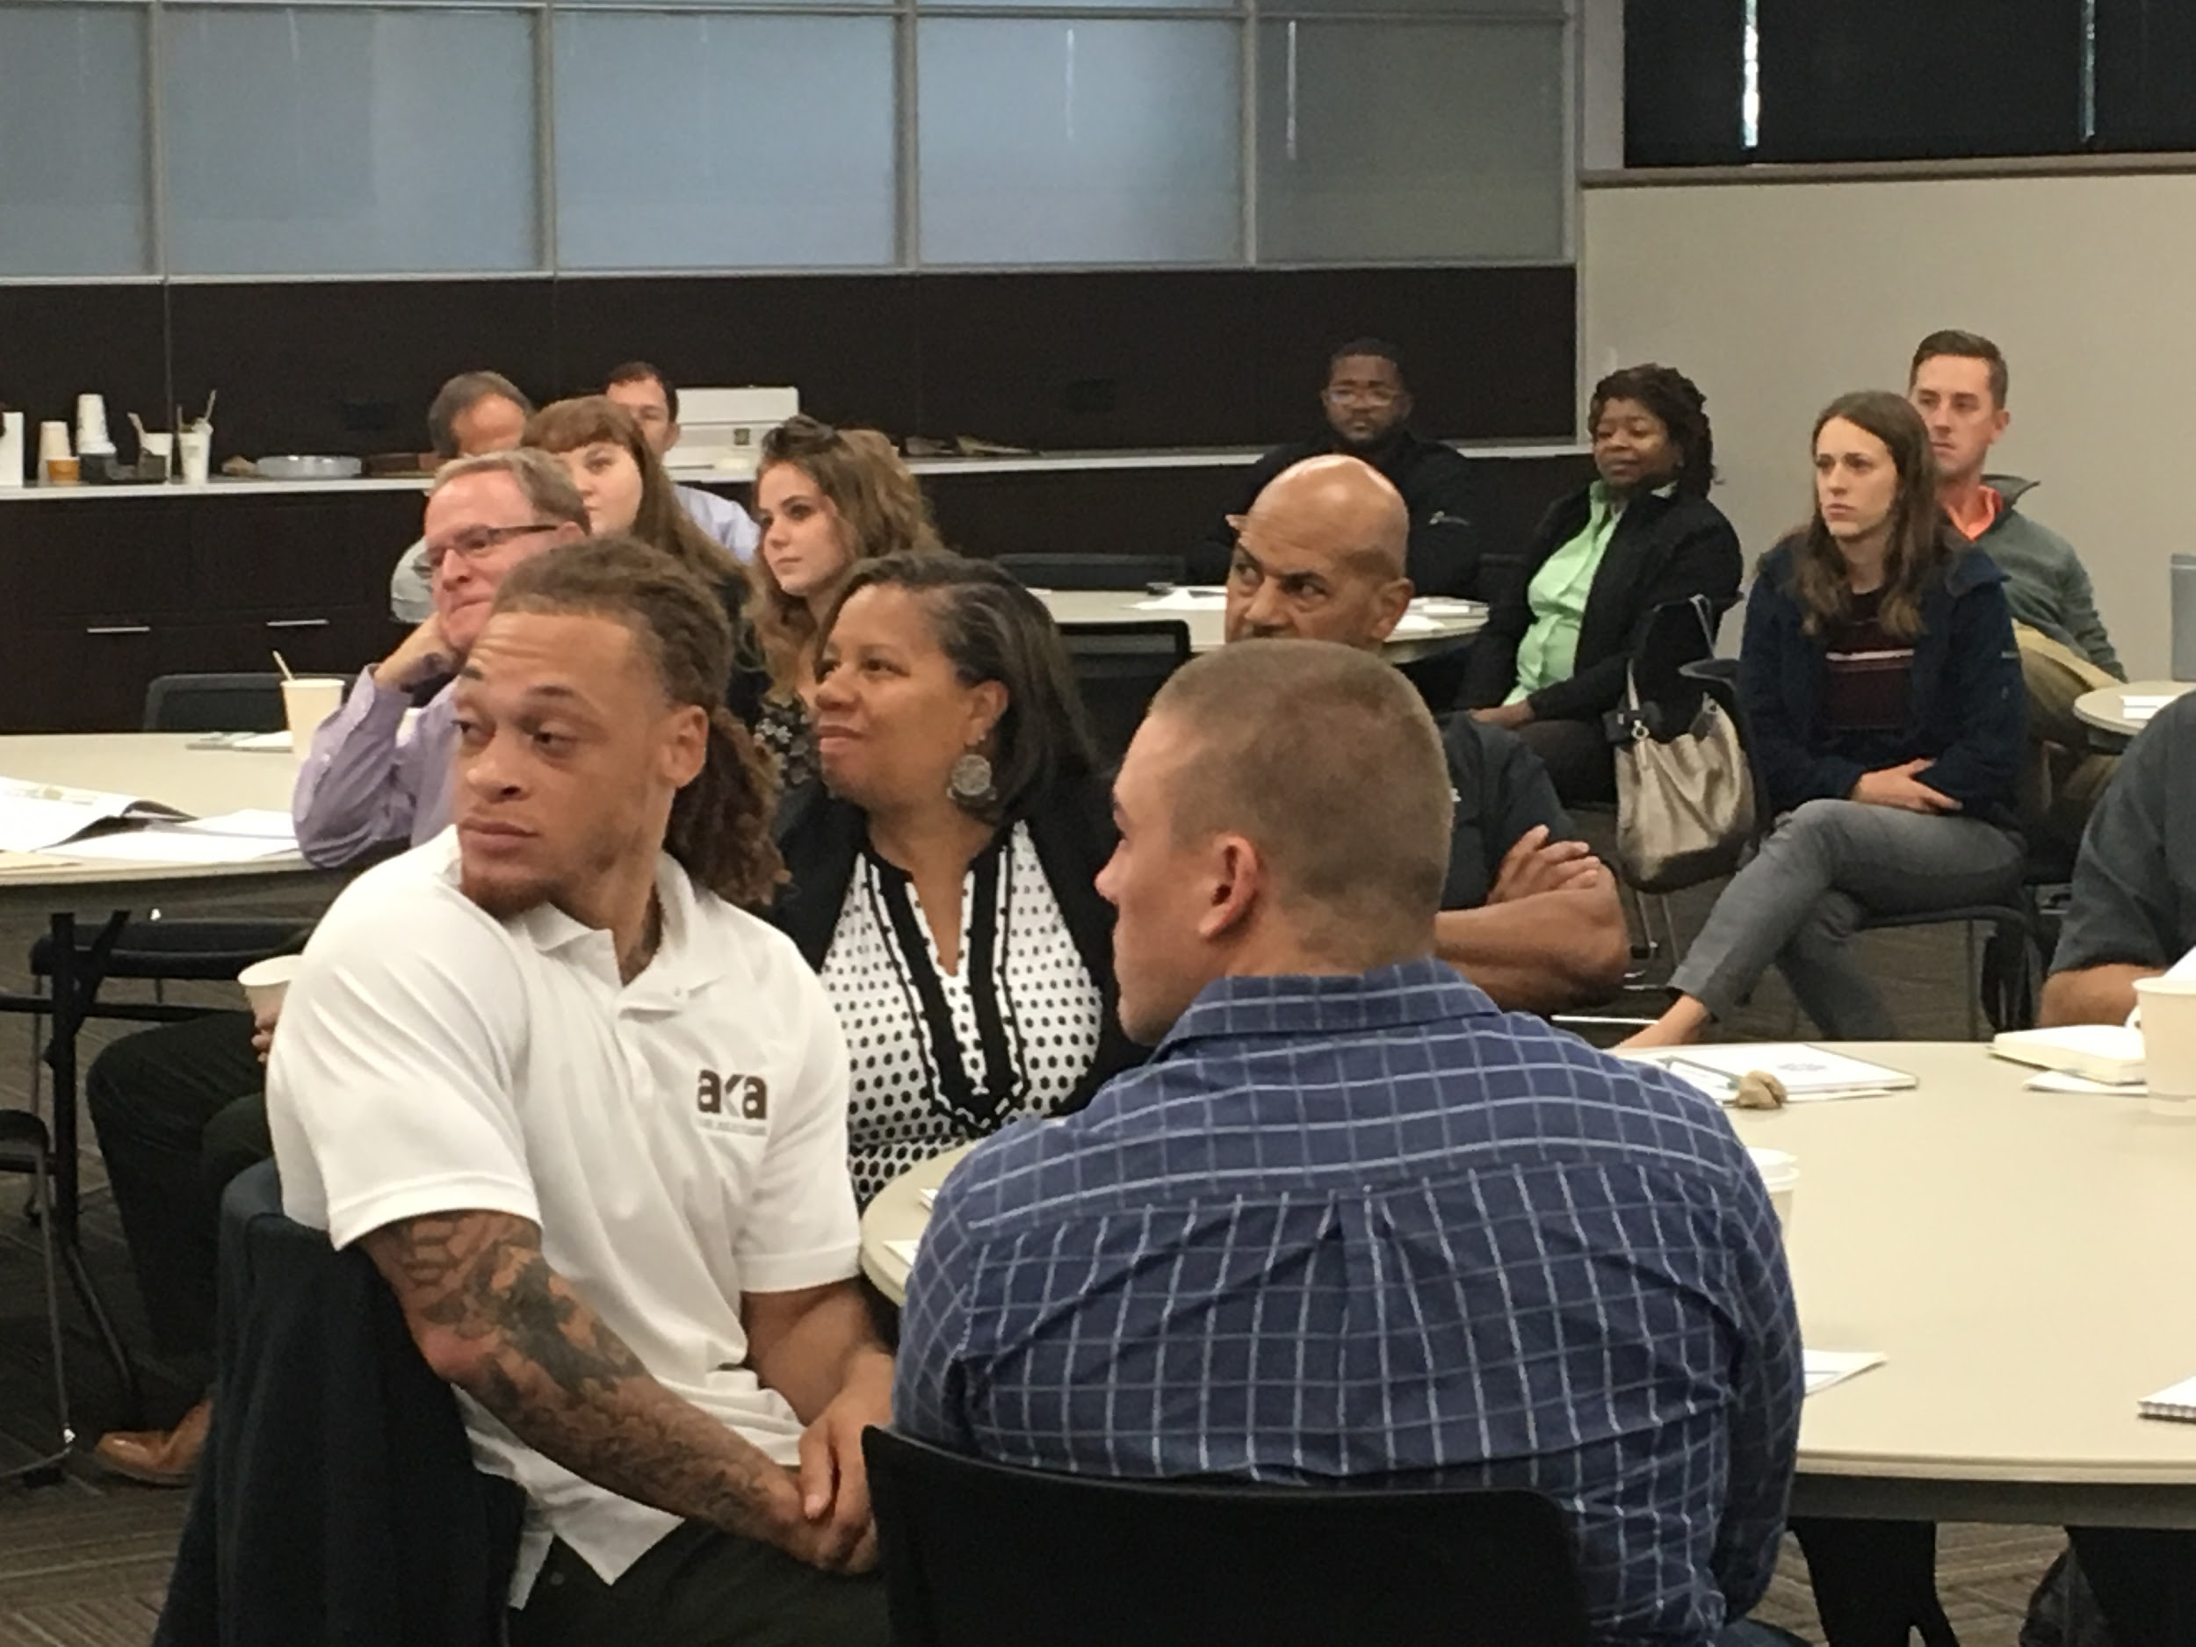
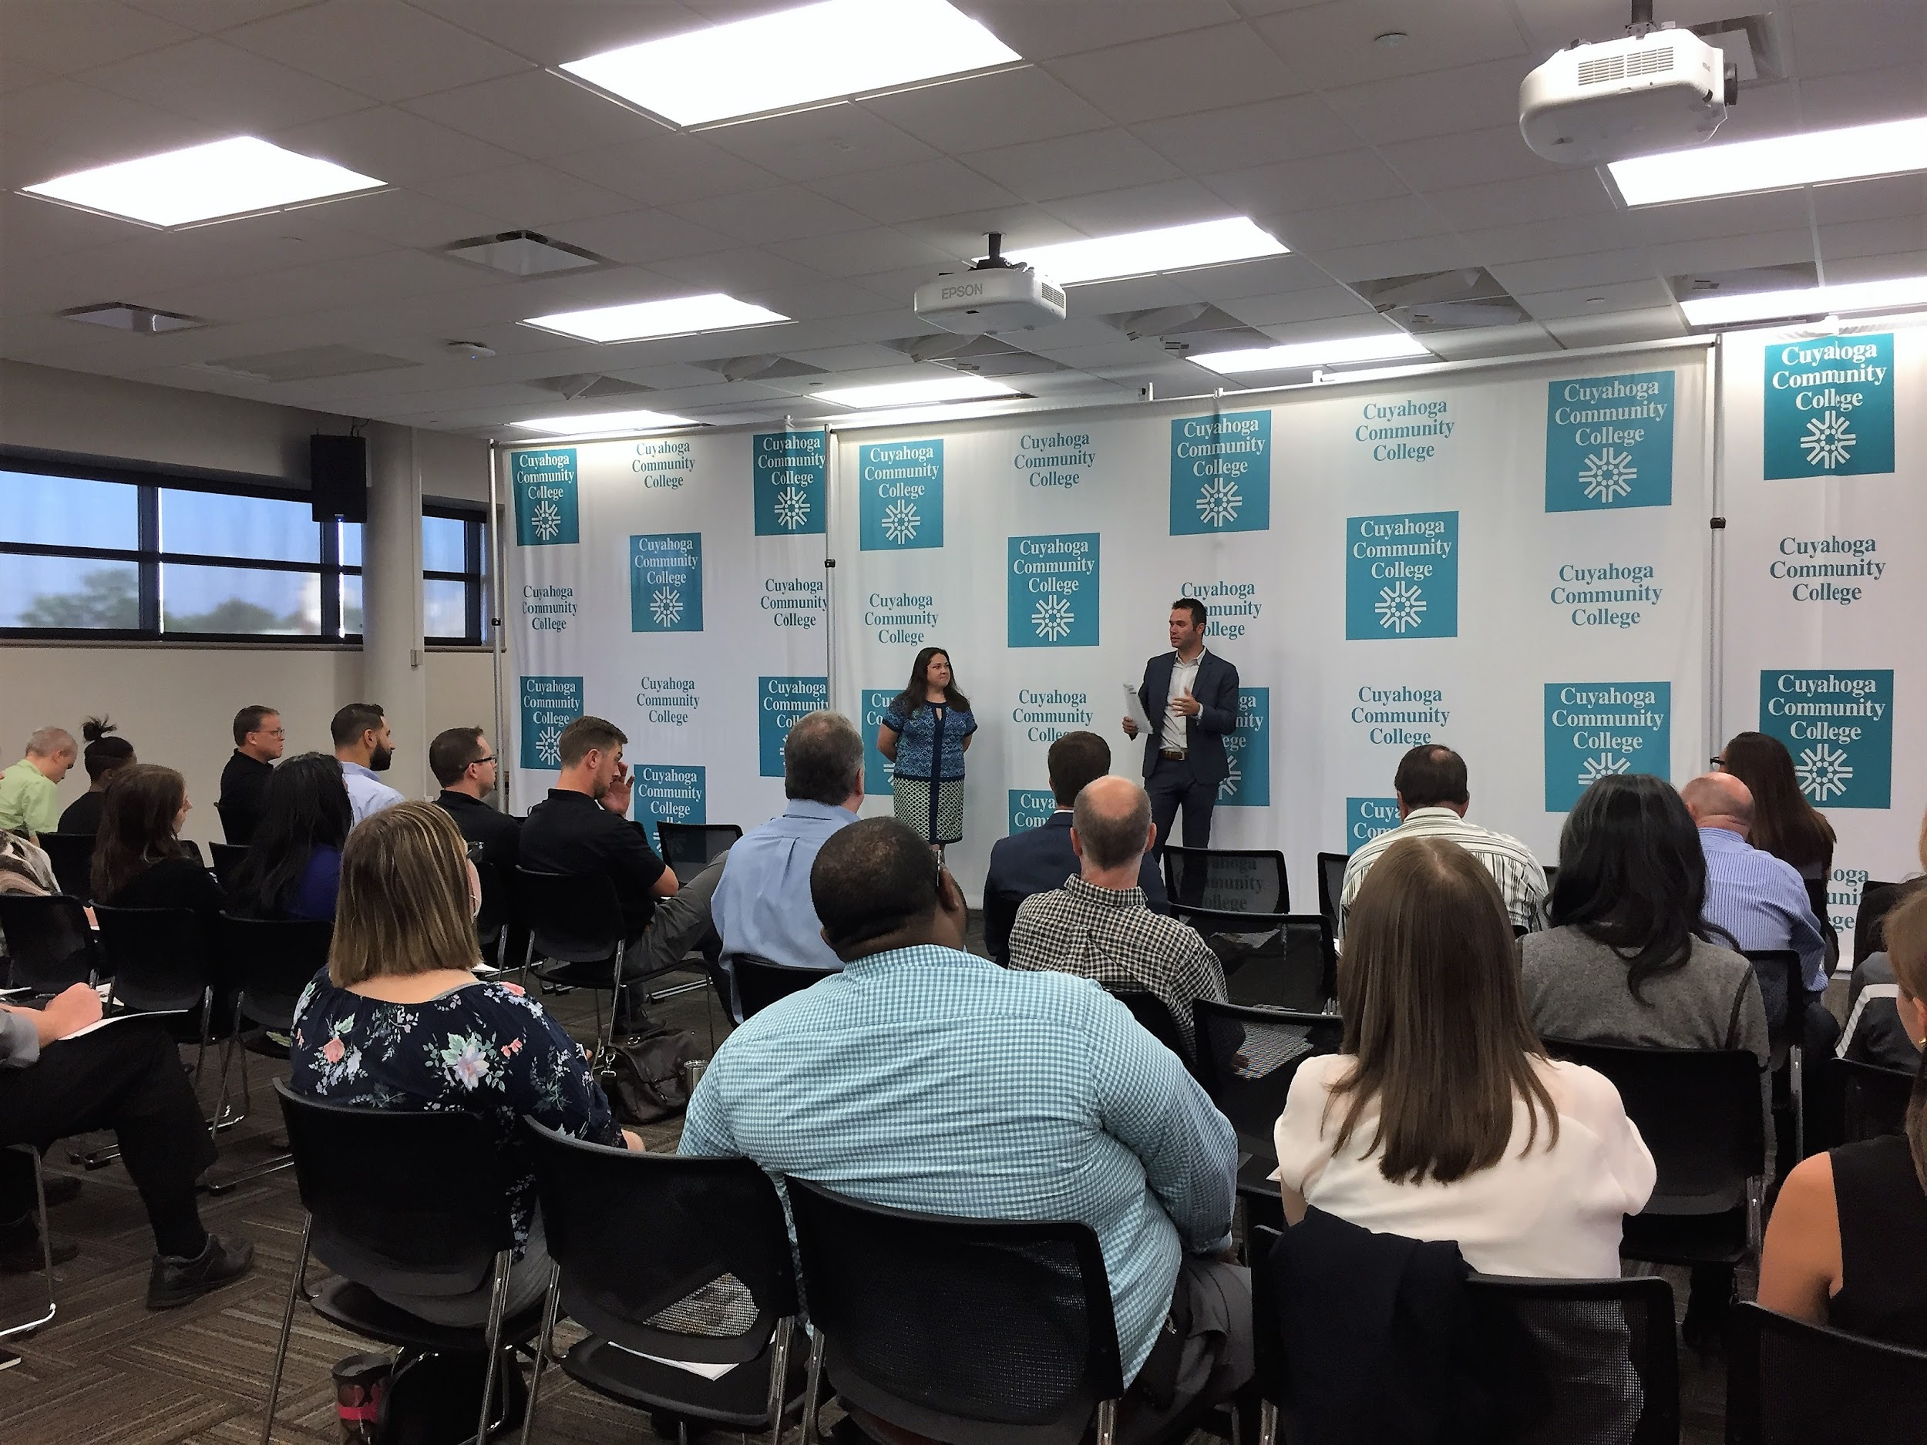
Annual Mentor Kickoff
Provide State of ACE Mentor (local and national) updates.
September event allows mentors from various schools/teams to meet, share best practices, unique resources, lesson plans and ideas.
Review ACE Mentor and Cleveland School policies and procedures.
Brief workshop on student engagement techniques.
Respective schools/team mentors spend 20 minutes together in breakout session

Slide 11
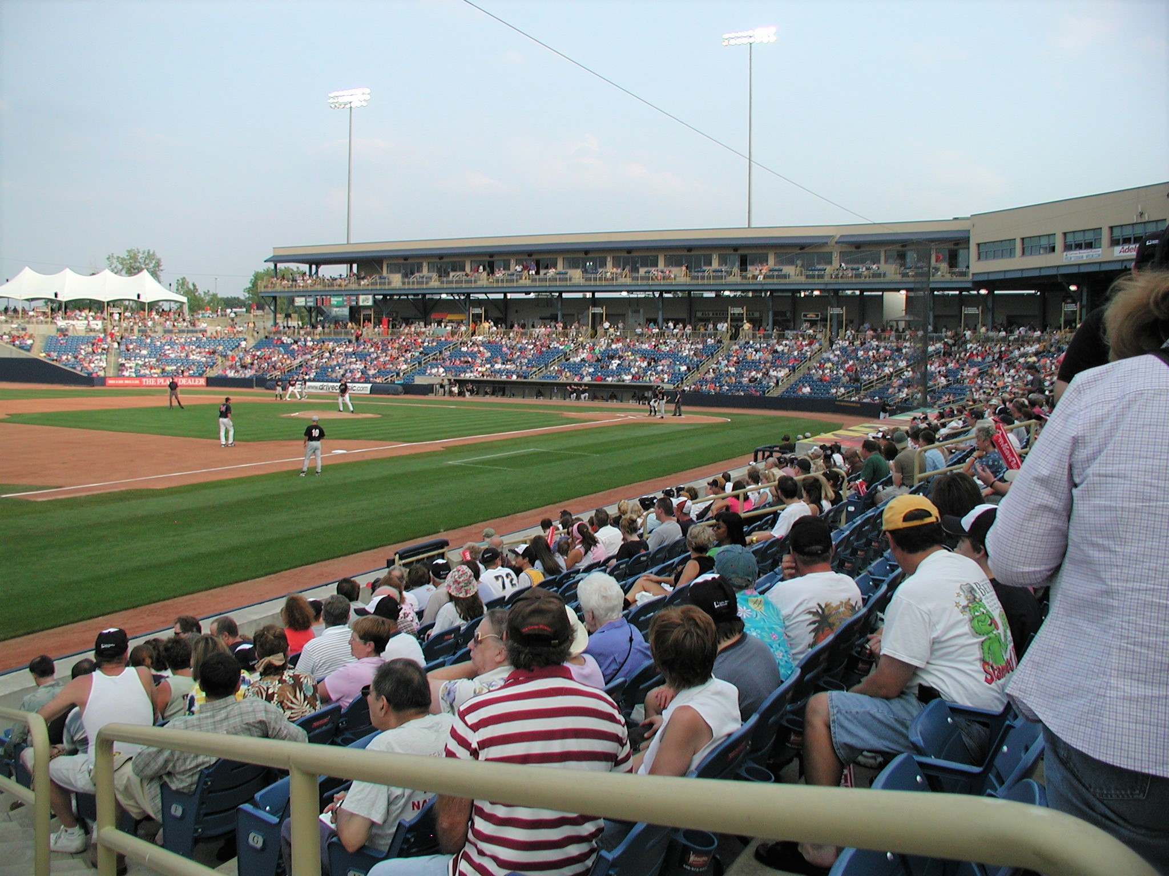
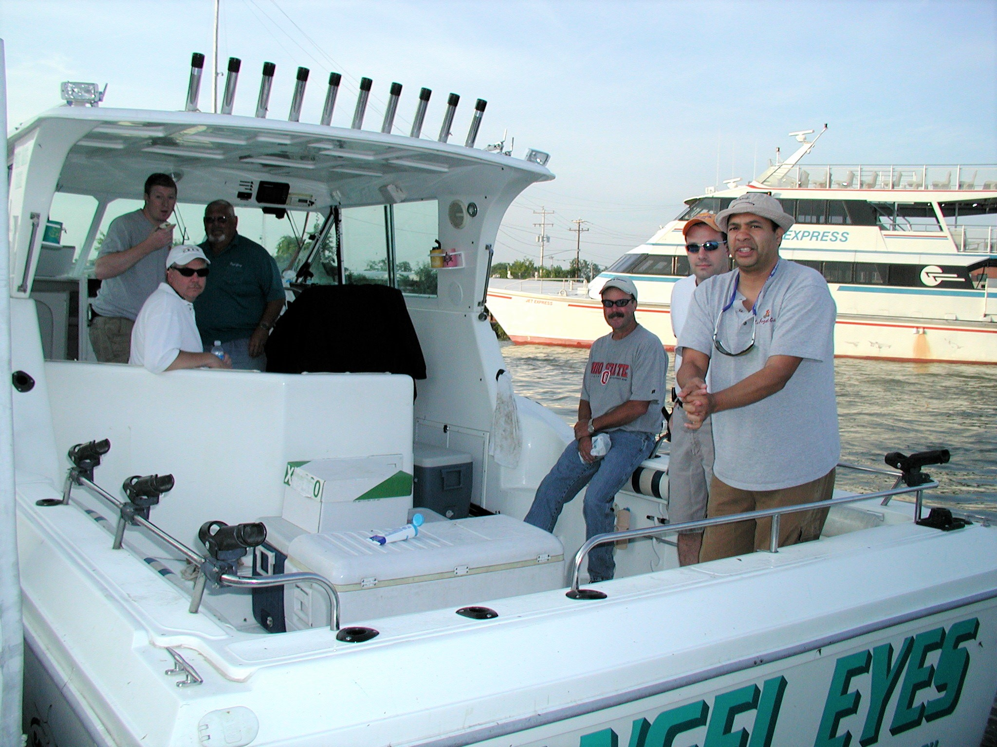
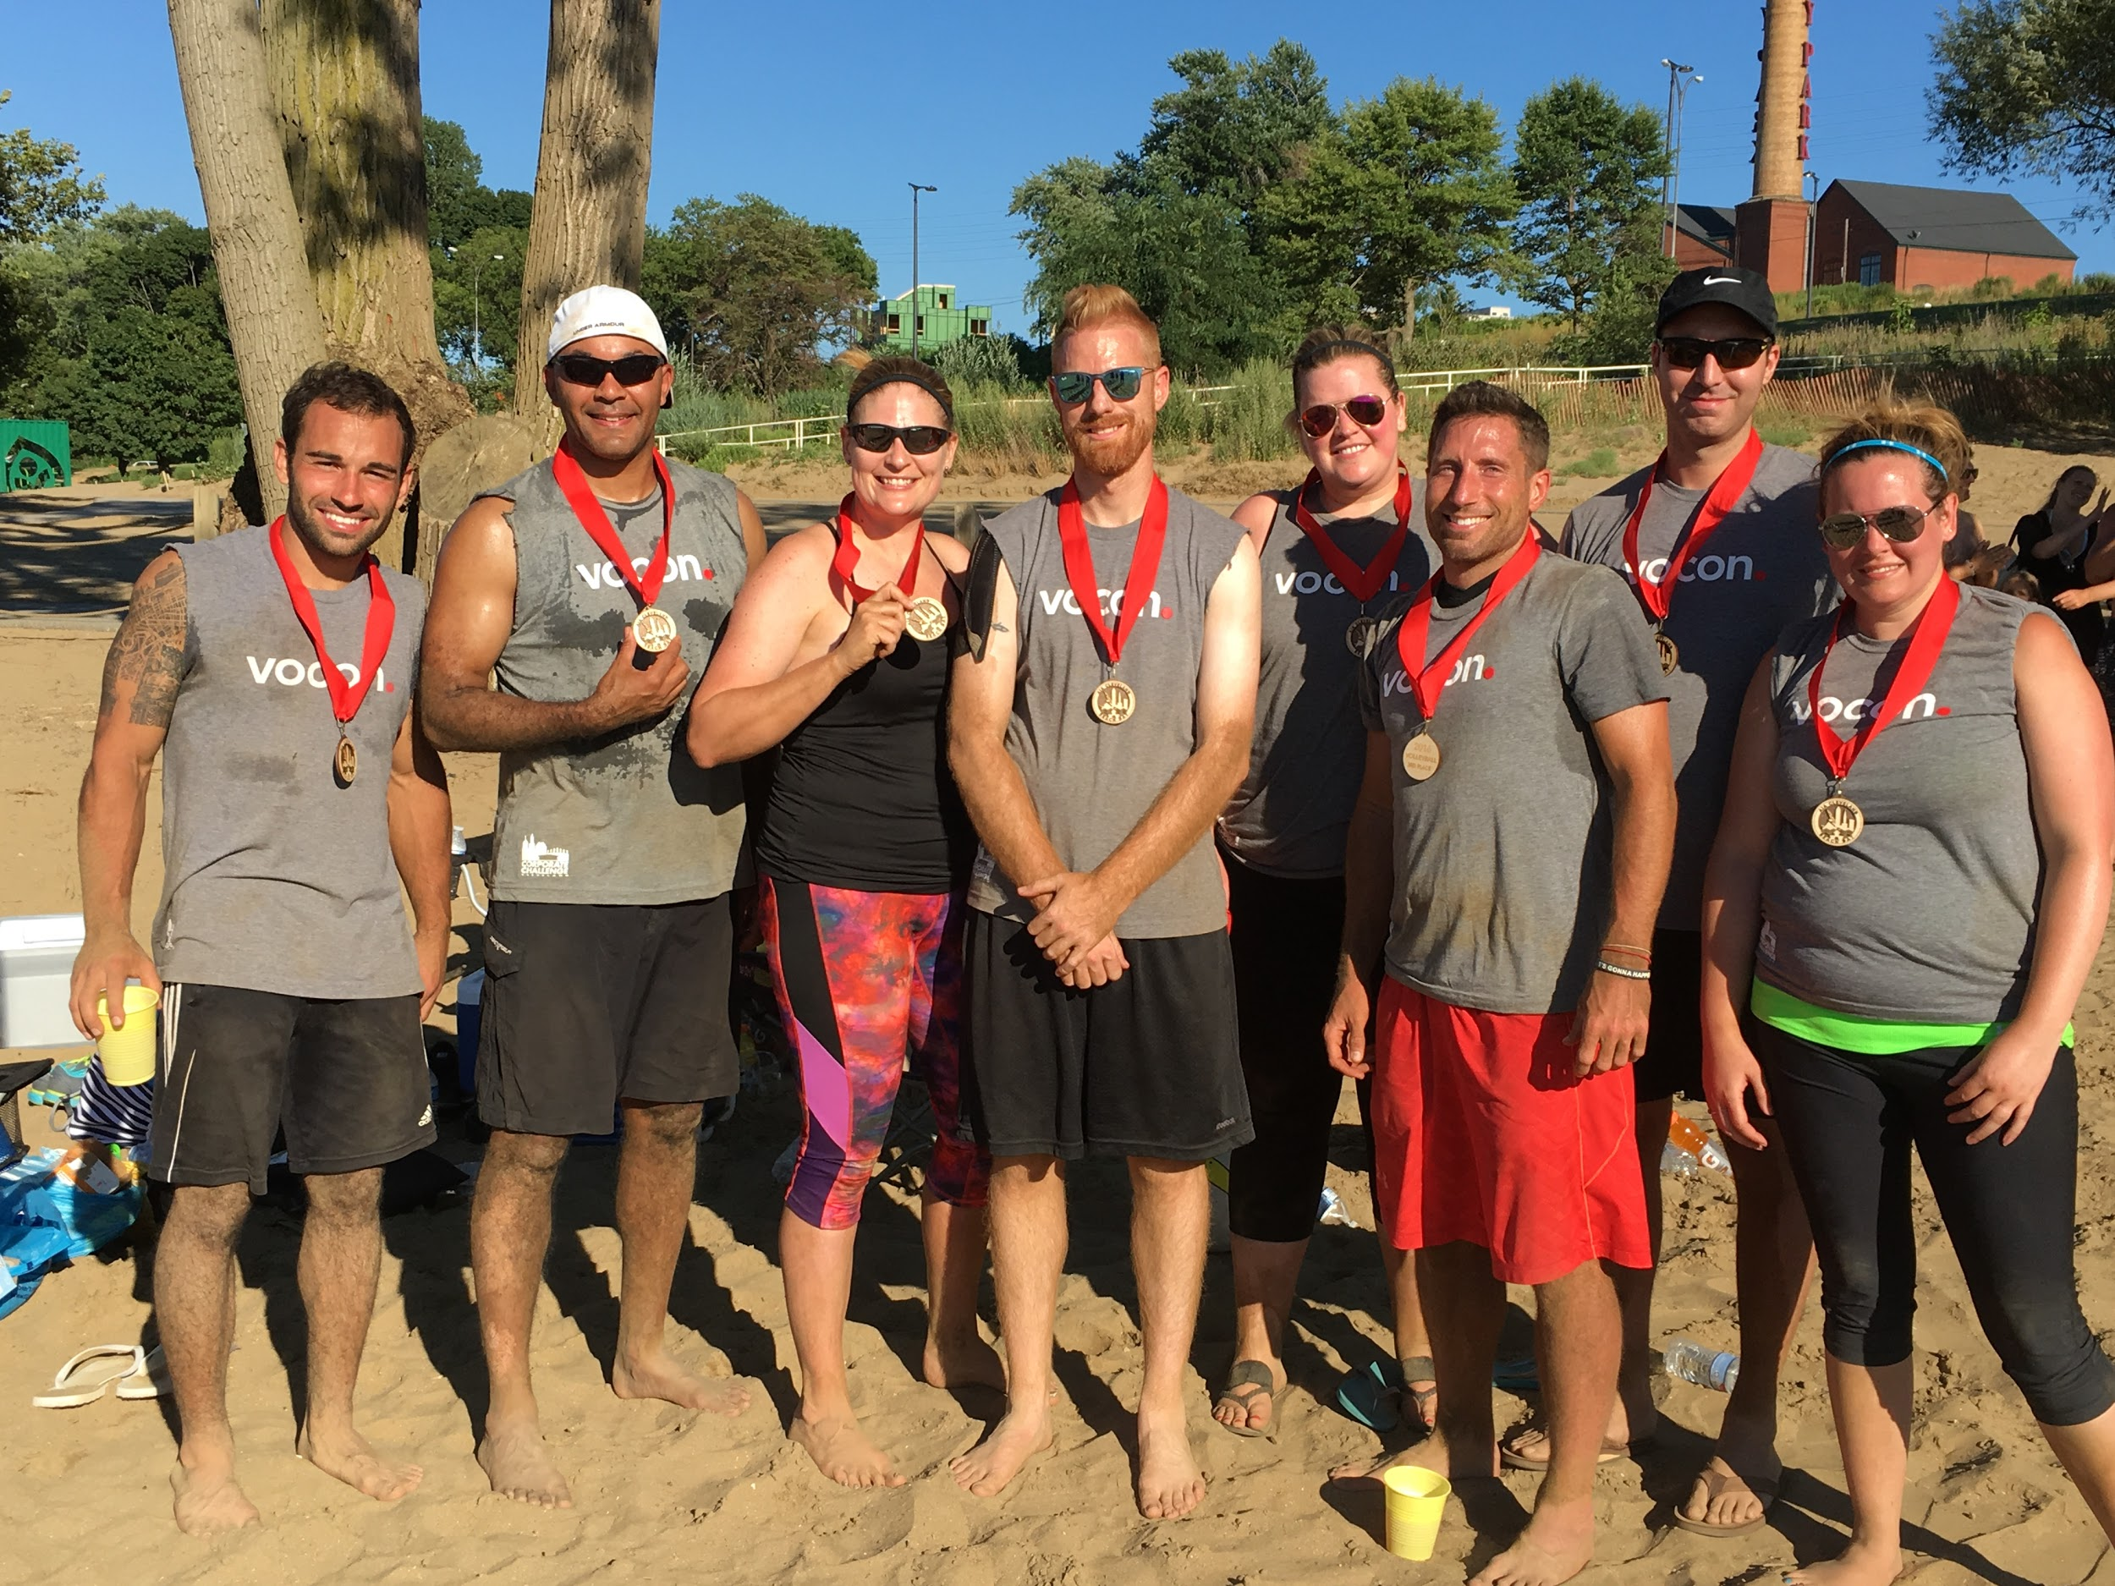
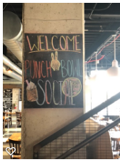
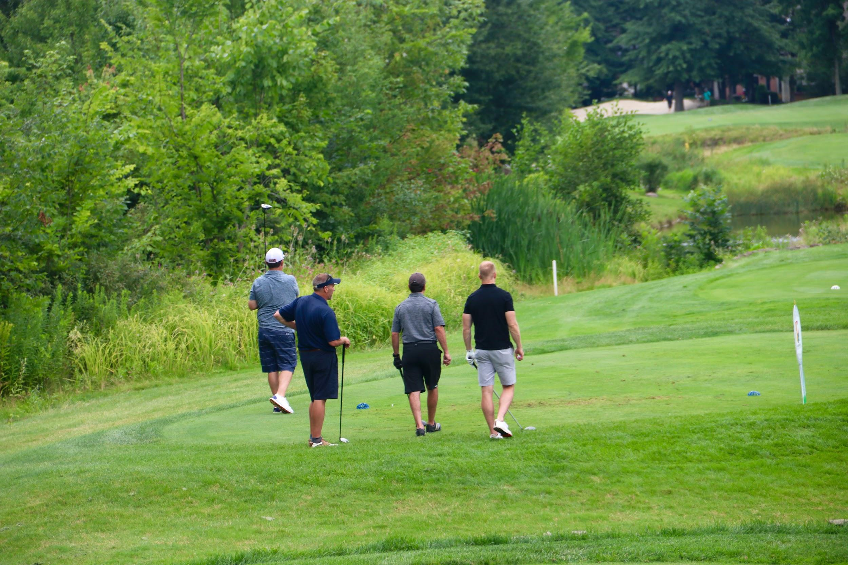
ACE Mentor Socials
Invite mentors to various Industry Associations social event (list as ACE Social).

Slide 12
ACE Communications and Recognition
ACE newsletter Bi-monthly distribution as well as website and social media posts
ACE industry partners (Construction (Employers Association, Cleveland AGC), AIA and Engineering Associations) newsletters.
Style guided profile sheets of numerous mentors, students, and teachers.
Features in Annual Report
Volunteer of the Year

Slide 13
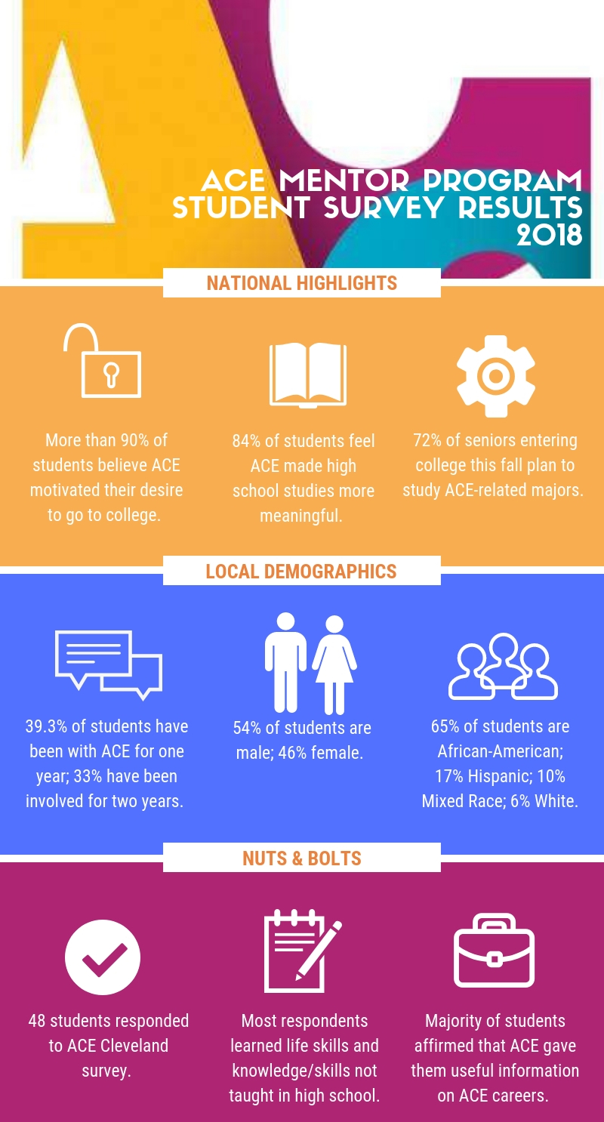
Annual Survey
Send to company executives of each active mentor, with letter of expressing thanks signed by Board Chair, Cleveland Schools CEO/Superintendent and Executive Director.
Send a letter of thanks to those who had expressed interest and/or were not active (attended less than 3 sessions).

Slide 14
MENTORS
Mentor Training
Mary Bradford
ACE Mentor Program of Greater DC

Slide 15
Why Mentor Training
“Programs with ongoing training made available to mentors showed greater effects in the mentoring relationship” (DuBois, Holloway, et al., 2002)
“Findings show the need for agencies to provide initial training, ongoing support, and to ensure their mentors are confident in their abilities as a mentor to guarantee that their mentors are satisfied in their relationships, perhaps making them more likely to continue mentoring.”(Martin, Sifers, 2012)
“Mentoring programs without training and periodic supervision achieve modest effects at best, and could negatively impact the mentee at worst.” (Martin, Sifers citing Rhodes, Grossman, and Roffman (2002))
Notes:
Mentoring: A Promising Strategy for Youth Development By Susan M. Jekielek, M.A., Kristin A. Moore, Ph.D., Elizabeth C. Hair, Ph.D., and Harriet J. Scarupa, M.S. February 2002
“youth satisfaction in structured mentoring relationships doubled when compared to relationships less than a year” – Mentoring, a promising strategy for youth development
An evaluation of factors leading to mentor satisfaction with the mentoring relationship
Shannon M. Martin ⁎, Sarah K. Sifers
Minnesota State University, Mankato, United States
Rhodes, J. E., Grossman, J. B., & Roffman, J. (2002). The rhetoric and reality of youth
mentoring. New Directions for Youth Development, 93, 9–20
“Training for mentors both before and after they are matched with youth also appears to be key to successful mentoring relationships. Mentors who received the most hours of training had longer lasting matches” (Jekielek, Moore, Hair, Scarupa 2002)
-Positive outcomes for youth correlates directly to the length of the relationship

Slide 16
Training Benefits
Pre Match Training
Effective Screening Tool
Determine volunteers desire to commit and be consistent
Recruitment Tool
Ongoing training
Supplements match support
Ongoing training motivates mentors, helps them handle the difficulties that arise as they really get to know their mentees, lets them know they have support from program staff, and allows them to talk about their relationships with other mentors. (Cannata, 2006)
Can be tailored to issues occurring within the program or on teams
Ongoing screening tool
Risk reduction
“Ongoing training also helps programs manage risk. During regular ongoing training sessions, program staff have a chance to interact in person with mentors. During these sessions mentors are more likely to talk openly and in depth about their relationships. ” (Cannata, 2006)
Highlight effective activities and keep mentors motivated
Notes:
Mentoring: A Promising Strategy for Youth Development By Susan M. Jekielek, M.A., Kristin A. Moore, Ph.D., Elizabeth C. Hair, Ph.D., and Harriet J. Scarupa, M.S. February 2002
“youth satisfaction in structured mentoring relationships doubled when compared to relationships less than a year” – Mentoring, a promising strategy for youth development
An evaluation of factors leading to mentor satisfaction with the mentoring relationship
Shannon M. Martin ⁎, Sarah K. Sifers
Minnesota State University, Mankato, United States
Rhodes, J. E., Grossman, J. B., & Roffman, J. (2002). The rhetoric and reality of youth
mentoring. New Directions for Youth Development, 93, 9–20
“Training for mentors both before and after they are matched with youth also appears to be key to successful mentoring relationships. Mentors who received the most hours of training had longer lasting matches” (Jekielek, Moore, Hair, Scarupa 2002)
-Positive outcomes for youth correlates directly to the length of the relationship

Slide 17
Orientation vs. Training
Training “is a focus on STRENGTHENING mentors’ KNOWLEDGE and SKILLS for how to develop and sustain high-quality and effective relationships with their mentees.”
ORIENTATION is going over rules, regulations and policies
EFFECTIVE Training program will have BOTH!
http://www.nationalmentoringresourcecenter.org/index.php/14-practices/107-pre-match-training-for-mentors.html

Slide 18
Training Topics to Cover
Suggested Orientation Topics
Mandated Reporters (i.e. child abuse and neglect)
Program policies (i.e. meeting location and requirements, role of team leaders, modes of communication, need for parent consents, etc.)
Program Procedures (reimbursements, setting up field trips, what to do in an emergency, how to use the database)

Slide 19
Training Topics to Cover
Suggested Skills Training Topics
How to be a great ACE Mentor
How to effectively engage with High School Students
How to run an ACE Session
Goal Setting
Relationship Development
Communication skills
Diversity and inclusion
Positive Youth Development

Slide 20
MENTORS
Team Leader Training
Thai Nguyen
ACE Mentor Program of Los Angeles/Orange County

Slide 21
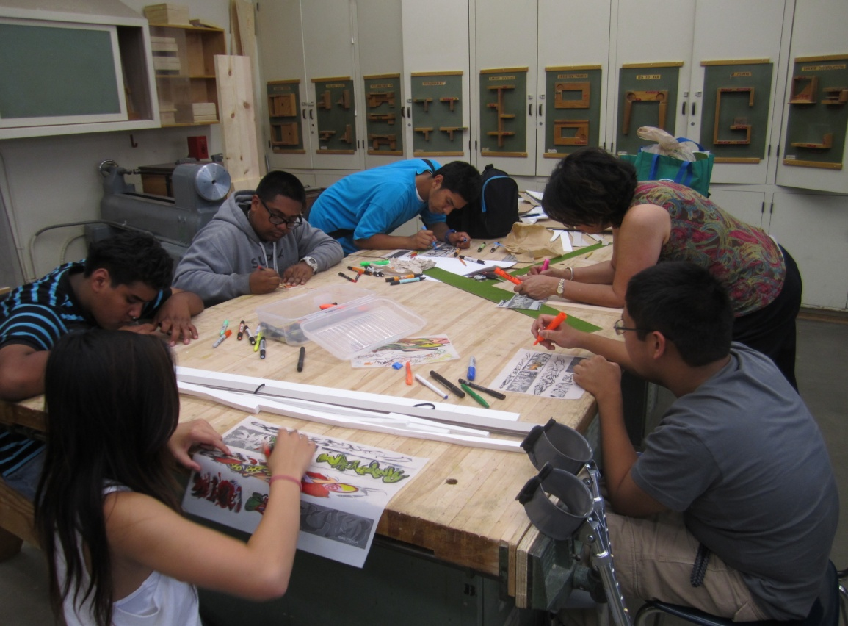
Team Leader Training
Step #1 - Identification
Leadership opportunity
Desire
Time commitment
Other team leaders help identify potential new team leaders

Slide 22
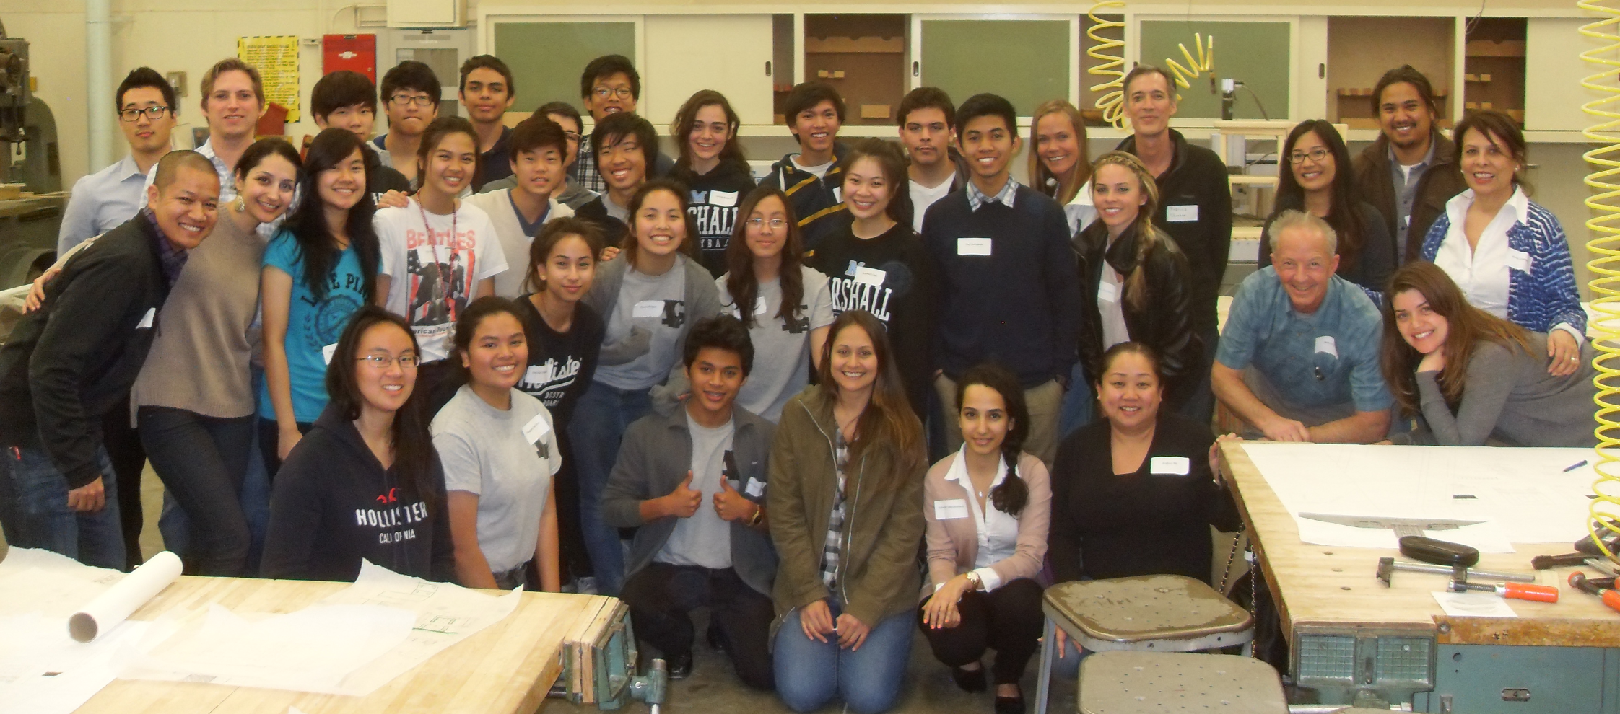
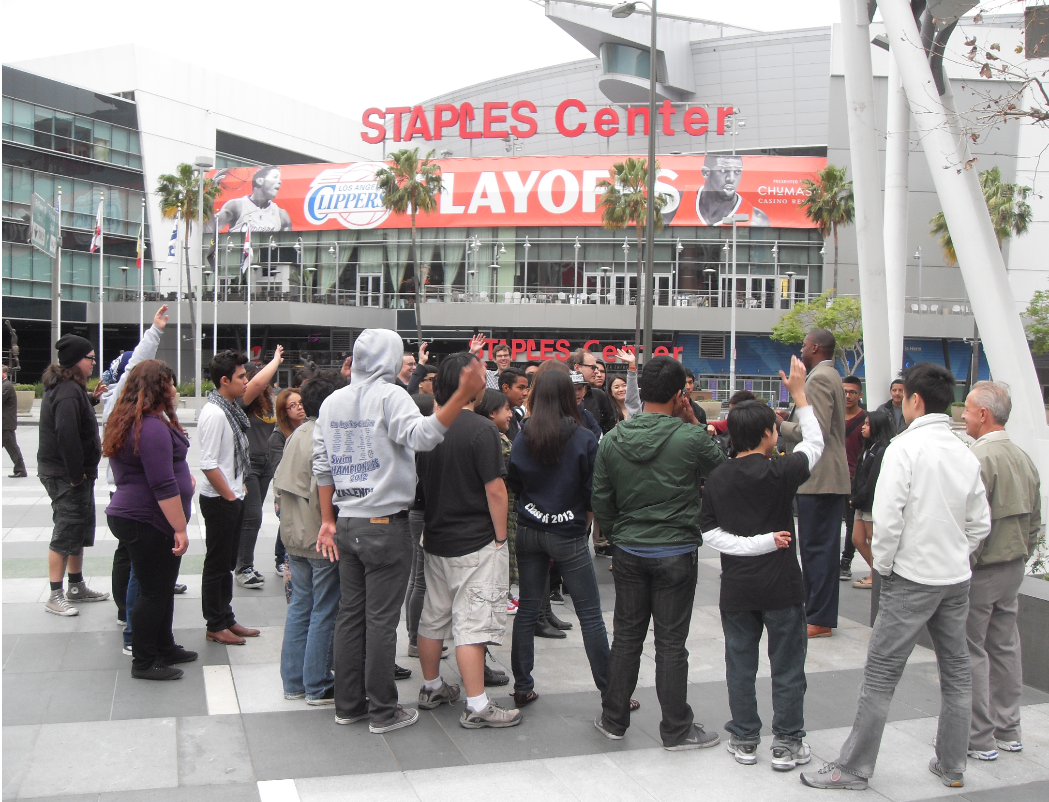
Team Leader Training
Step #2 - Team
A strong team leader is only strong when equipped with a team
Identify the co-team leader
Faculty Advisor
Board pairing
Succession planning

Slide 23
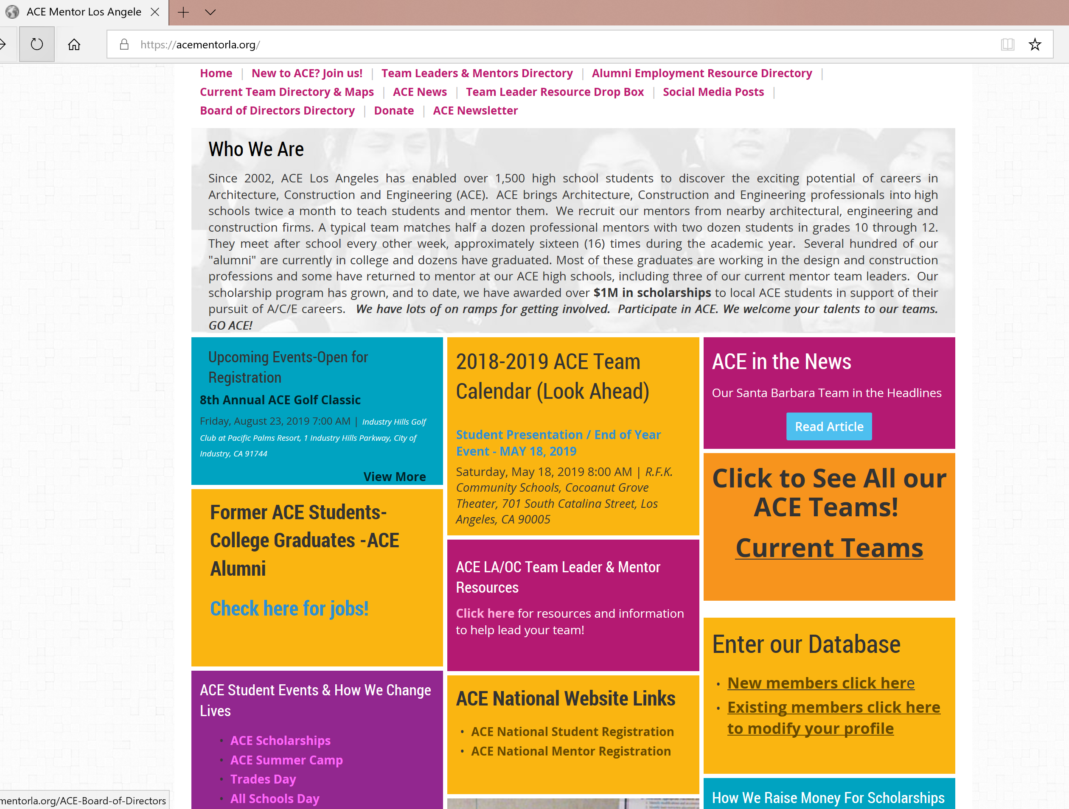
Team Leader Training
Step #3 - Resources
www.acementorla.org
“How to”
ACE in a box

Slide 24
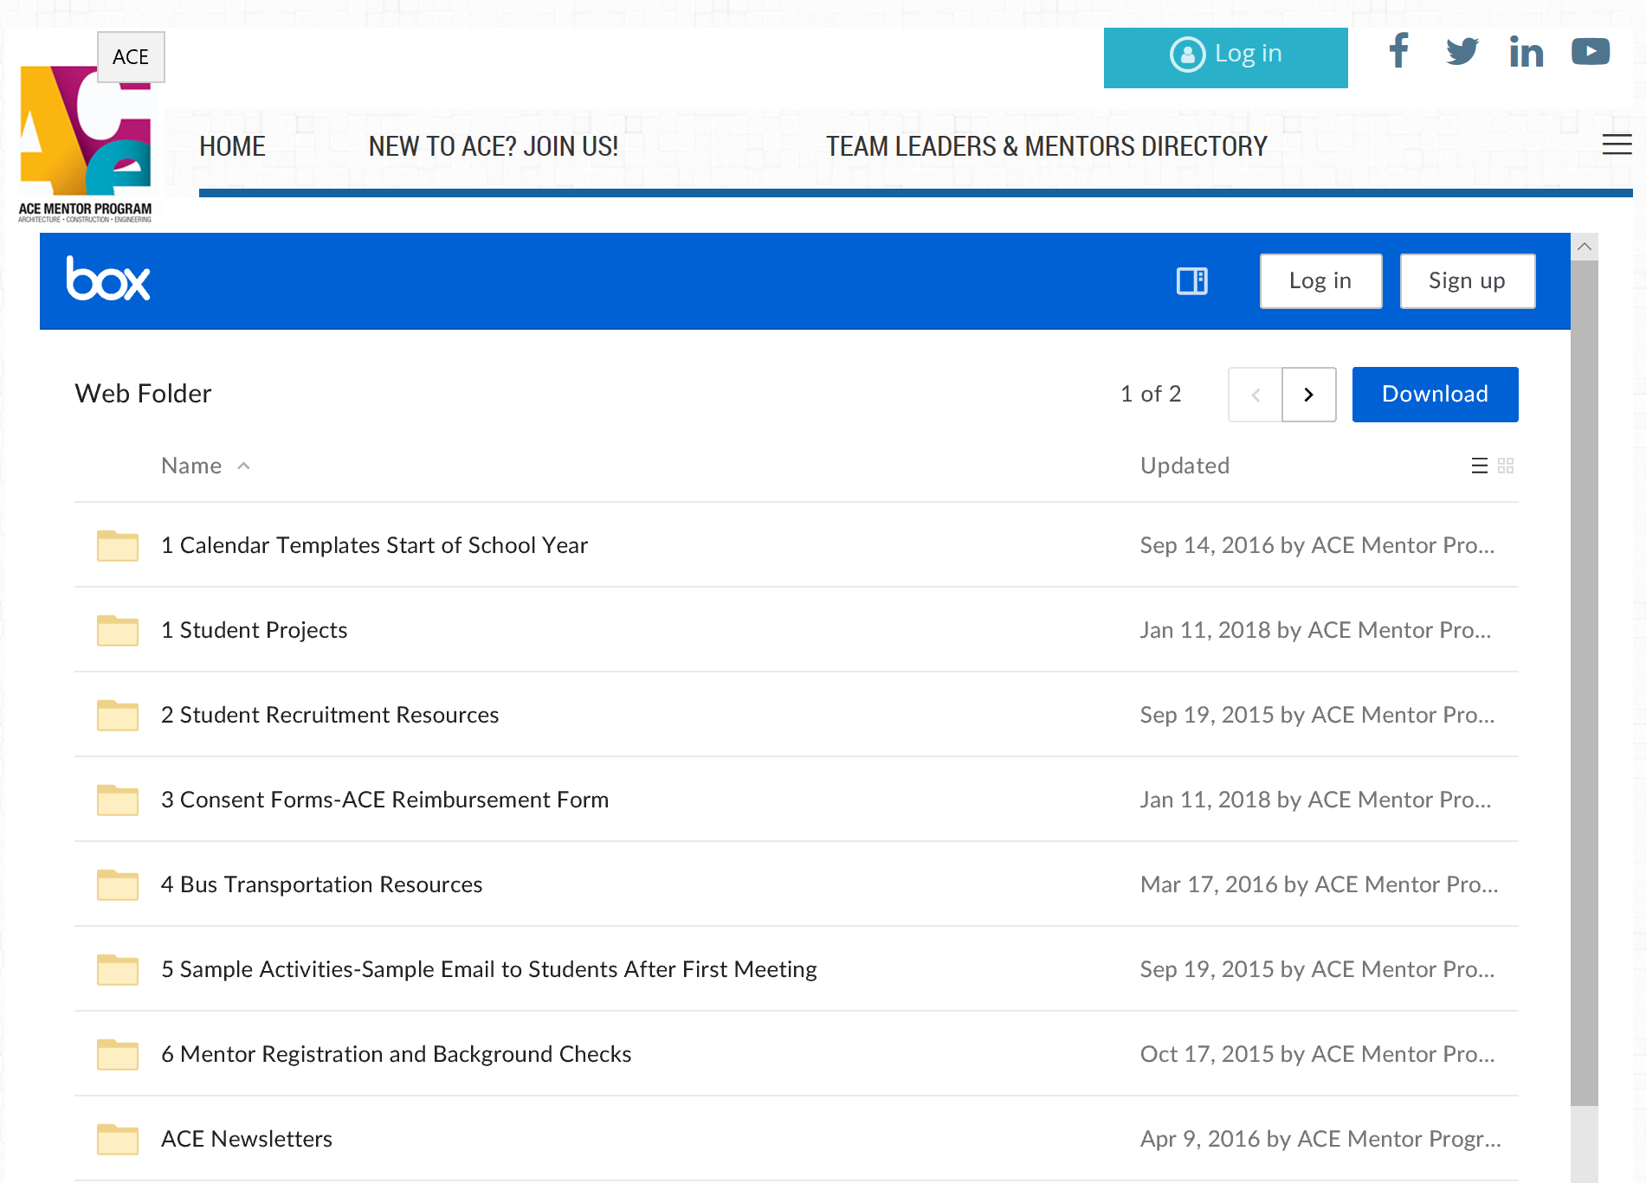
Team Leader Training
Step #3 - Resources

Slide 25
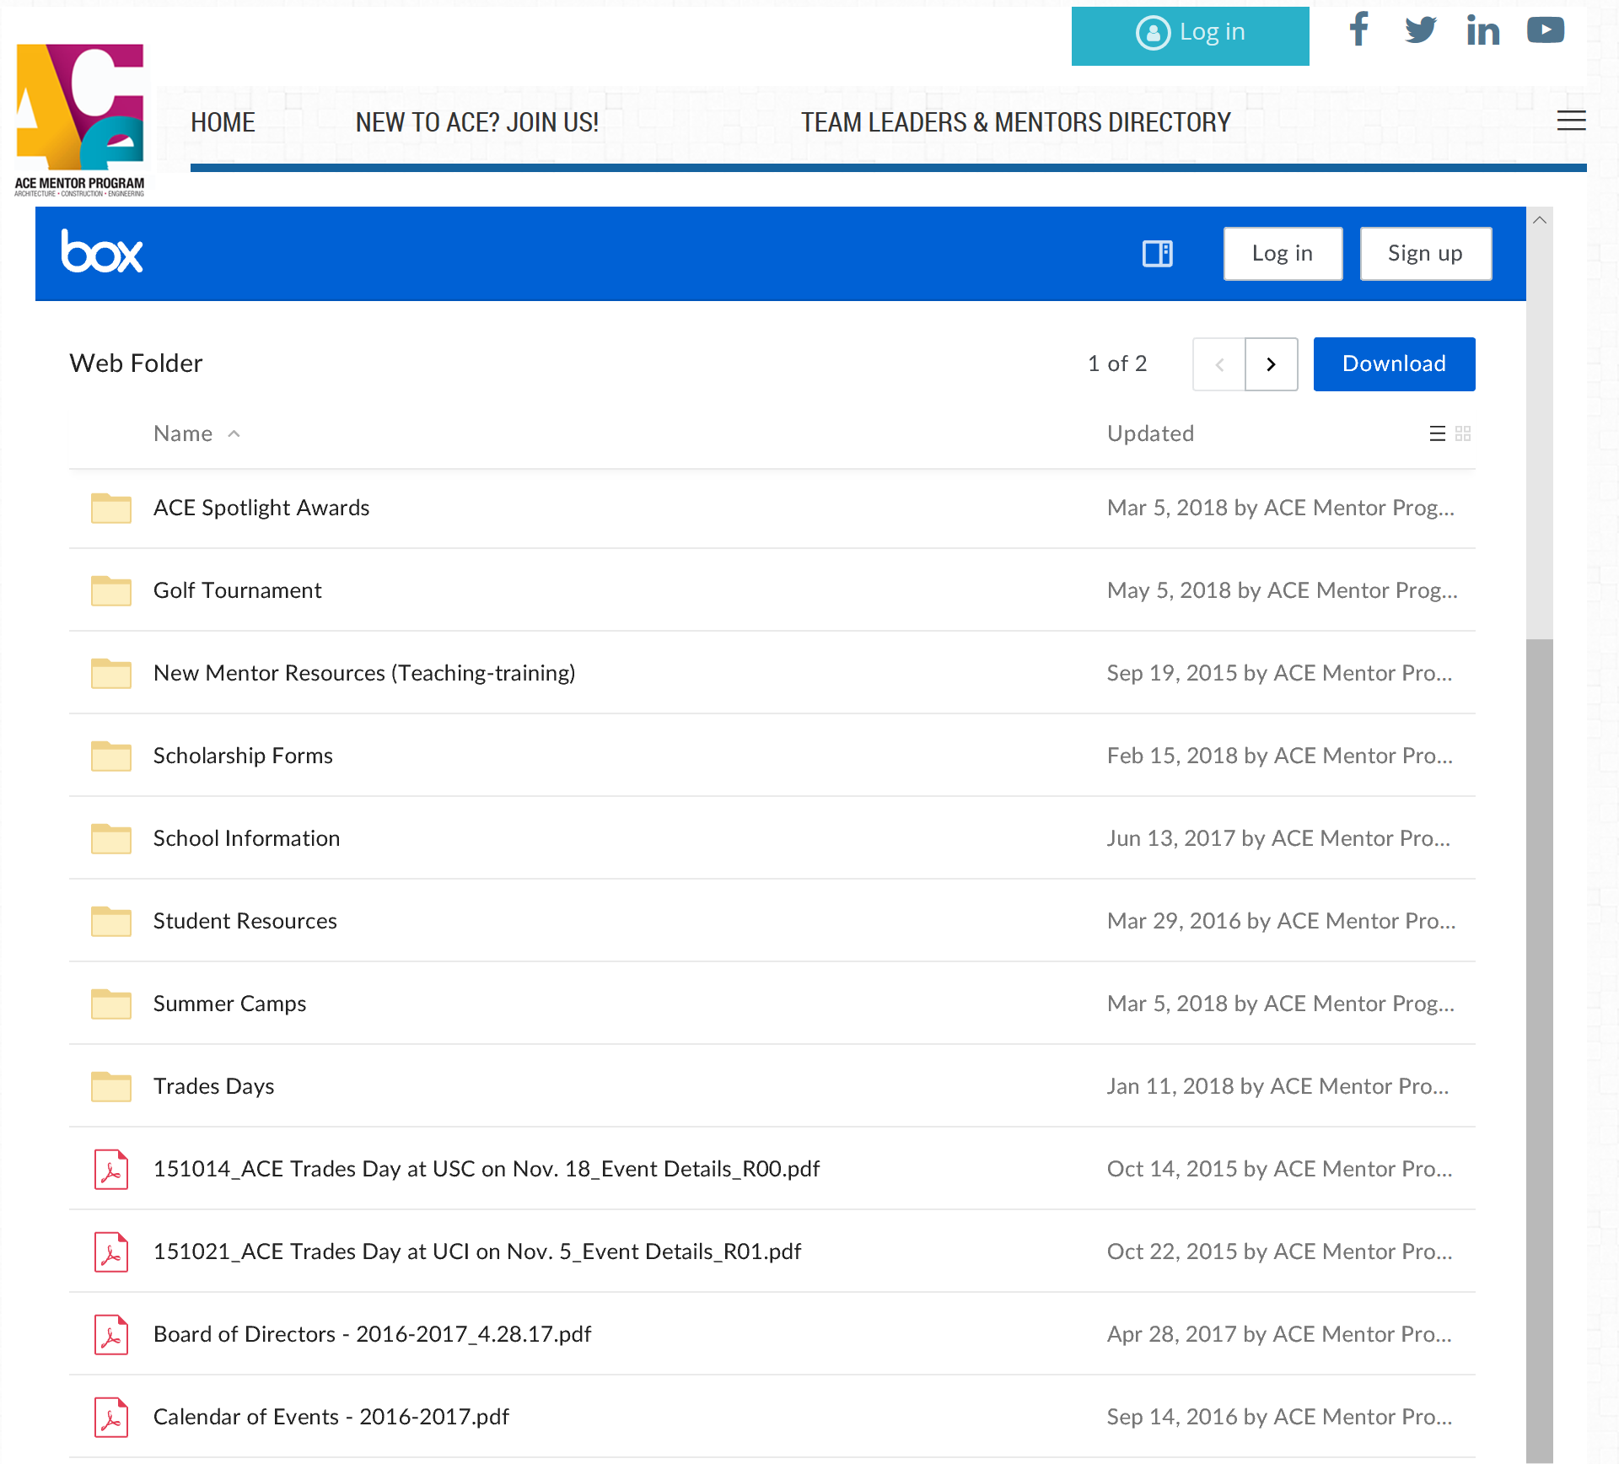
Team Leader Training
Step #3 - Resources

Slide 26
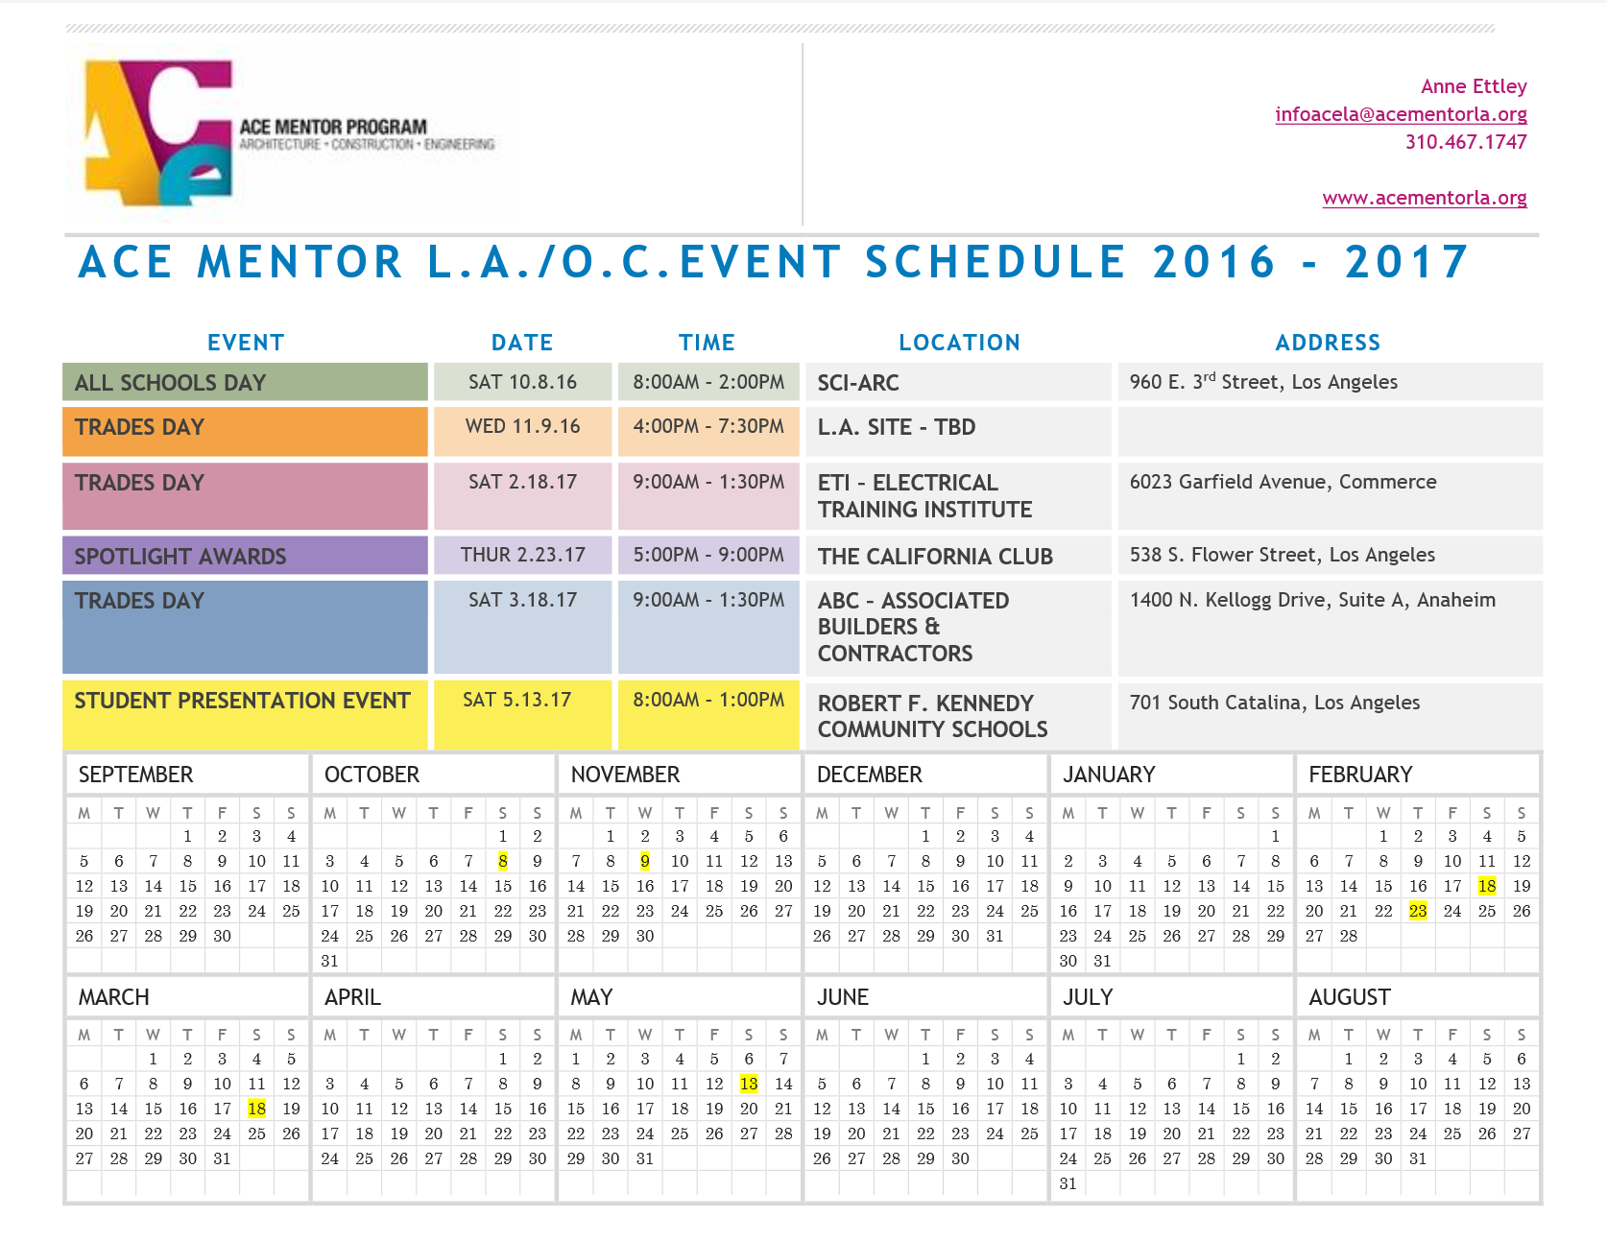
Team Leader Training
Step #4 - Organization
Have a kick-off meeting with your mentors (trick them with pizza - it works for mentors too!)
Meet with the faculty advisor prior to the school year starting
Create a calendar

Slide 27
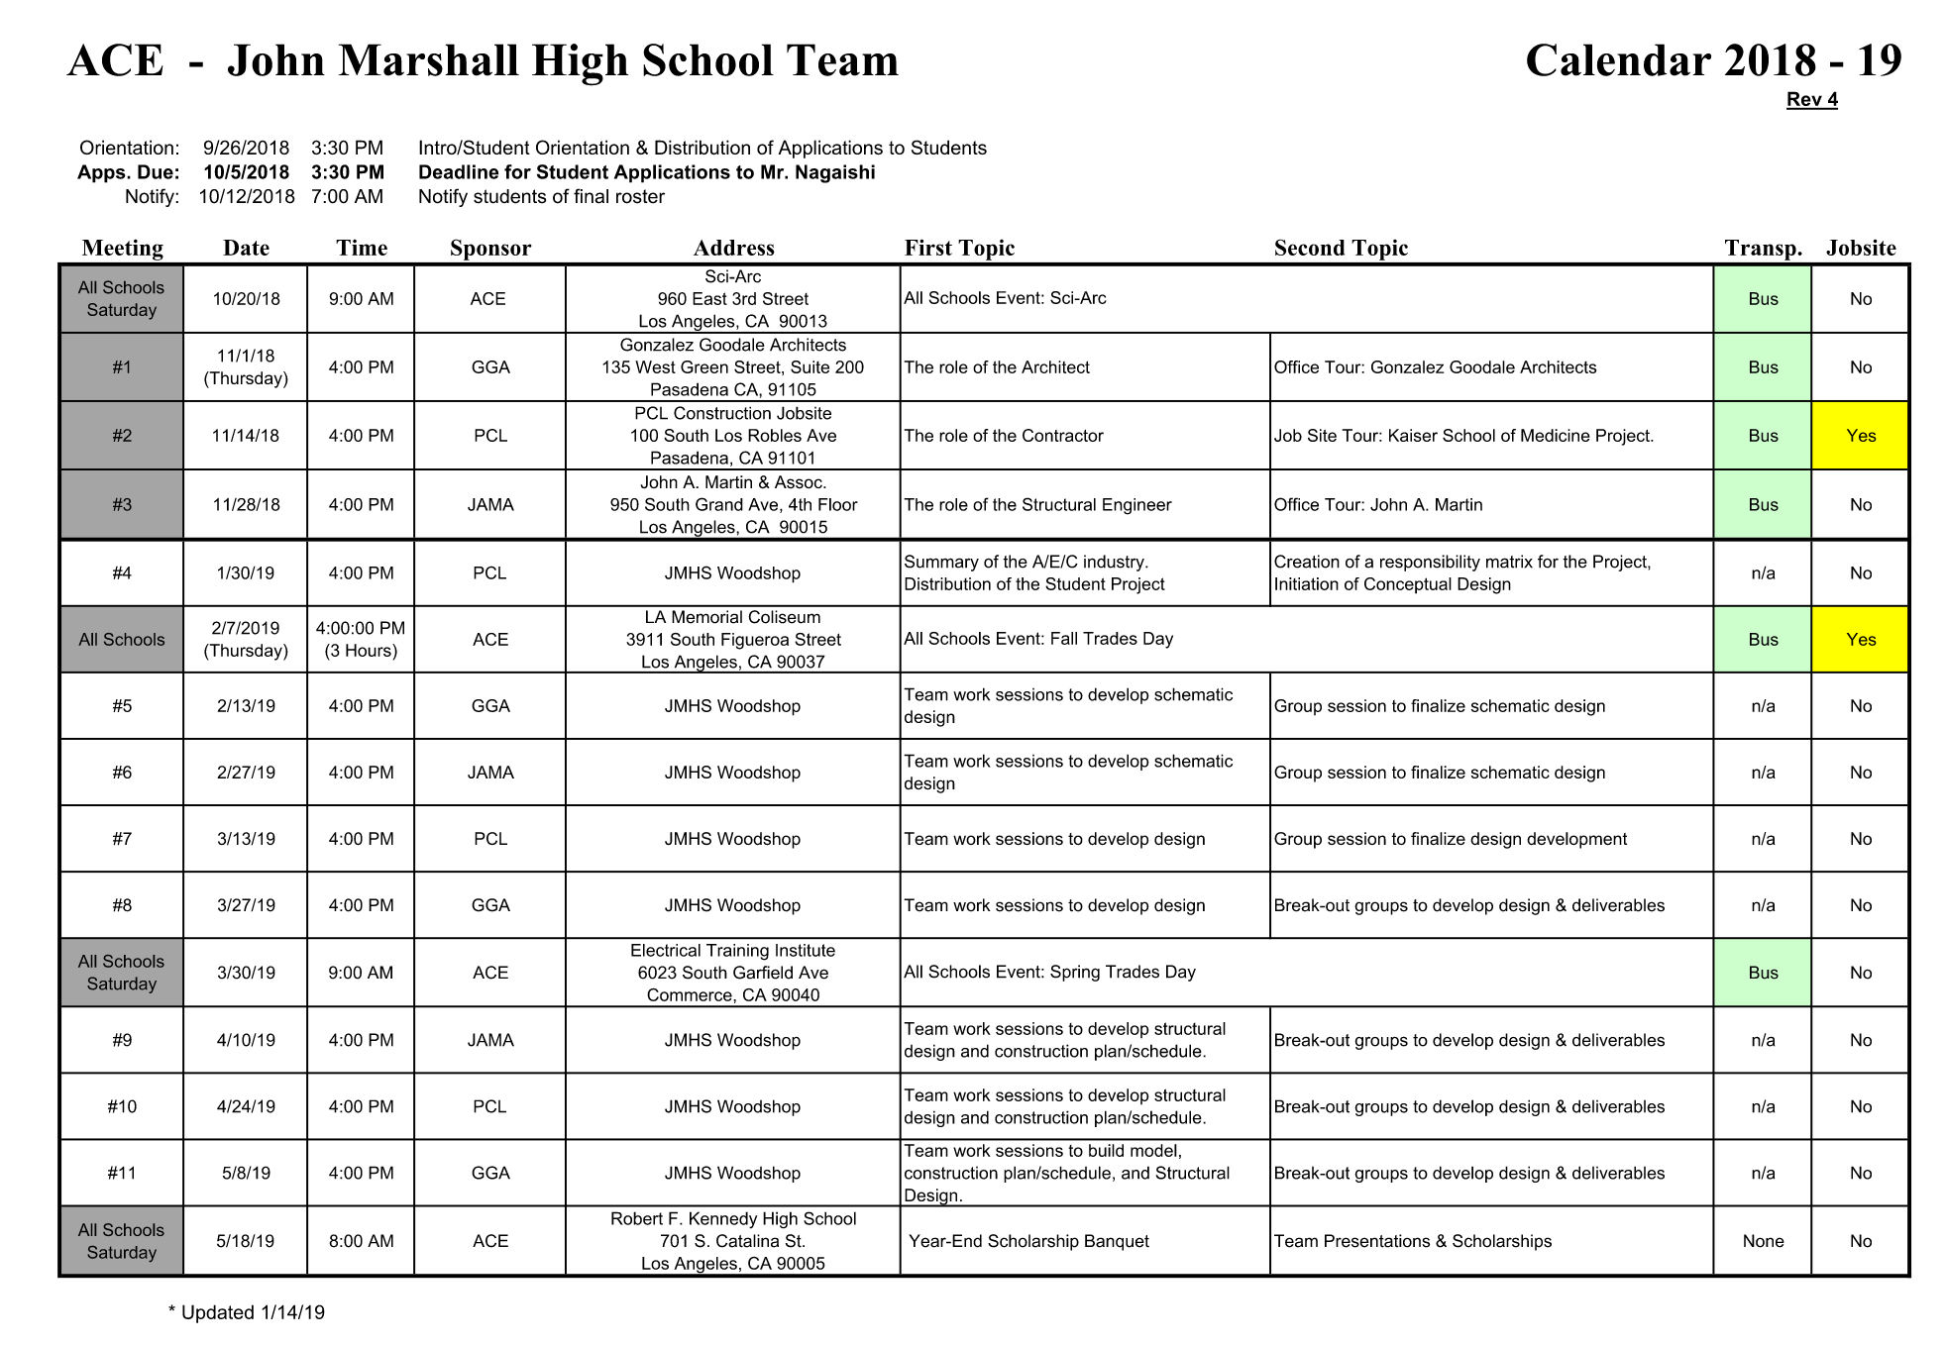
Team Leader Training
Step #4 - Organization
Introduction meeting at the school for the students
Have student packet ready with ACE school year calendar

Slide 28
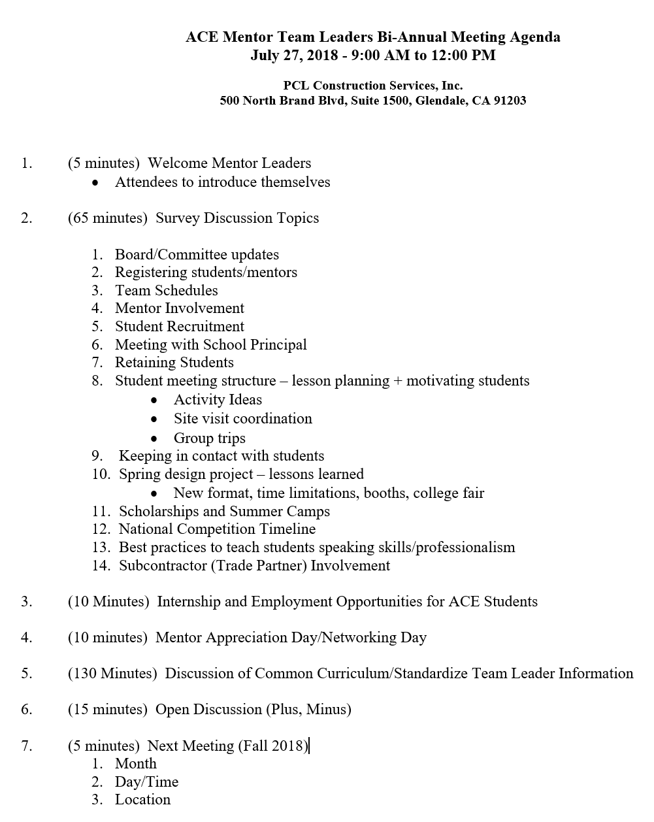
Team Leader Training
Step #5 - Support
Bi-Annual team leader meetings
Monthly team leader check-in calls
Team leader/mentor appreciation events
A strong team leader is only strong when equipped with a team
Identify the co-team leader
Succession planning
Have a great Executive Director like Anne Ettley!

Slide 29
MENTORS
RFP Options: CIRT & Local Project
Michelle Ashline
ACE Mentor Program of Central Iowa

Slide 30
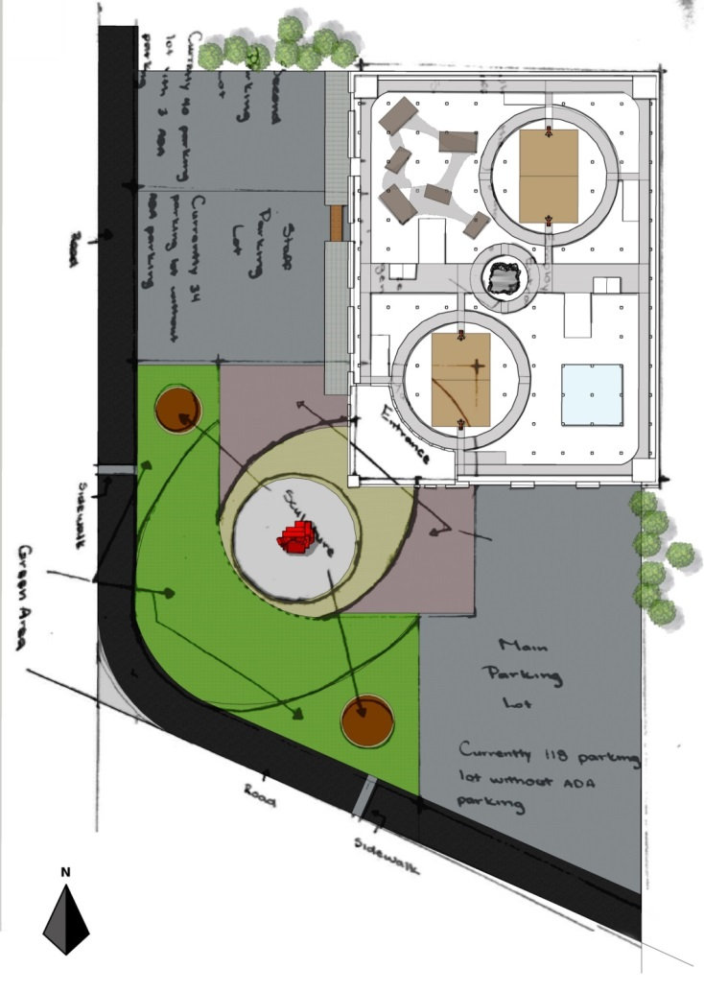
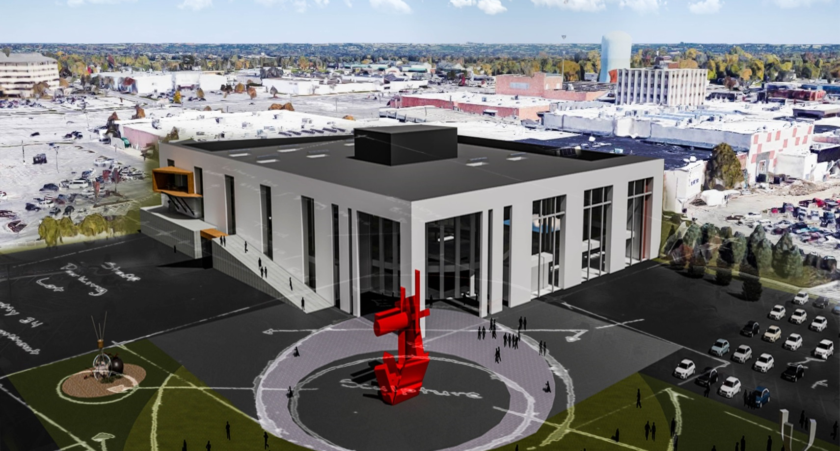
2019 CIRT Competition
Unboxed
RFP Options: CIRT & Local Project: Michelle Ashline, ACE Mentor Program of Central Iowa

Slide 31
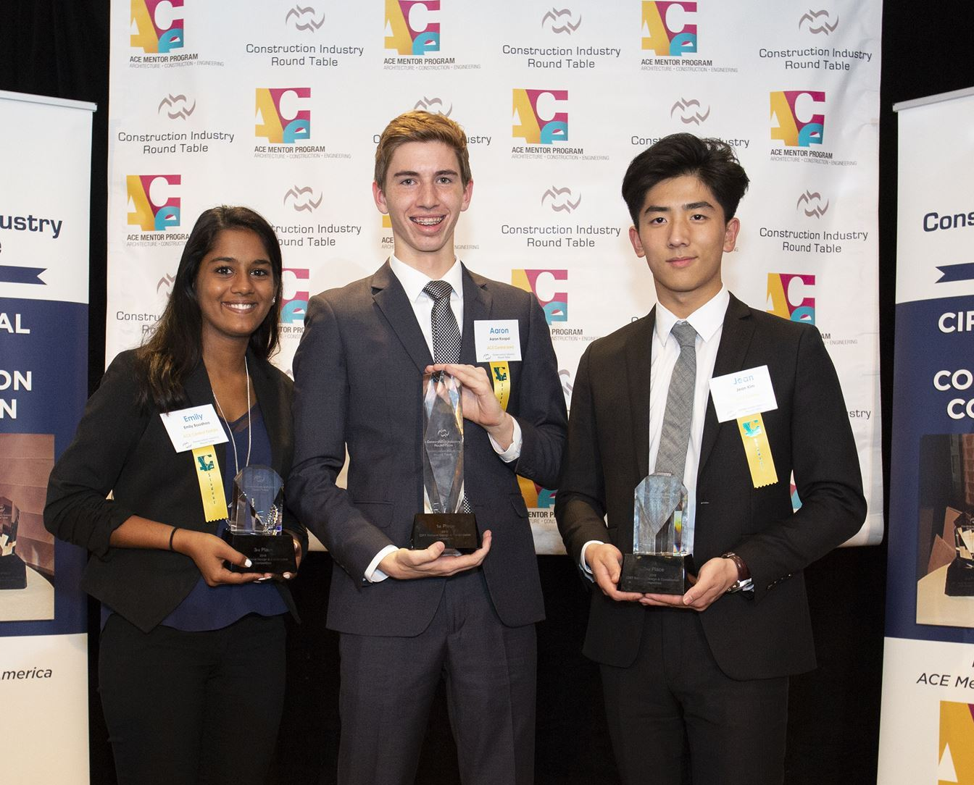
History of Success
We’ve participated the last 7 years
2013 – First place nationally
2014
2015 – Runner up in our design category
2016 – Second place nationally
2017
2018 – First place nationally
2019 – One of 3 finalists in DC

Slide 32
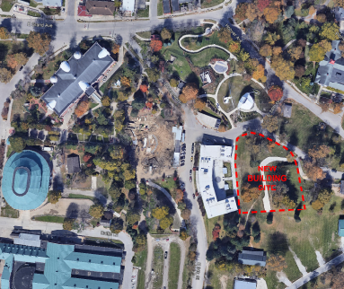
2019 Local RFP

Slide 33
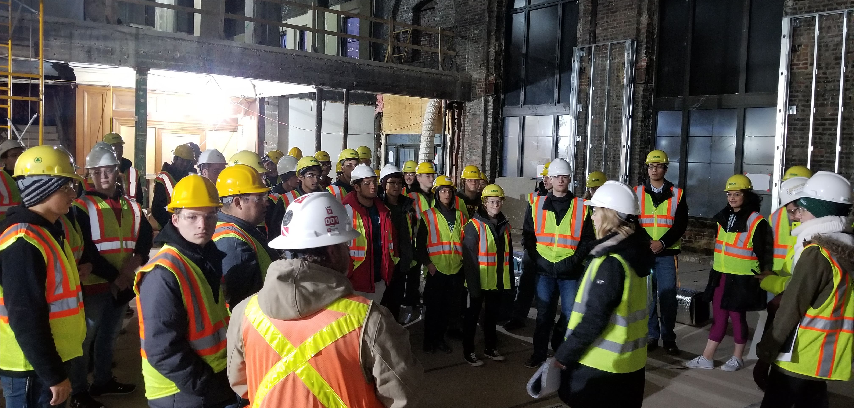
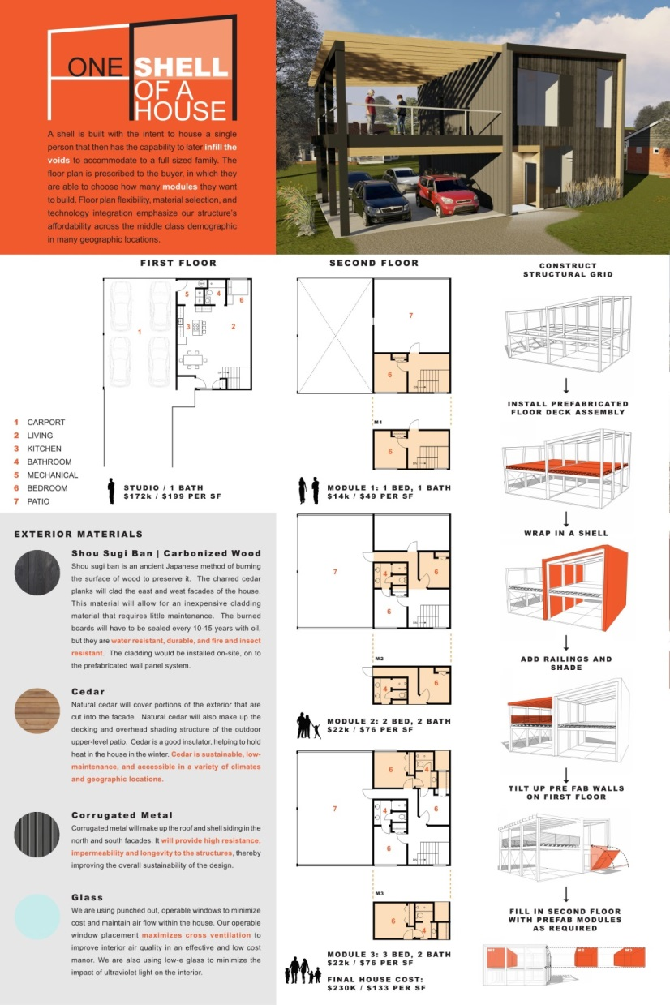
The Why

