Slide 1
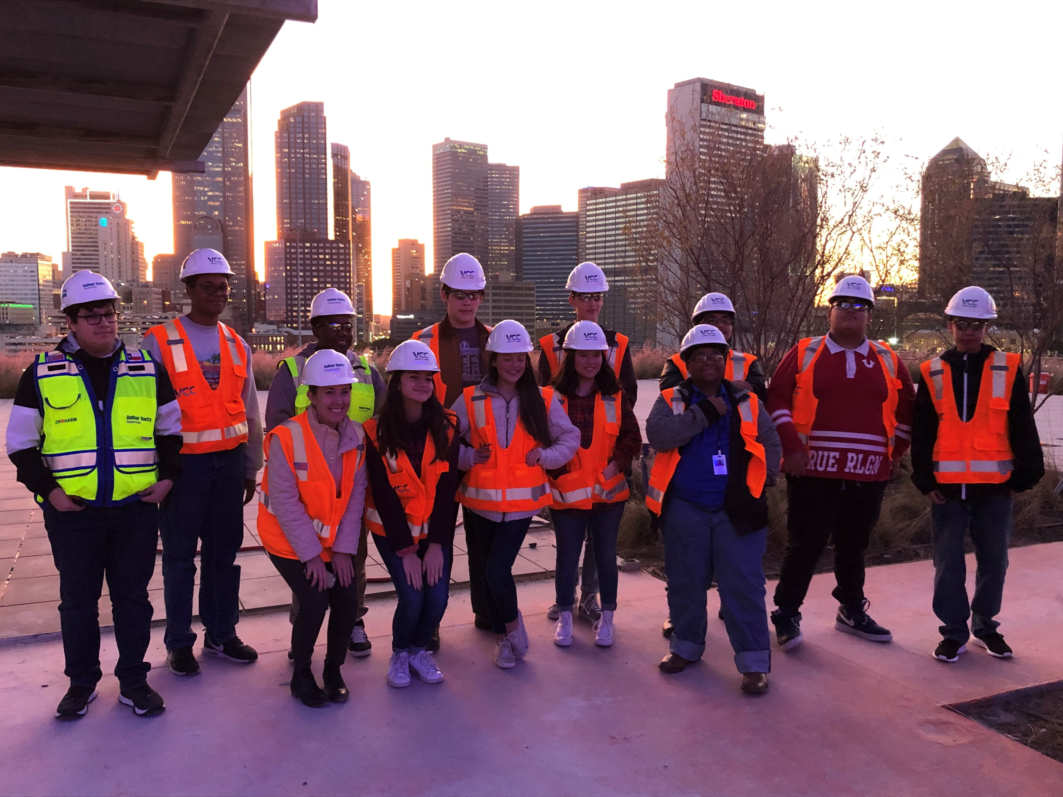
SUCCESSION PLANNING
DALLAS/FT. WORTH
Creating a smooth transition

Slide 2
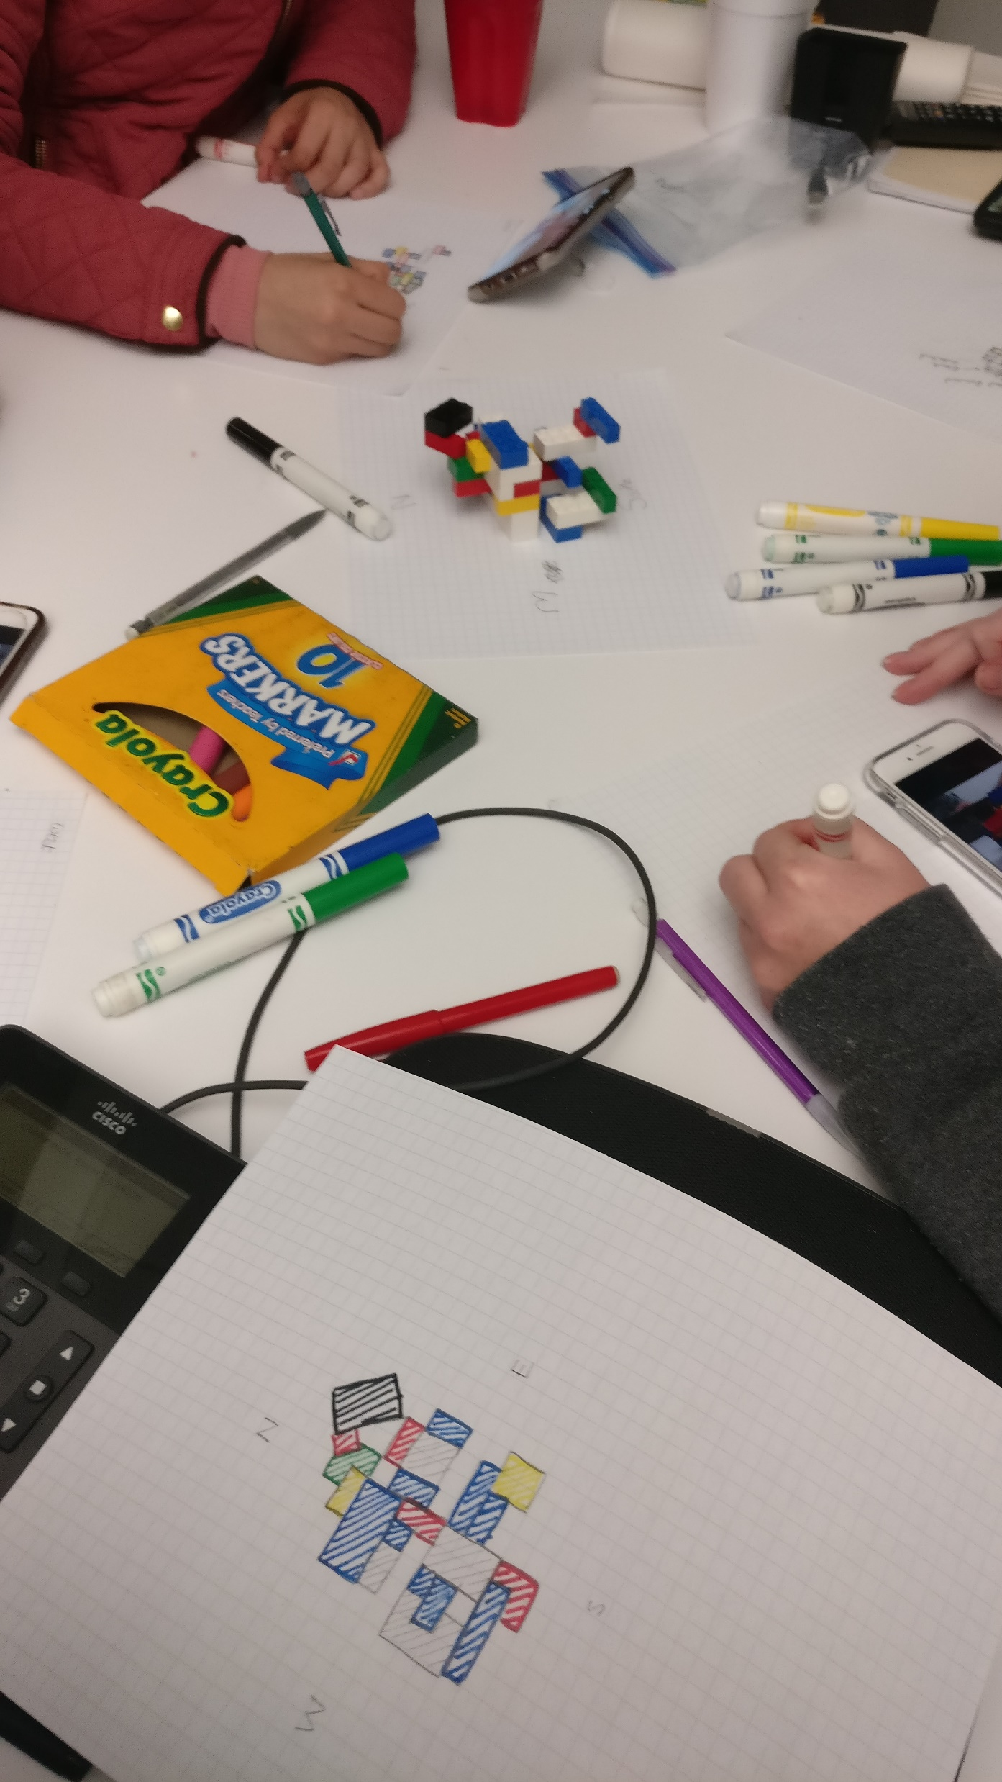
SUCCESSION PLANNING
ACE DFW History
2004-2005 – First Class of Students
2008 – Cadre Formed
2012 – ACE DFW Associate Board Organized

Slide 3
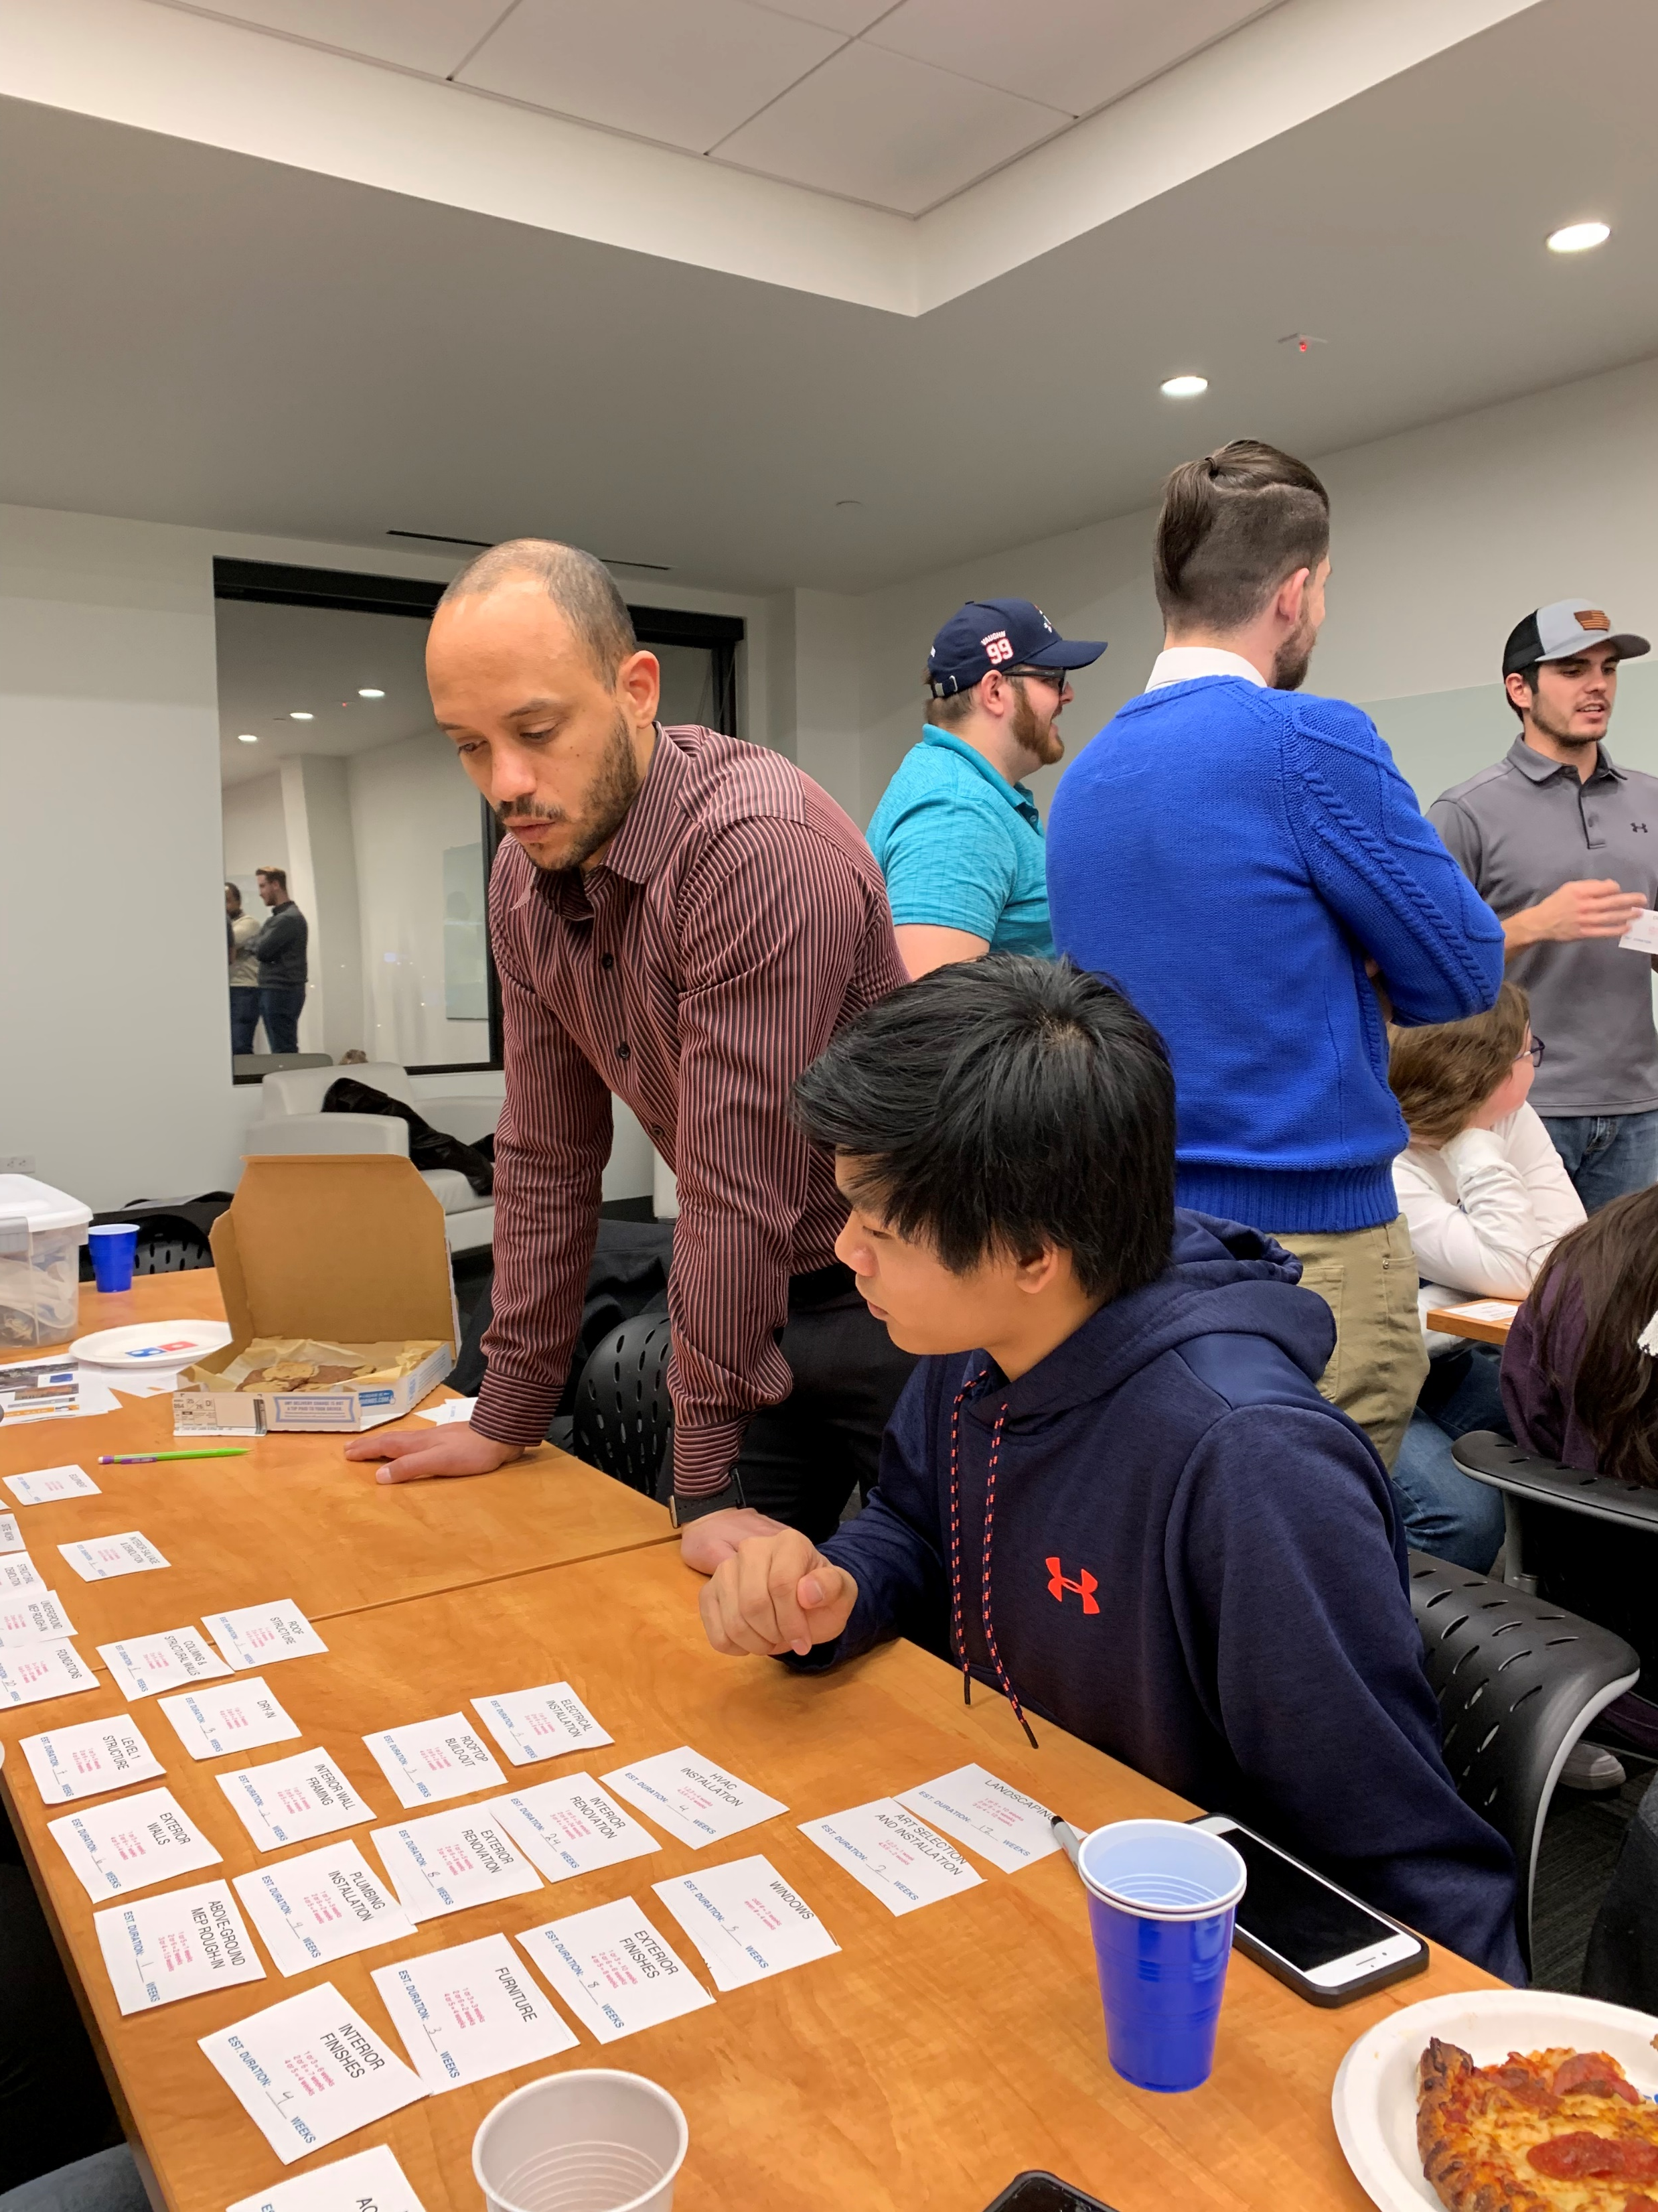
SUCCESSION PLANNING
Early Organization
2004 - 2008
Board of Directors
Mentor Coordinator
Mentors at large
Location(s):
Dallas only
2004: One magnet school
2005-2008: Expansion to multiple schools
Meets in ACE company offices

Slide 4
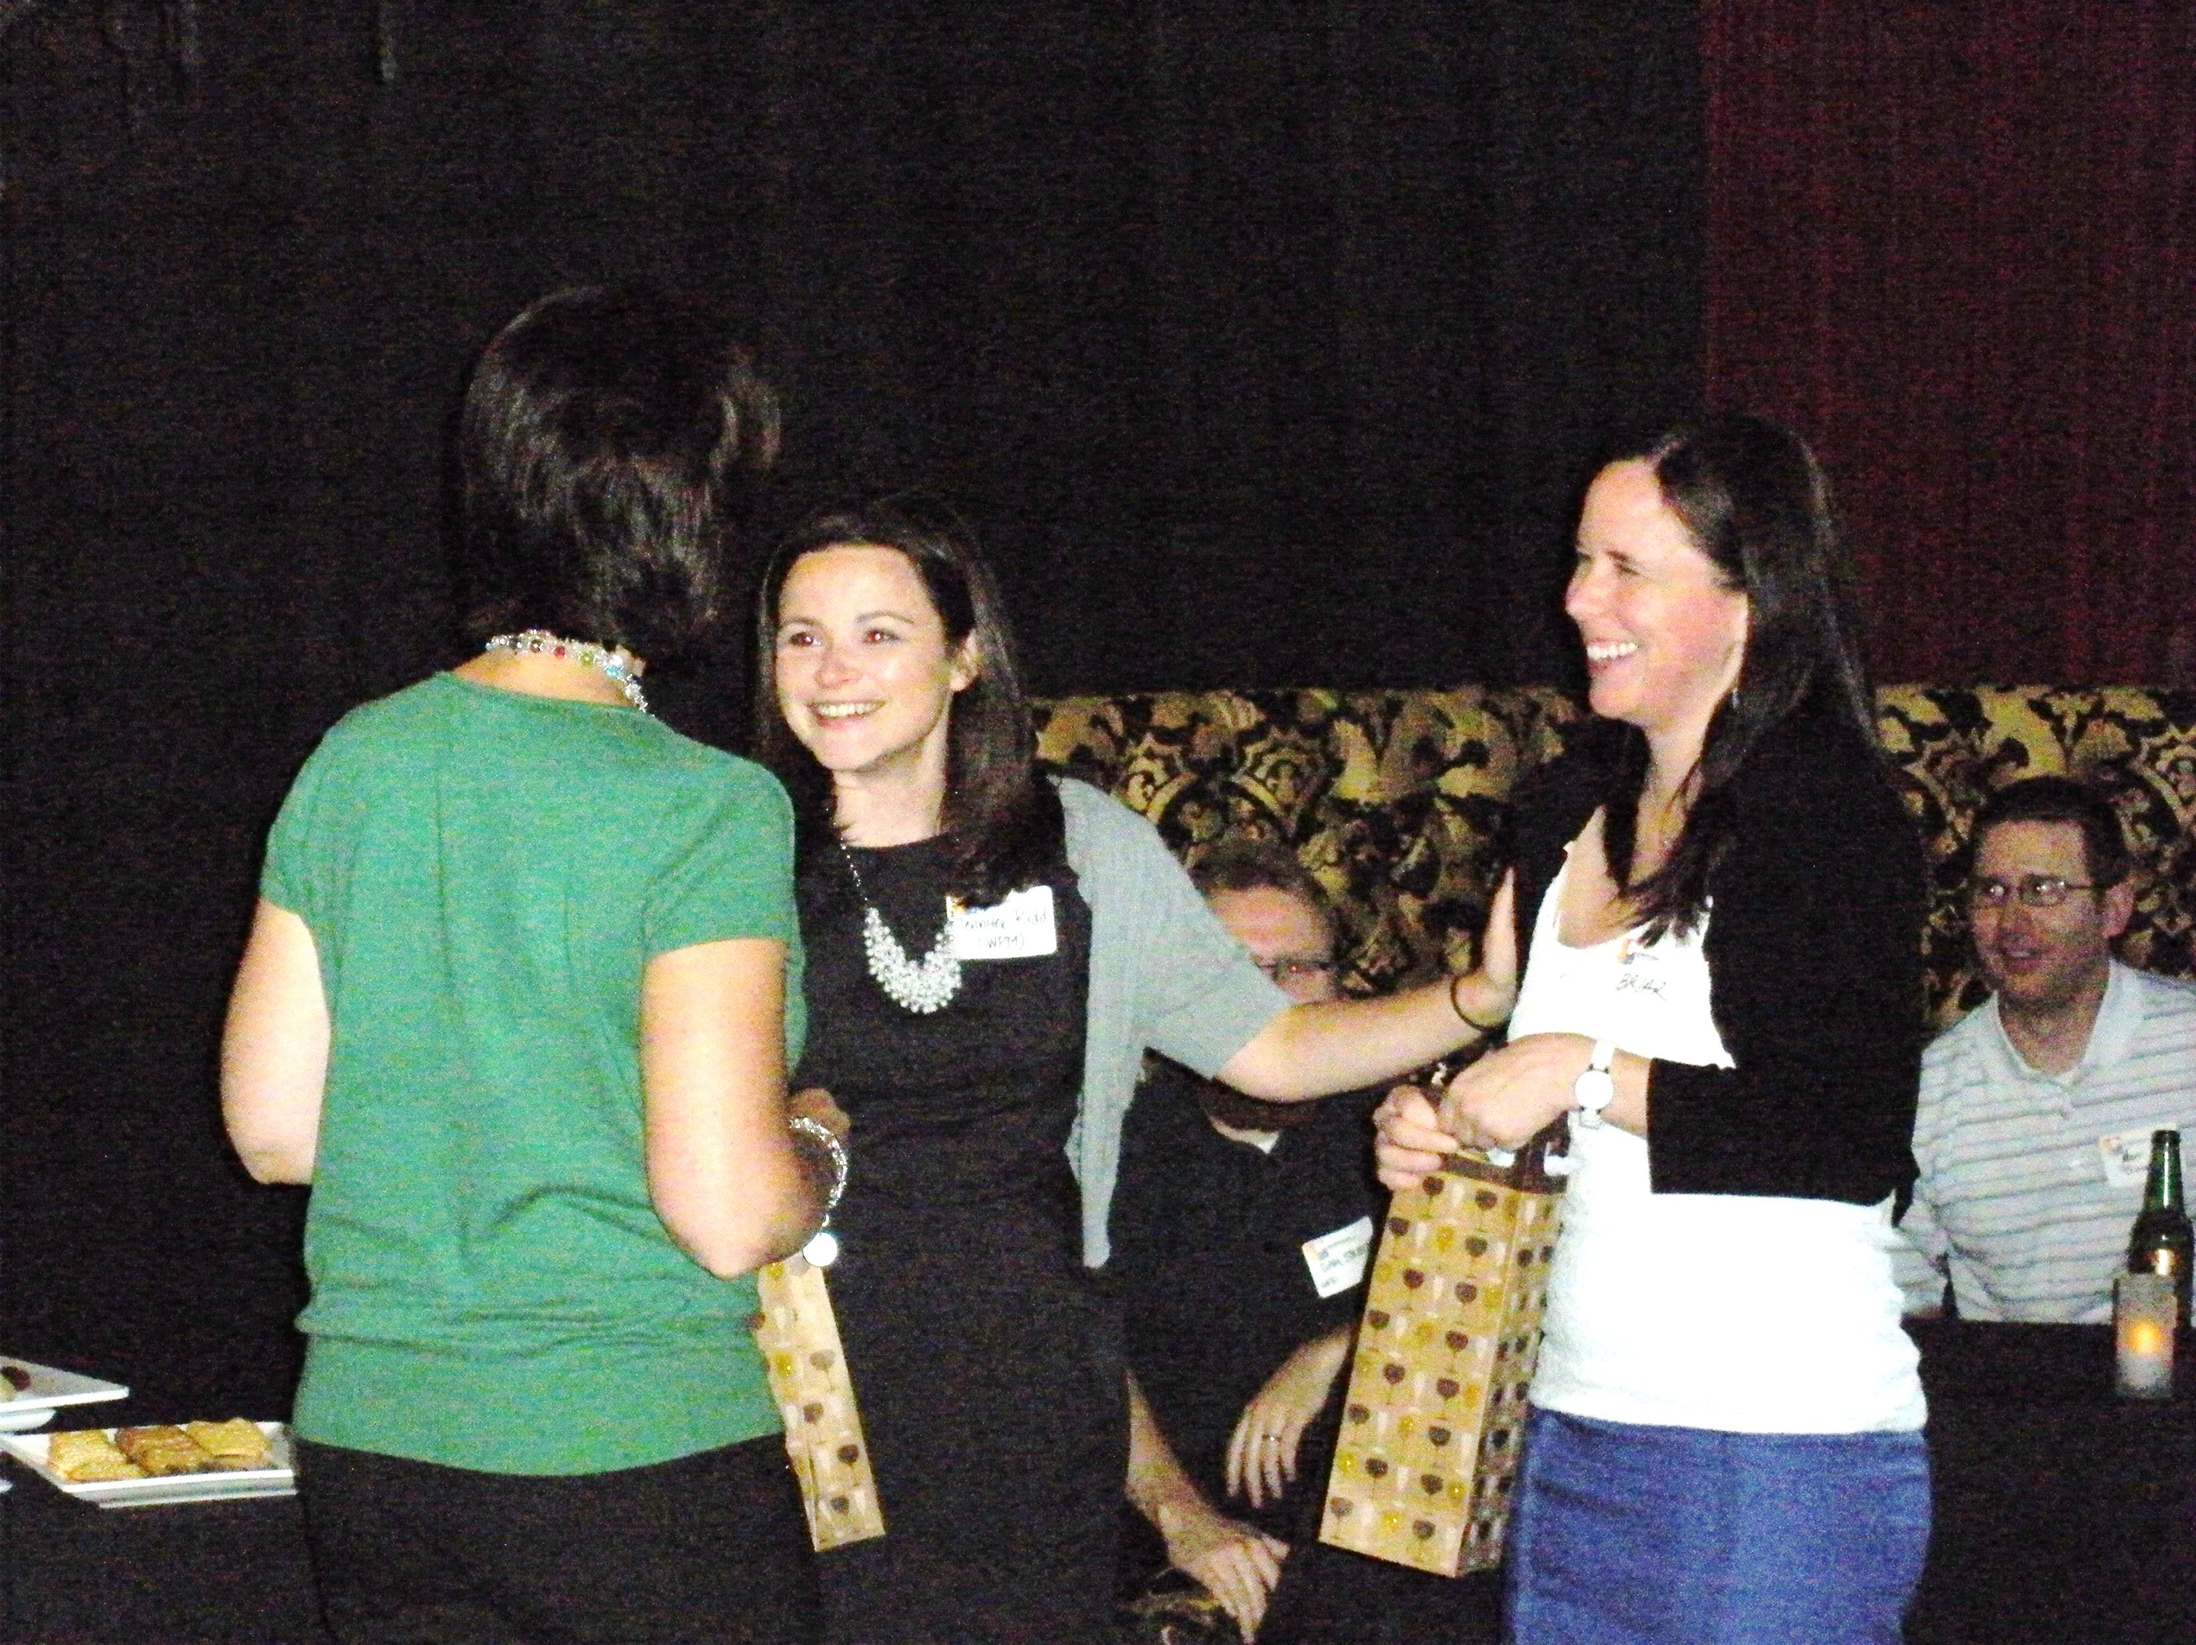
SUCCESSION PLANNING
Cadre
2008
Operational gap between Executive Board and Mentors is recognized
6-8 committed mentors meet over the summer to plan the next year.
All ACE sectors are represented
Members become team leaders for the next school year.

Slide 5
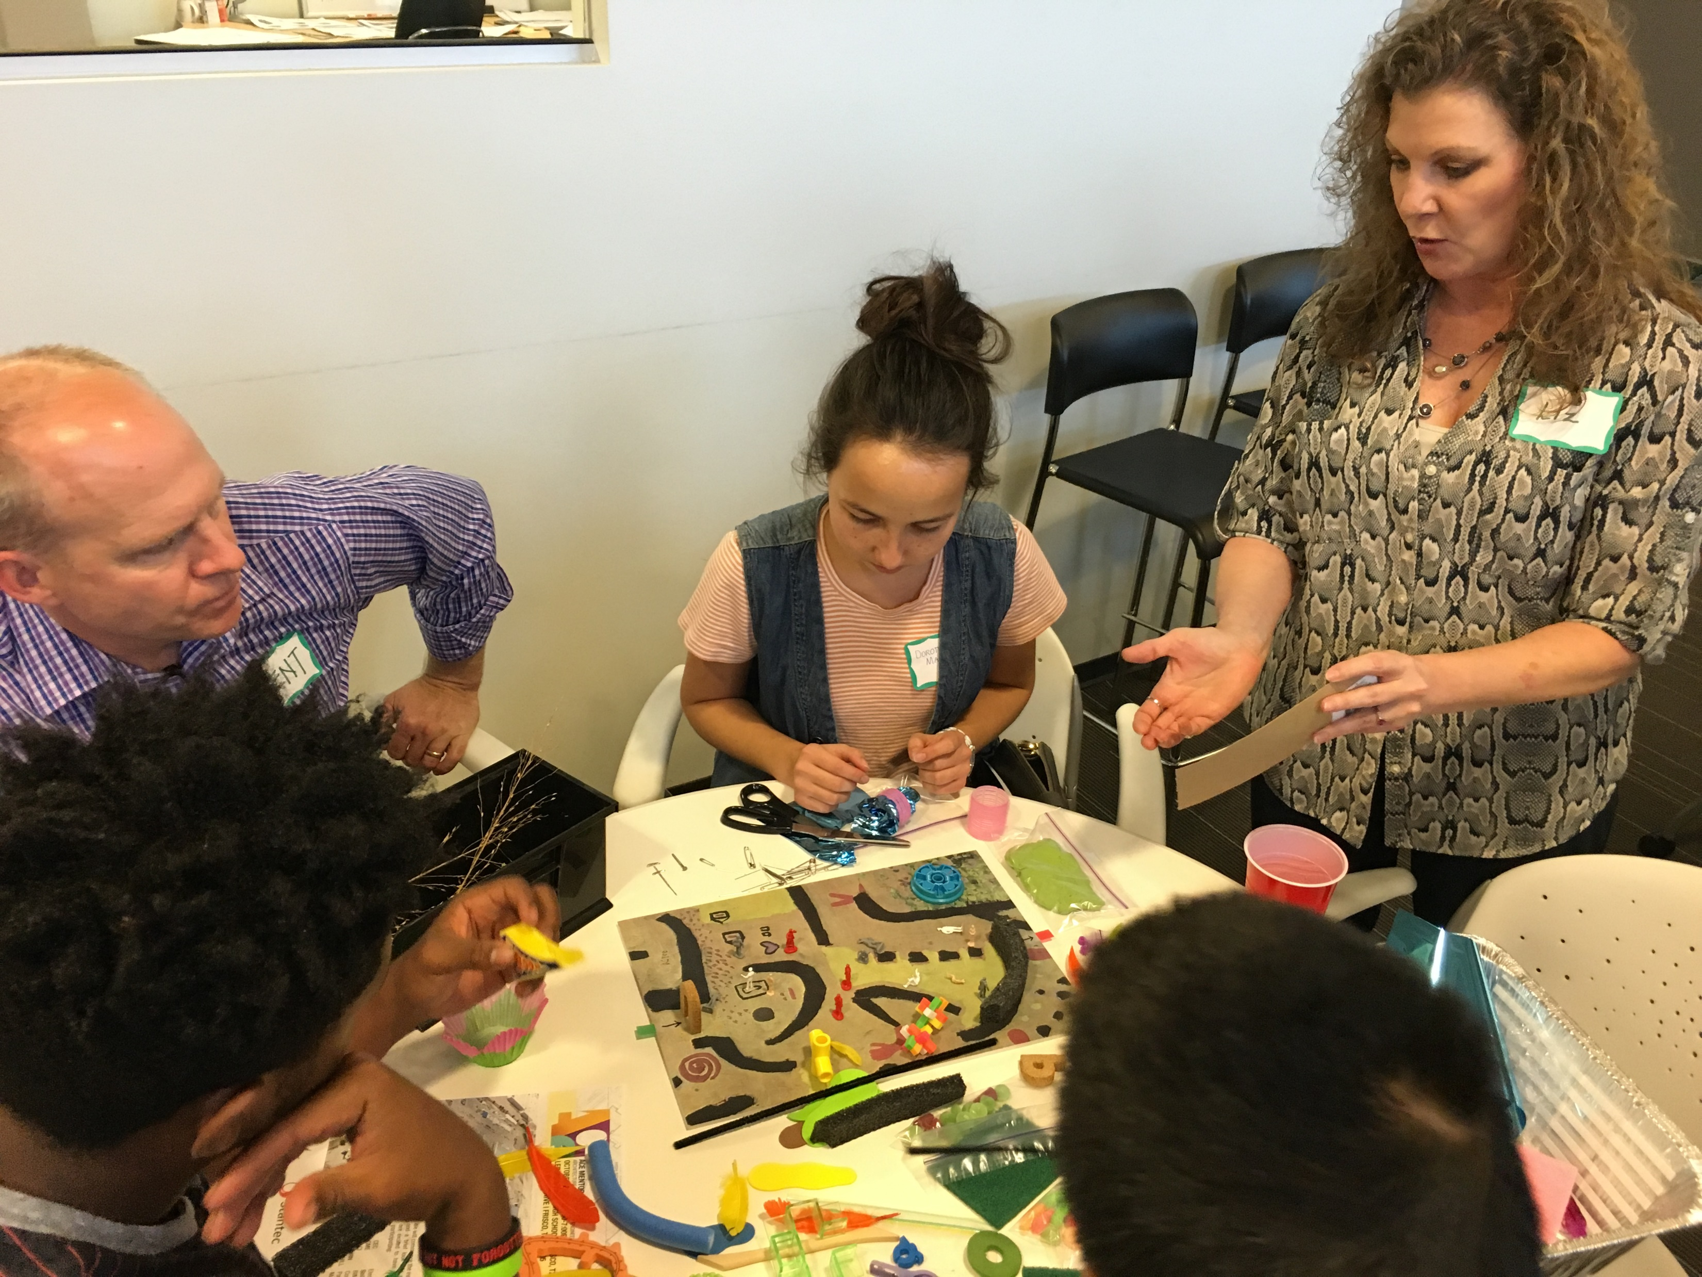
SUCCESSION PLANNING
Cadre
2011- 2012
Cadre members advance their careers and family obligations increase
Original Cadre members cannot make weekly commitment to ACE
Original mentor coordinators begin to burn out
Cadre recognizes that succession plan is needed.

Slide 6
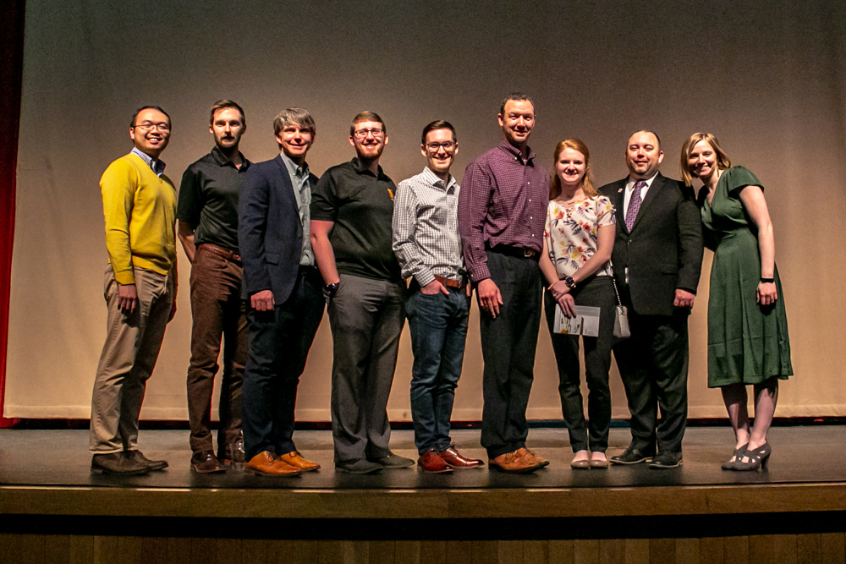
SUCCESSION PLANNING
Associate Board
2012 - THE ASSOCIATE BOARD IS BORN!
Allows former mentors committed to ACE to maintain participation
Retains knowledge among experienced mentors
Fills gap between Executive Board and Mentors
Relieves Mentor Coordinator of non-student-related responsibilities

Slide 7
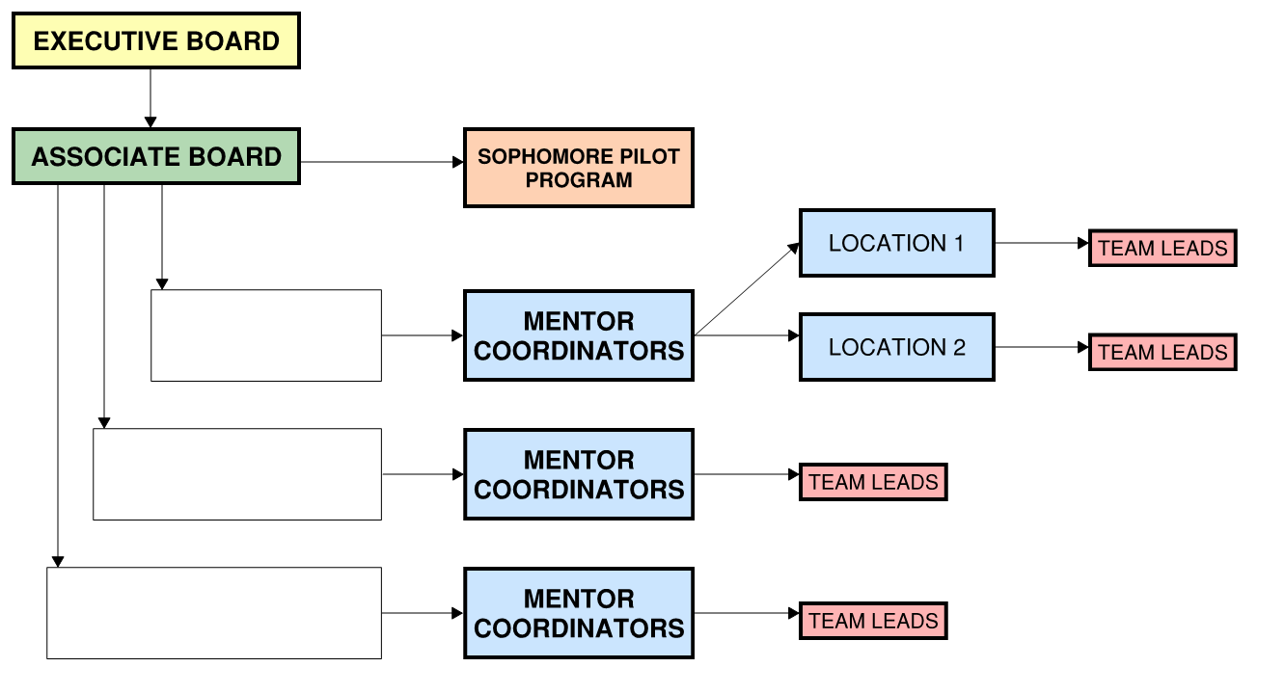
SUCCESSION PLANNING
DFW Affiliate Structure

Slide 8
SUCCESSION PLANNING
Executive Board
Governance
Fundraising
Program expansion
Strategic planning
Membership Qualifications
25 companies from across the DFW Metroplex
Each member pays annual dues
Member recruitment by current members and the
Associate Board
No current term limits for membership

Slide 9
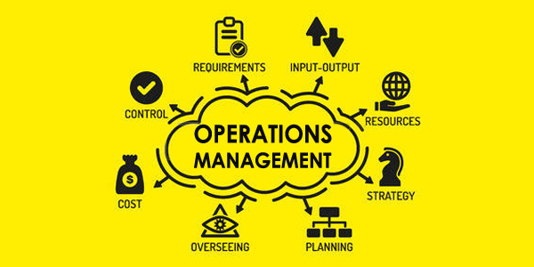
SUCCESSION PLANNING
Associate Board
Coordinate and oversee operations
Assess and support all program needs
Incubator for future Executive Board members
Membership Qualifications
2 years as an active mentor
Nomination from current Associate Board member or Mentor Coordinator
No dues or term limits for membership

Slide 10
SUCCESSION PLANNING
Mentor Coordinators
Organize and oversee weekly student sessions
Plan student final project program
Coordinate mentor/student groups
Incubator for future Associate Board members
Membership Qualifications
Highly motivated mentor
Recruited by previous Mentor Coordinator
Approved by Associate Board
2-year minimum commitment

Slide 11
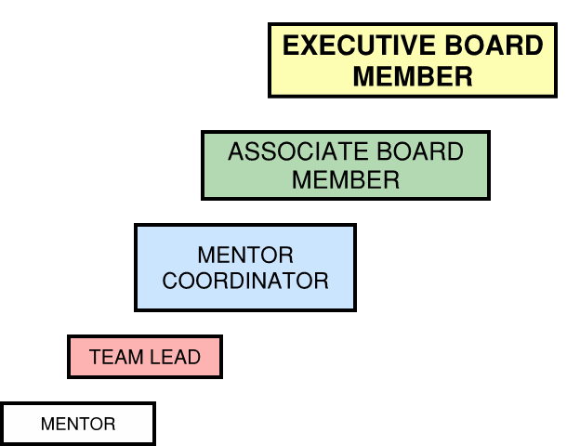
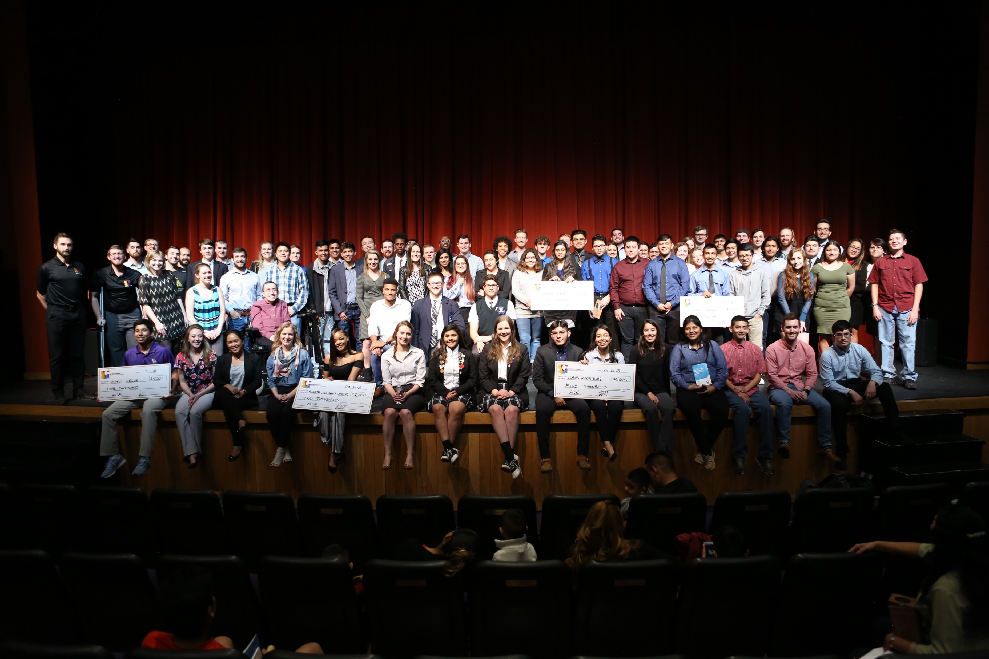
SUCCESSION PLANNING
Our Goal:
To grow the next generation of ACE DFW leaders!

Slide 12
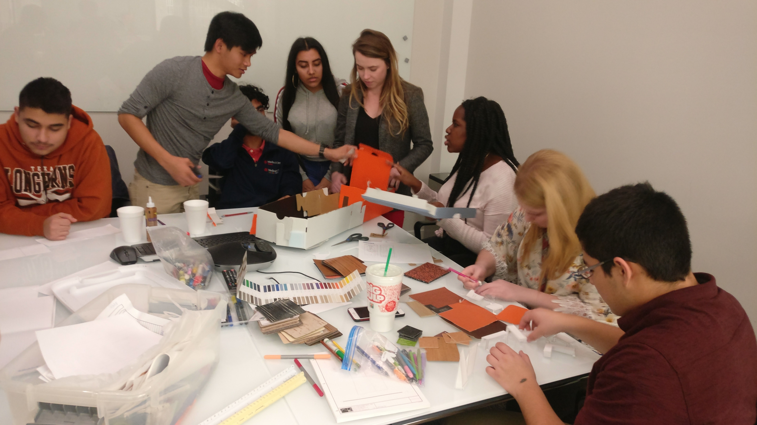
SUCCESSION PLANNING
Q&A

