Slide 1
Sustainability in the Built Environment
Methods of designing and operating
the built environment sustainably

Slide 2
Living Sustainability
What are ways that you save energy and water in your everyday lives?

Slide 3
Living Sustainability
What are ways that you save energy and water in your everyday lives?
Examples:
Turning off the water while you brush your teeth
Turning off the lights when you leave a room
Walking, biking, carpooling, or taking public transportation (bus,
metro, etc.)

Slide 4
Terminology
Sustainability
Net Zero Energy/Carbon Resilience
Eco-friendly
LEED

Slide 5
Terminology
Sustainability = Using resources at a rate/quantity that does not deplete those resources for future generations or the surrounding ecology
Net Zero Energy/Carbon = Balancing the amount of energy you consume (or carbon you emit) with the amount of energy you produce (or carbon you sequester)
Resilience = The ability to recover quickly and smoothly from failure or disaster
Eco-friendly = Not harmful to the environment
LEED = Leadership in Energy and Environmental Design

Slide 6
Sustainable Buildings - Passive Design
Architecture
Orientation
Window-to-Wall Ratio
Natural Ventilation
Building Envelope
Bioretention/Landscaping

Slide 7
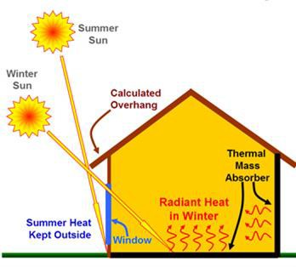
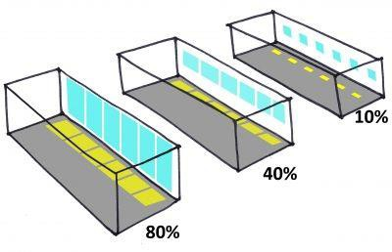
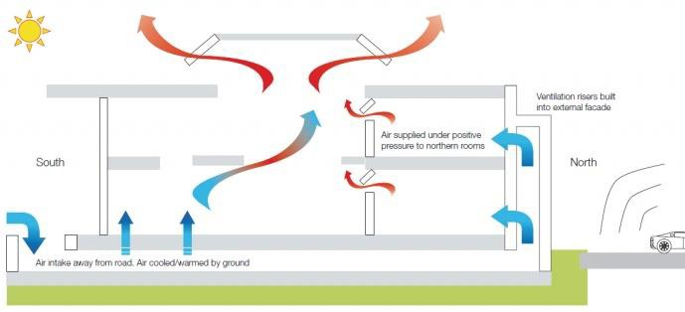
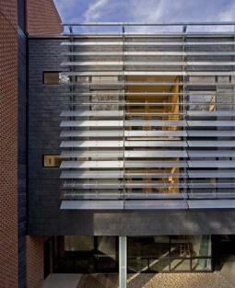
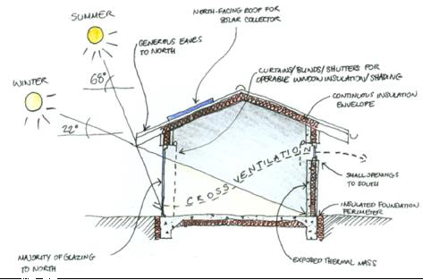
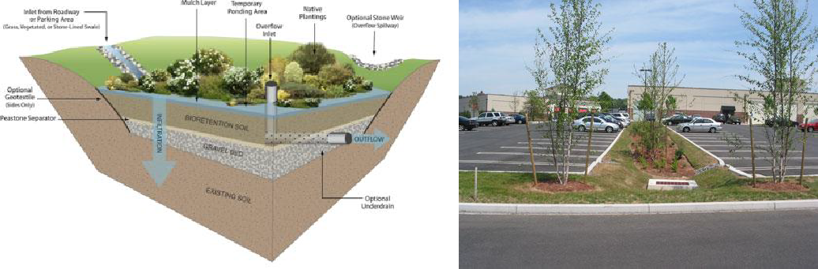
Sustainable Buildings - Passive Design
Orientation
Window-to-Wall Ratio
Natural Ventilation
Building Enclosure
Bioretention/Landscaping

Slide 8
Sustainable Buildings - Active Design
Engineering
System Controls / Building Automation System (BAS)
Light-Emitting Diode (LED) Lighting, Daylighting, Motion/Occupancy Sensors
Low-Flow Water Fixtures
High-Efficiency, Demand-Controlled Heating, Ventilation, and Air Conditioning (HVAC)
Renewable Energy + Battery Storage
Carbon Capture & Sequestration

Slide 9
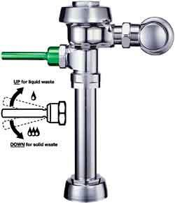
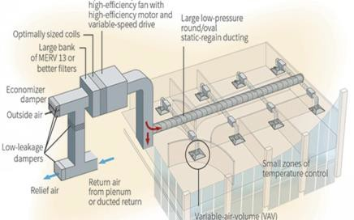
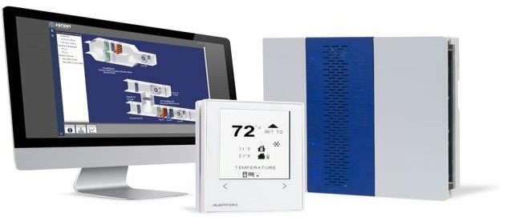
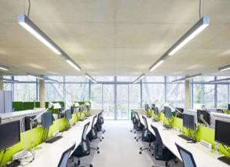
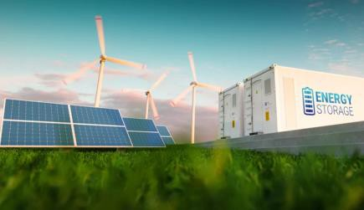
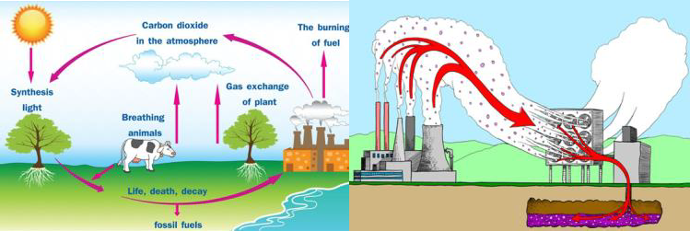
Sustainable Buildings - Active Design
LED Lighting/ Daylighting/ Motion Sensors
High-Efficiency HVAC
System Controls/BAS
Low-Flow Fixtures
Renewable Energy +
Battery Storage
Carbon Capture and Sequestration

Slide 10
Utilities
Electricity
Natural Gas
Water
Propane
Diesel Gas

Slide 11
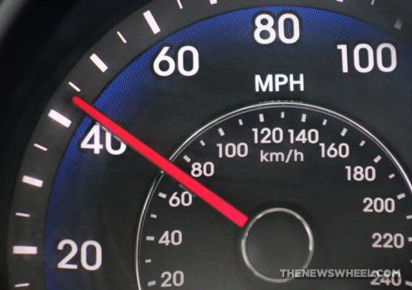
The Basics of Electricity
Watt
Kilowatt (kW)
Kilowatt-hour (kWh)

Slide 12
The Basics of Electricity
Watt = 1 Joule/second
(unit of energy)
Kilowatt (kW) = 1,000 Joules/second
(rate at which electricity consumed)
Example: 60 miles per hour
Kilowatt-hour (kWh) = Rate x Time
(amount of electricity consumed)
Example: 60 mph x 1 hour = 60 miles driven

Slide 13
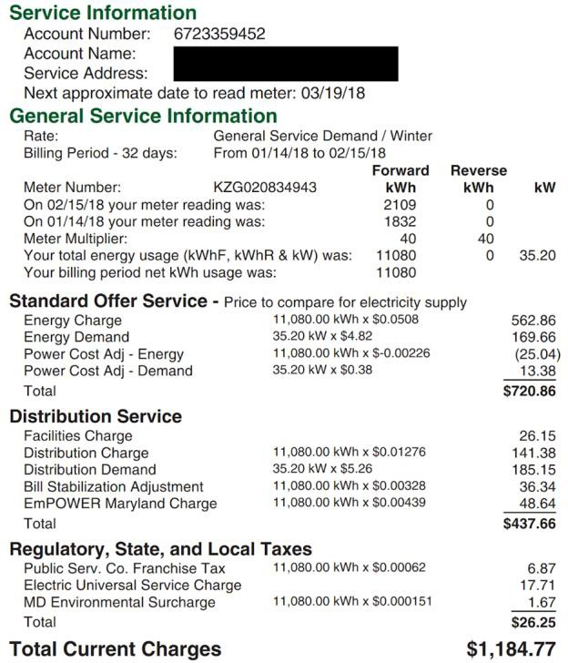
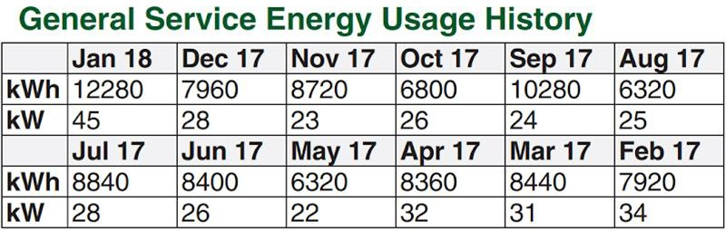
How to Read an Electricity Bill
Rate/Tariff
Historic Consumption & Demand
kWh Consumption
kW Demand

Slide 14
How to Read an Electricity Bill - Rates
kWh rates Energy charge Distribution charge
EmPOWER Maryland Charge Public Serv. Co. Franchise Tax MD Environmental Surcharge
$0.0508/kWh
$0.01276/kWh
$0.00439/kWh
$0.00062/kWh
$0.000151/kWh
$0.068721/kWh
kW rates
Energy demand charge
Distribution demand charge
$4.82/kW
$5.26/kW
$10.08/kW

